Slide 1
Assessing van der Waals packing as a driving force in membrane protein folding
IPiB Seminar
Gilbert Loiseau

Slide 2
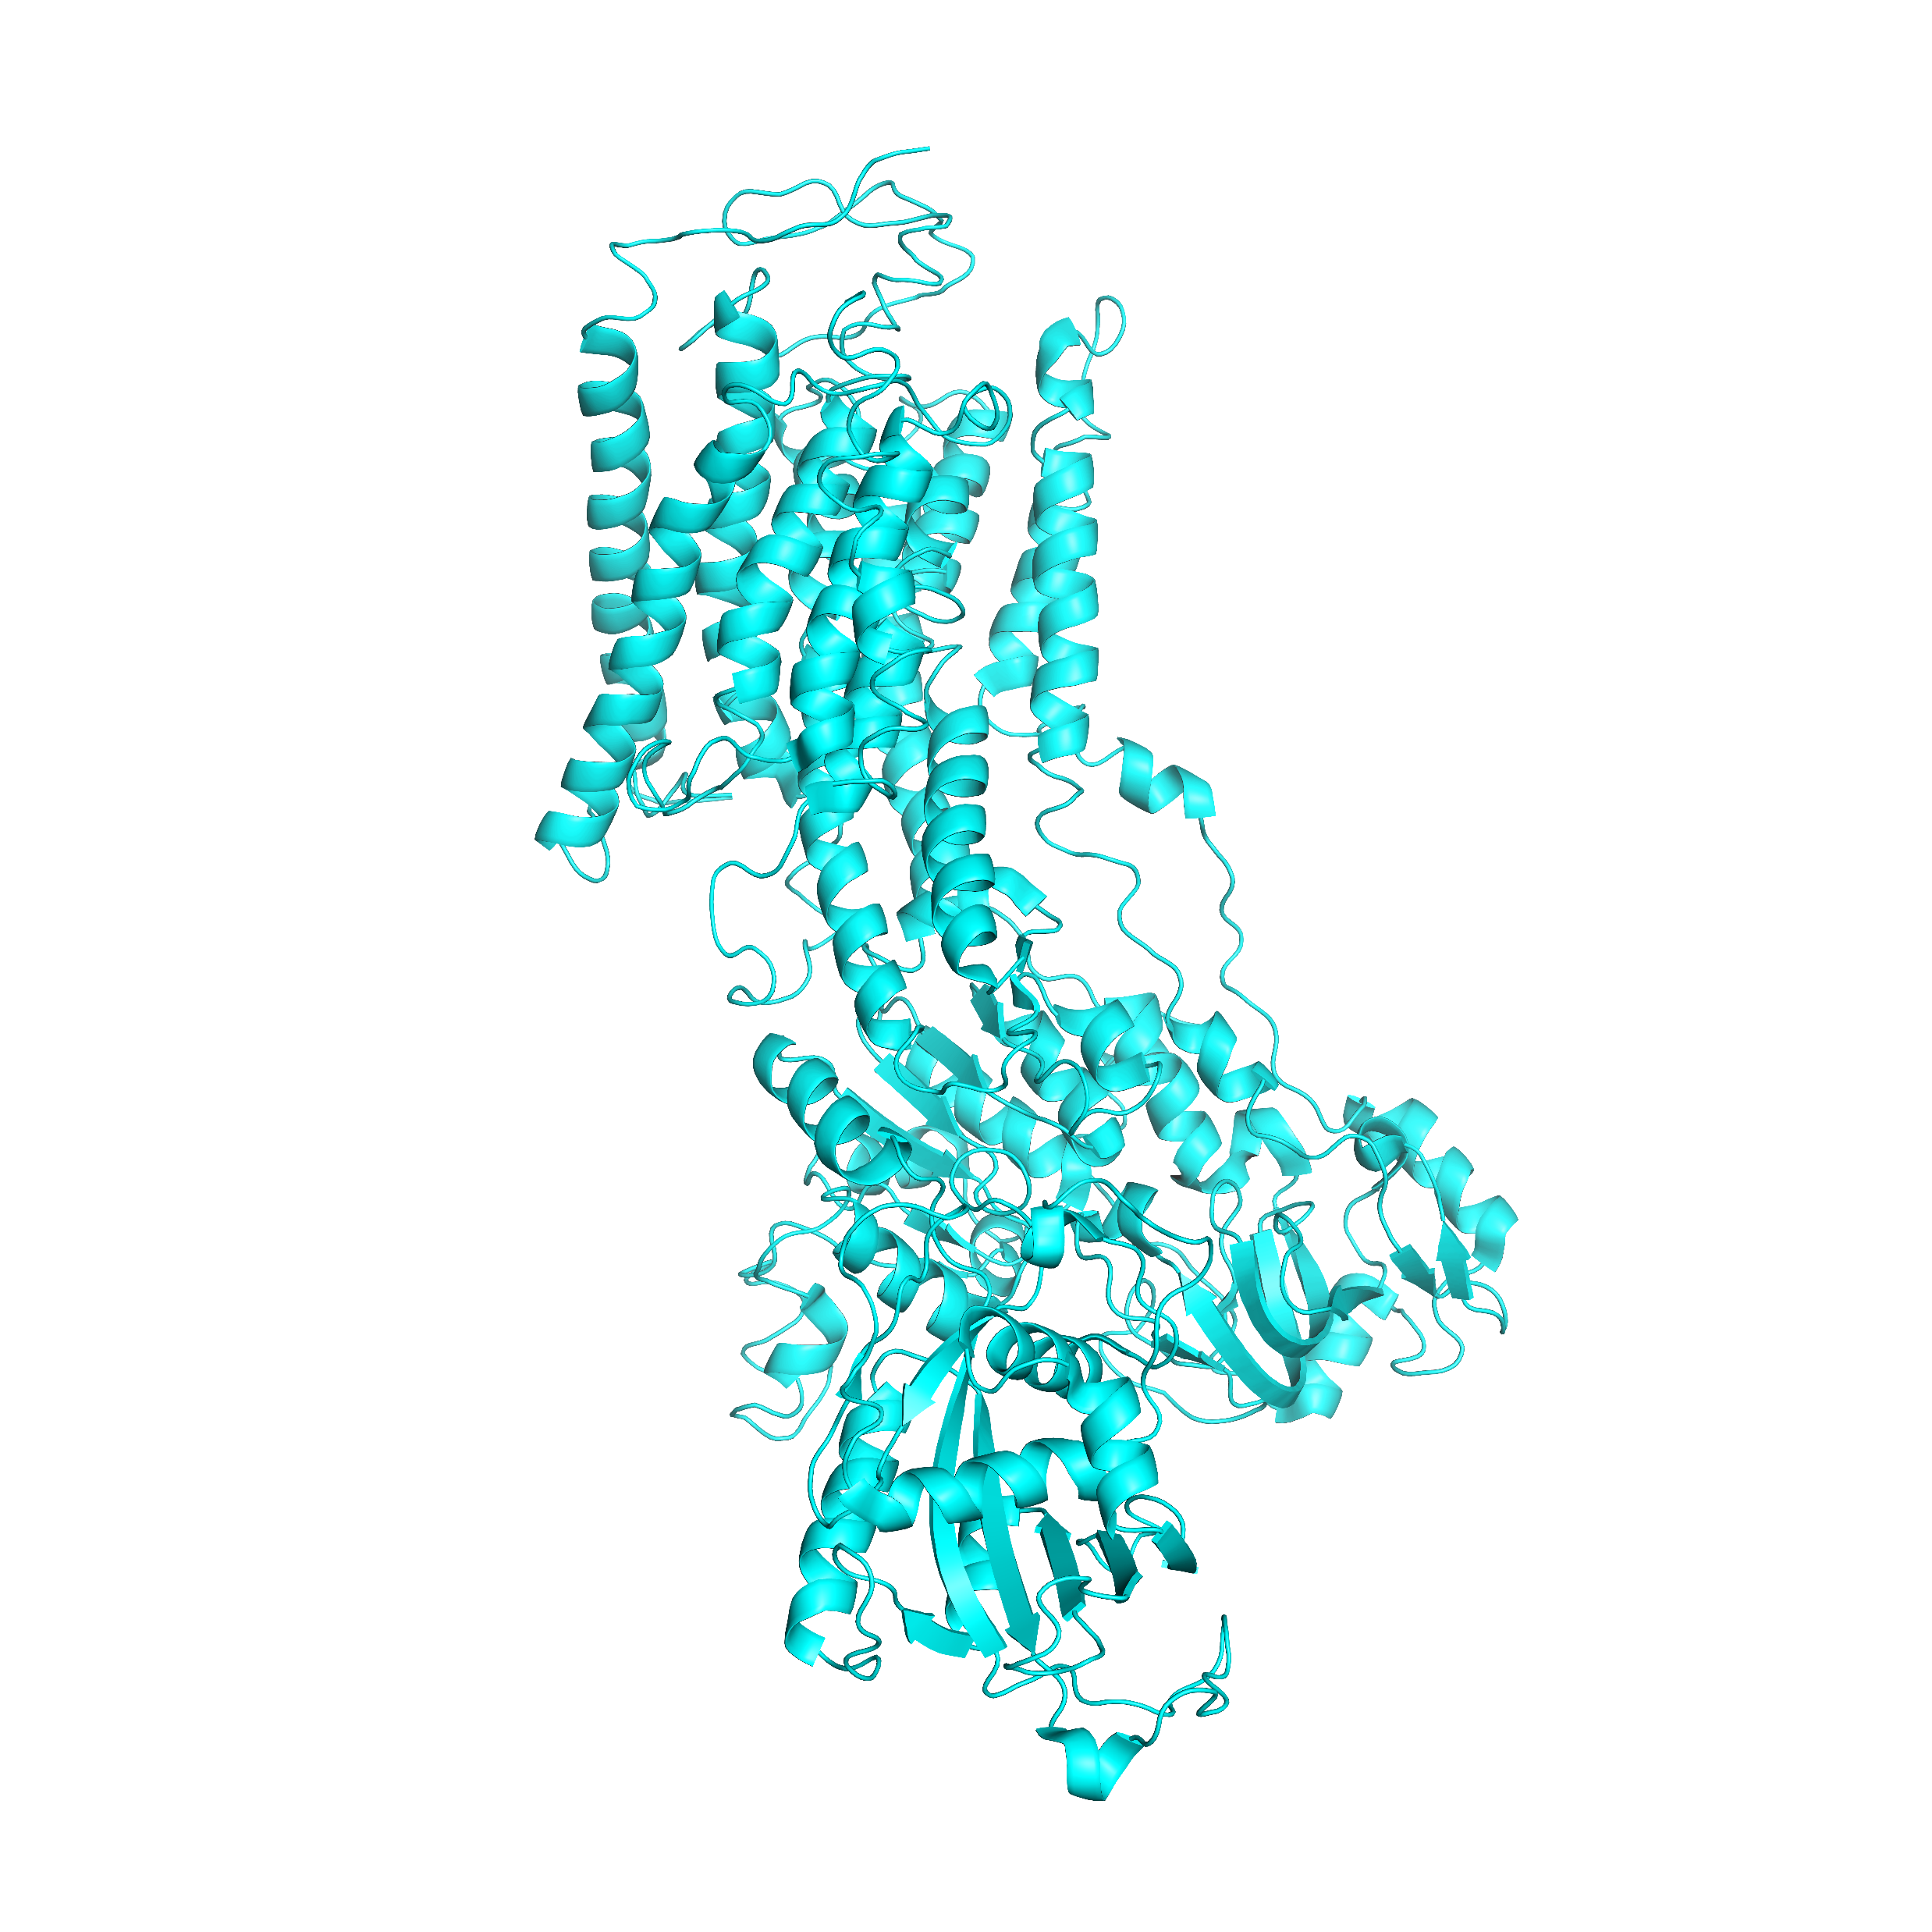
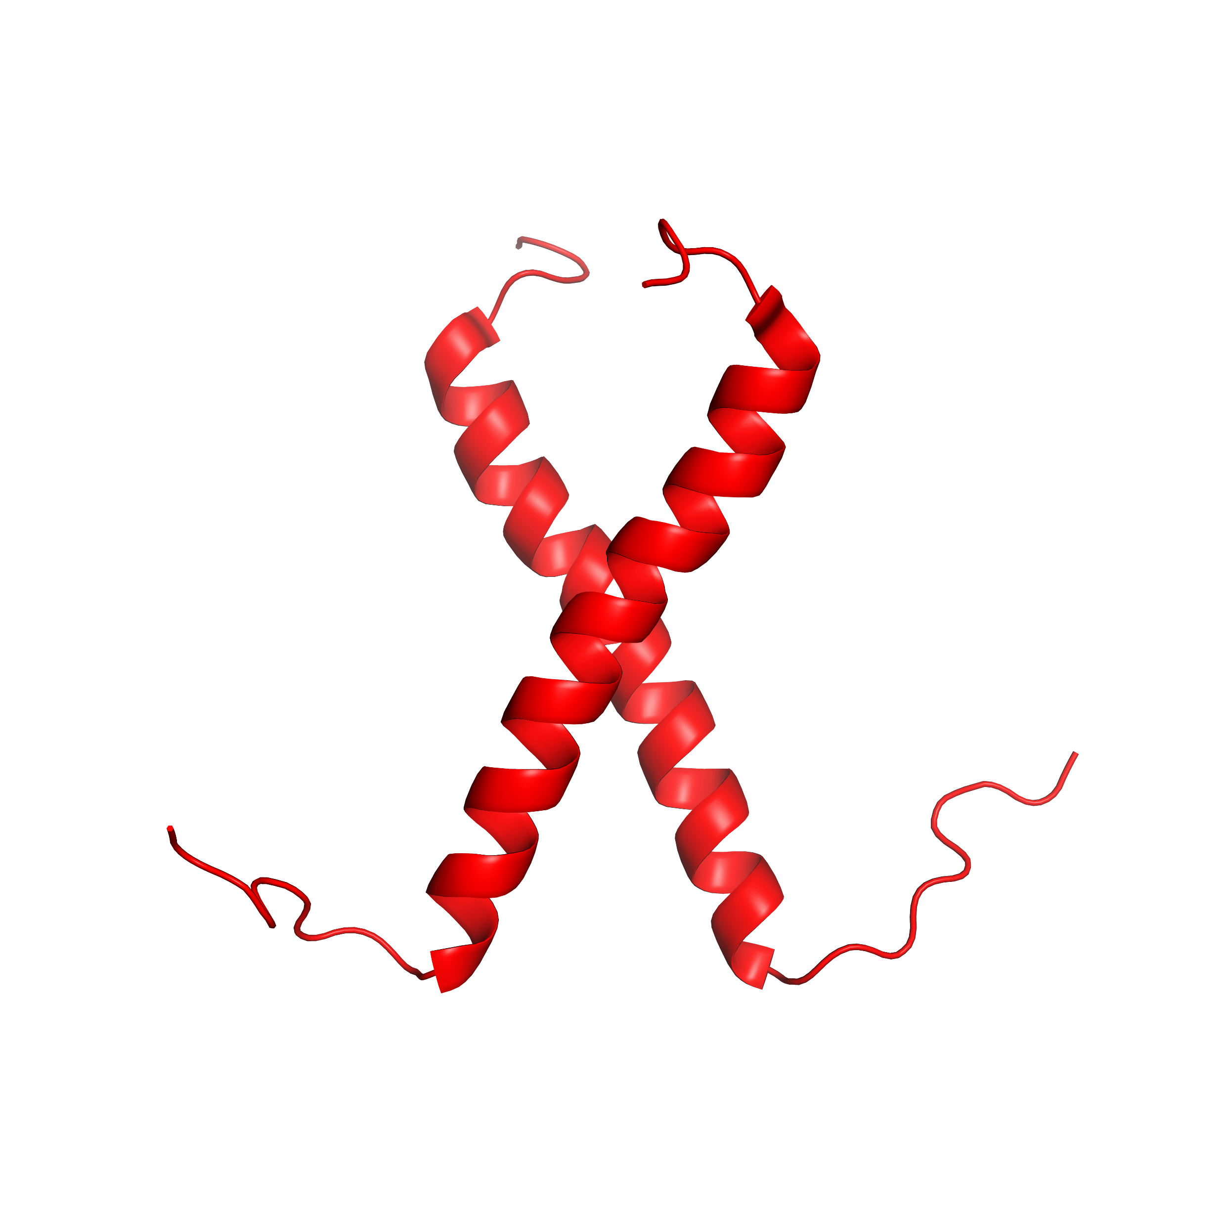
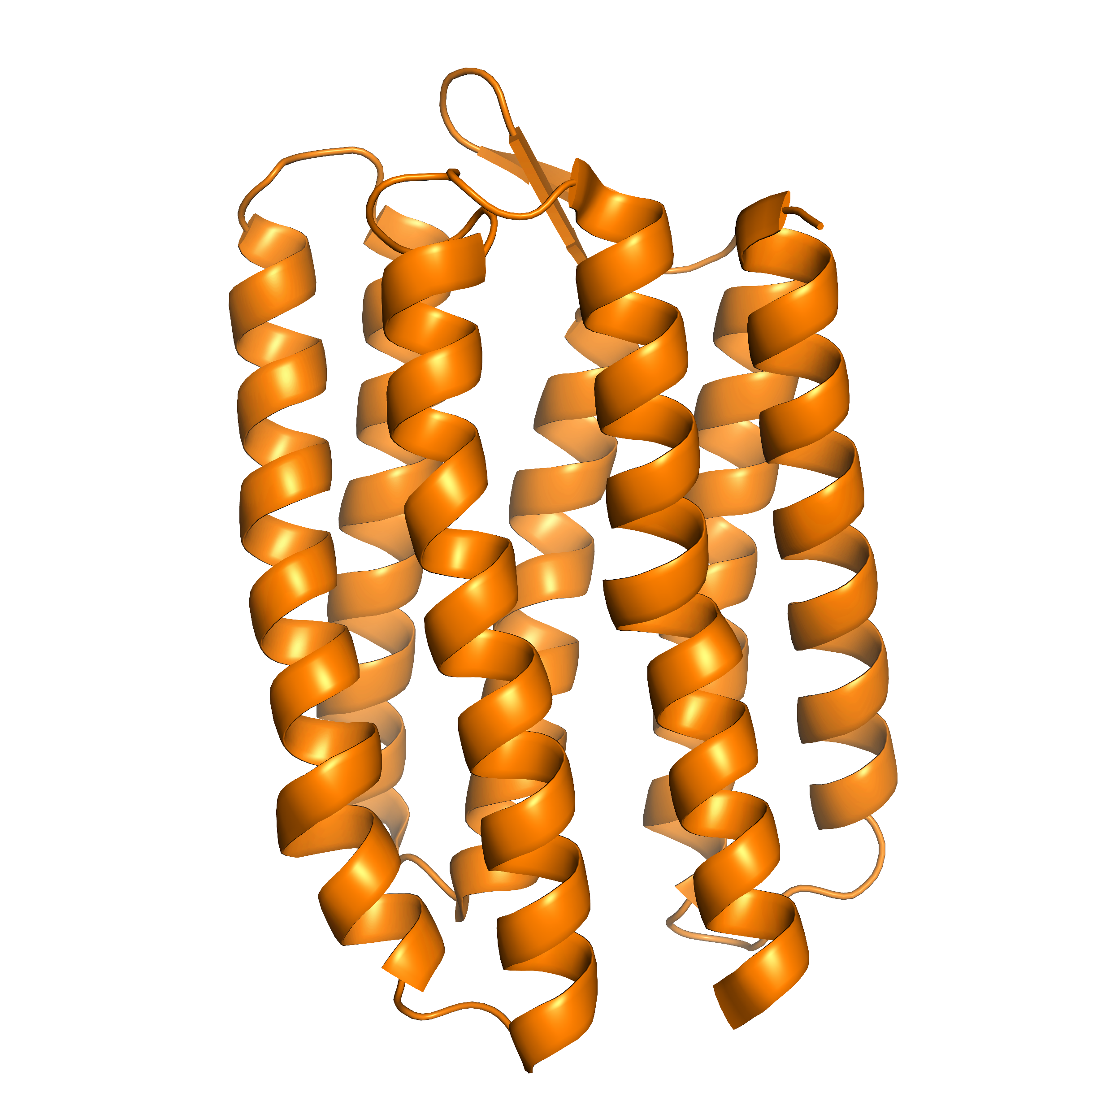
Membrane proteins are essential to everyday life
Rhodopsin
GPCR family
Vision
Na⁺-K⁺ Pump
Enzymes
Membrane potential
Epidermal Growth Factor Receptor
RTK family
Signal transduction
Notes:
Membrane proteins are proteins that are embedded in a lipid bilayer
GPCRs-relay sensory information to the brain
Enzymes-regulate ion balance and are important for membrane potential of a cell
RTKs-regulate expression of genes
To understand these proteins functions, many groups look to understand how these proteins fold and the biophysical forces involved in this process.

Slide 3
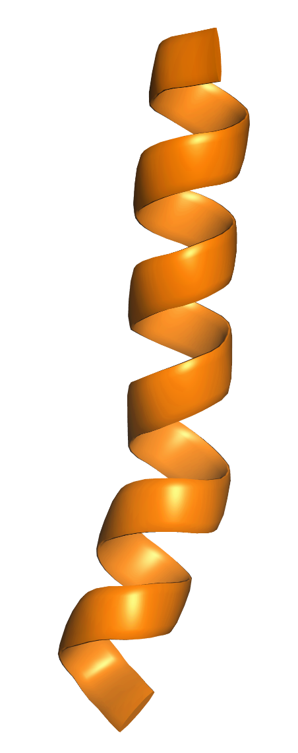
Membrane protein folding occurs in two stages
Translocon
Insertion
Ribosome
Notes:
Membrane protein folding occurs in two stages: Insertion
Ribosome and translocon work to translate and insert domains
The formation of functional membrane protein structures through folding occurs in two stages. Before being able to fold into the functional structure shown on the right, the ribosome and translocon act together to translate and insert individual protein domains (helices) into proper orientations in the membrane.

Slide 4
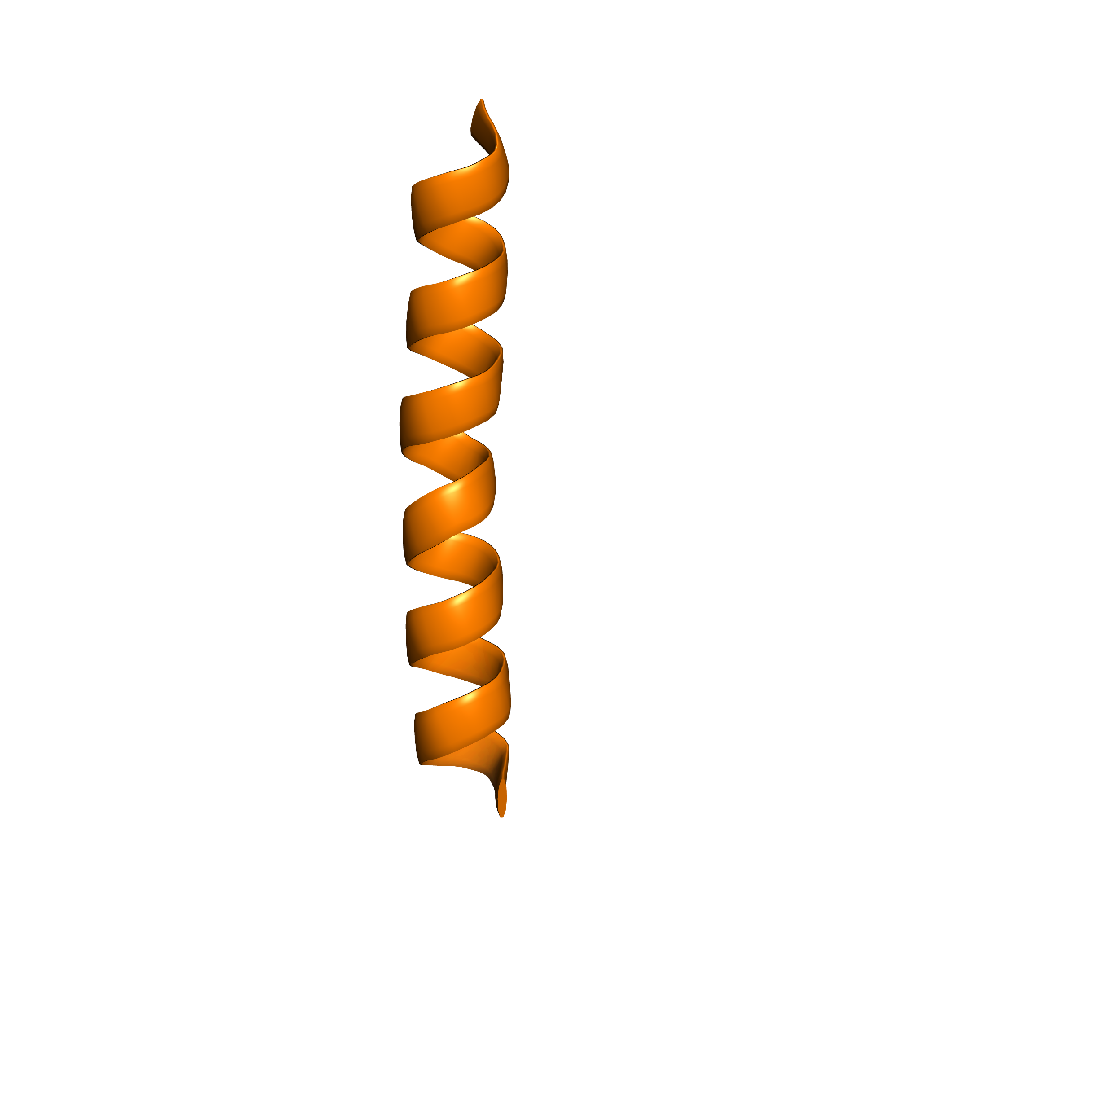
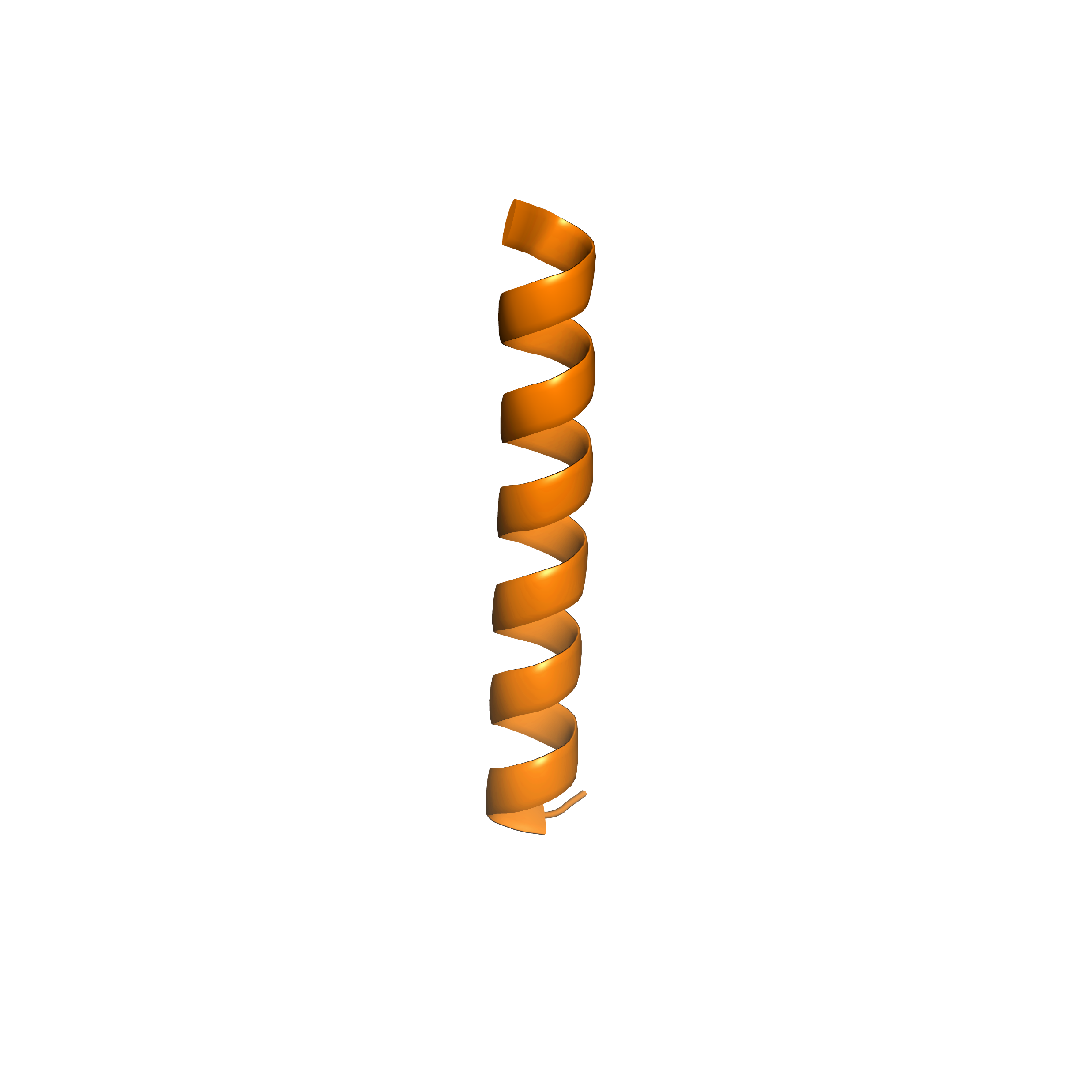
Membrane protein folding occurs in two stages
Translocon
Insertion
Ribosome
Notes:
This insertion stage of folding continues threading all of the domain into the membrane. Simultaneously, the second stage of membrane protein folding begins to occur.

Slide 5
Membrane protein folding occurs in two stages
hydrogen bonding, polar interactions, van der Waals packing
Association
Notes:
The second stage: association; helices interact and stabilize into folded state
This is where my research is focused: We are interested in understanding how a balance of these forces is involved in stabilizing the folded state.

Slide 6
Membrane protein folding occurs in two stages
hydrogen bonding, polar interactions, van der Waals packing
Association
How does packing contribute to membrane protein association?
Notes:
Previous research has focused on investigating the impact of both hydrogen bonding and polar interactions, however, the contribution of vdW packing to the folded state is not well understood.
Understanding van der Waals packing in particular is crucial to fully understand how membrane proteins fold.

Slide 7
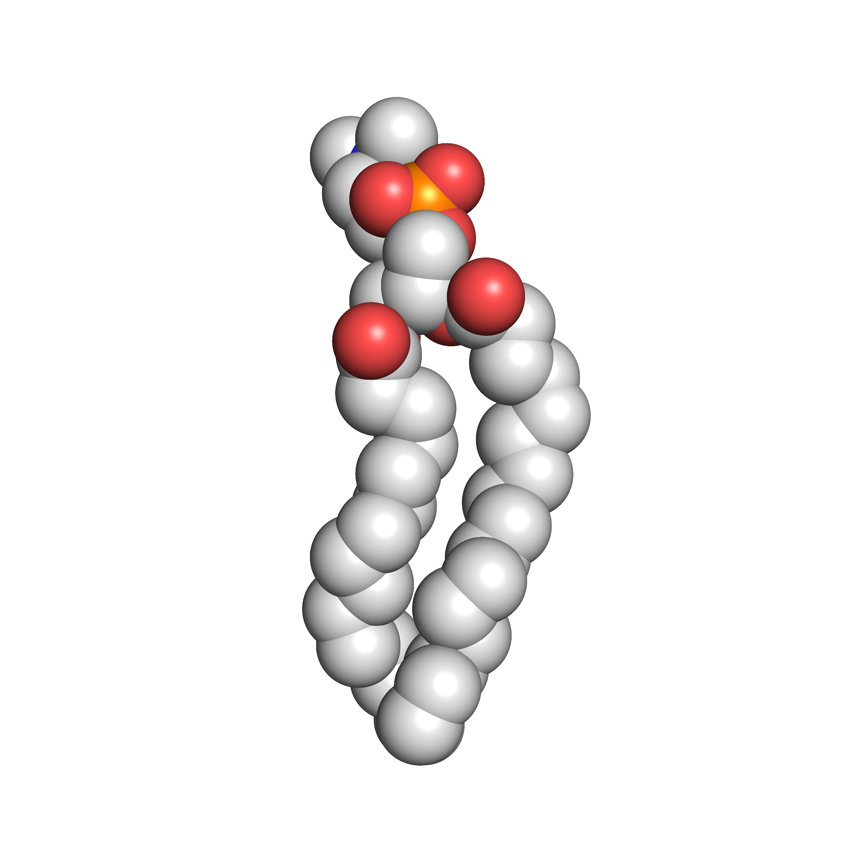
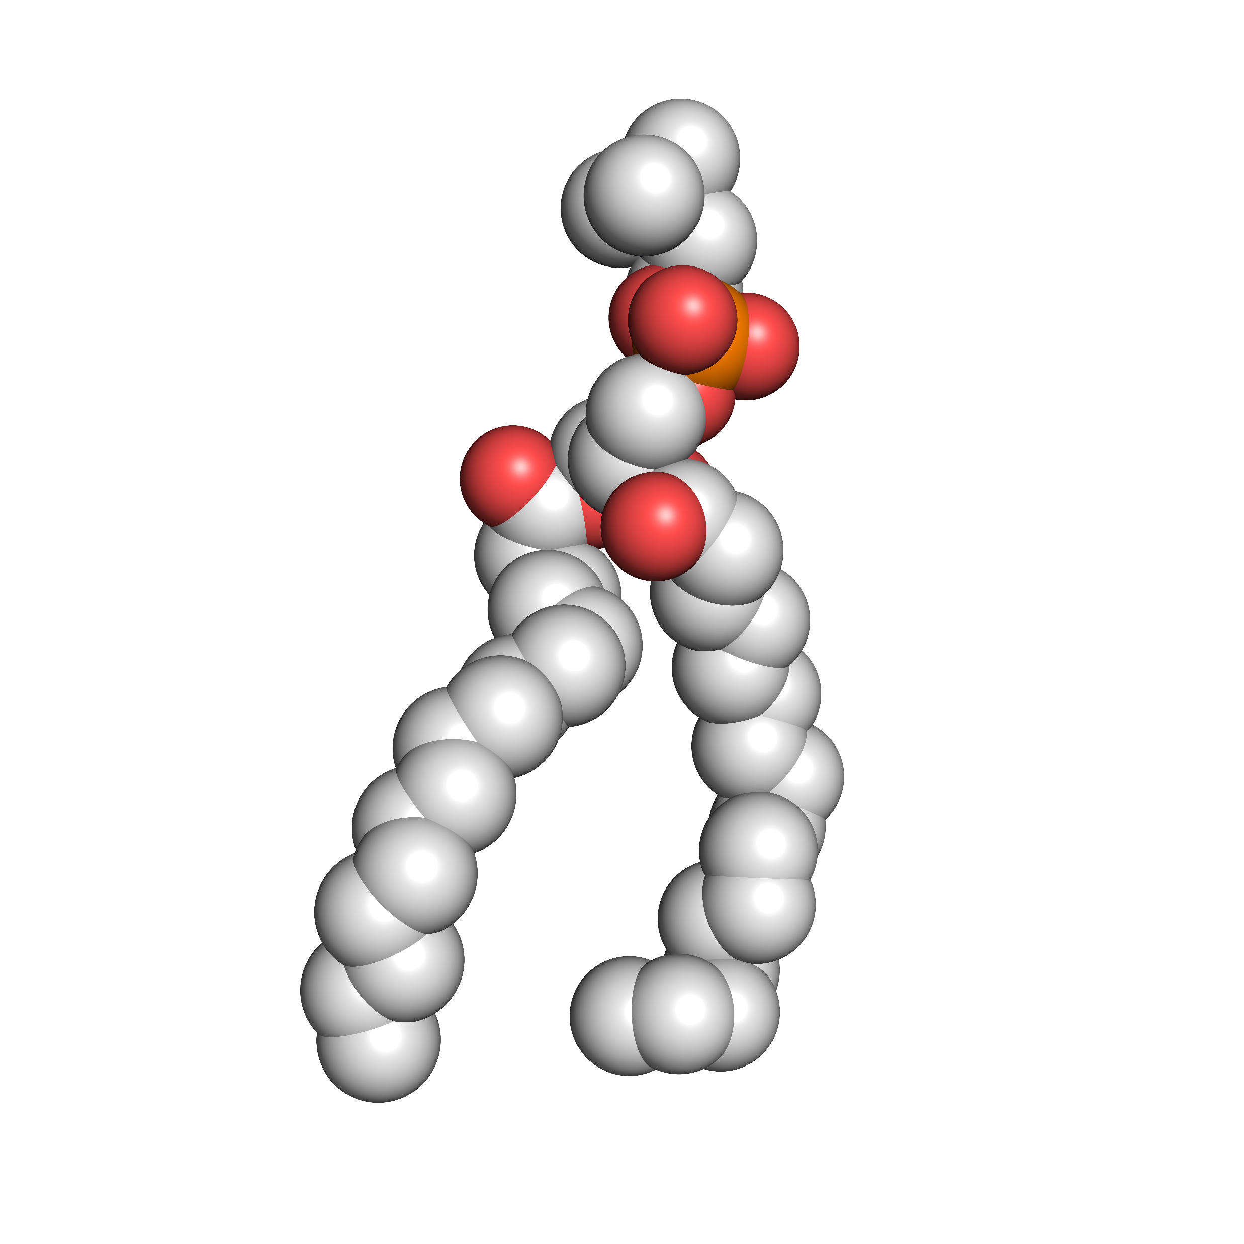
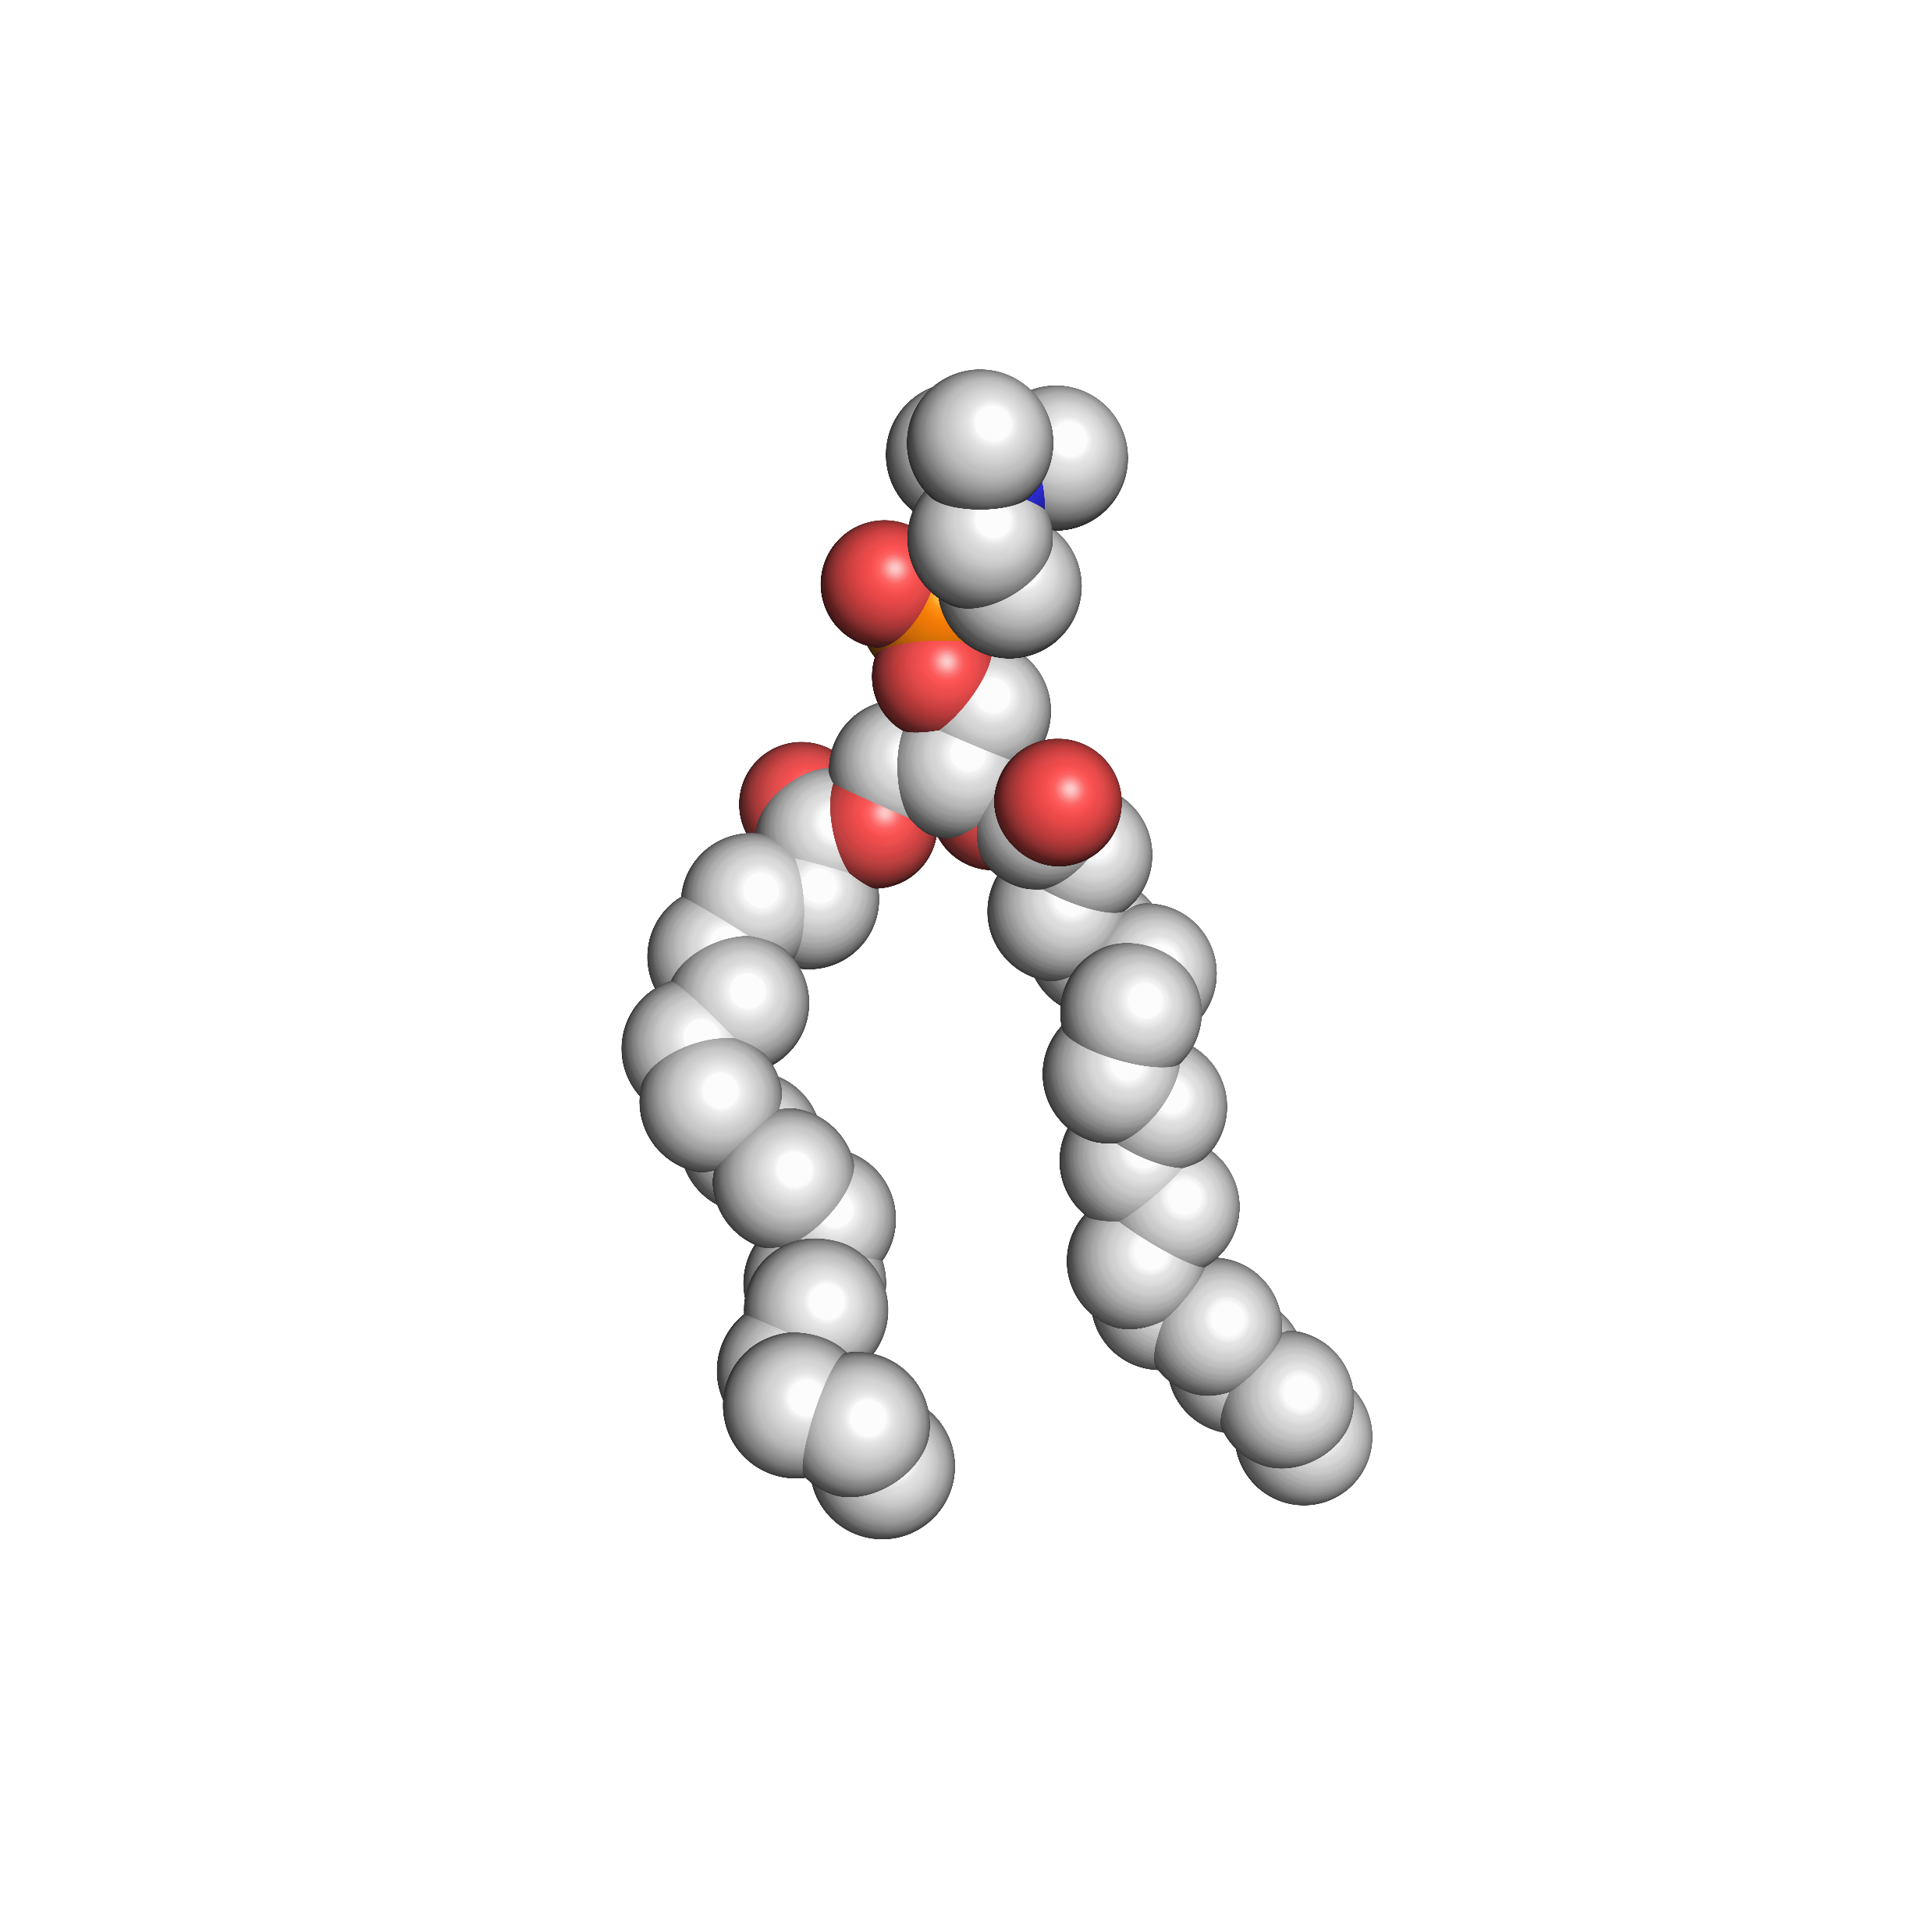
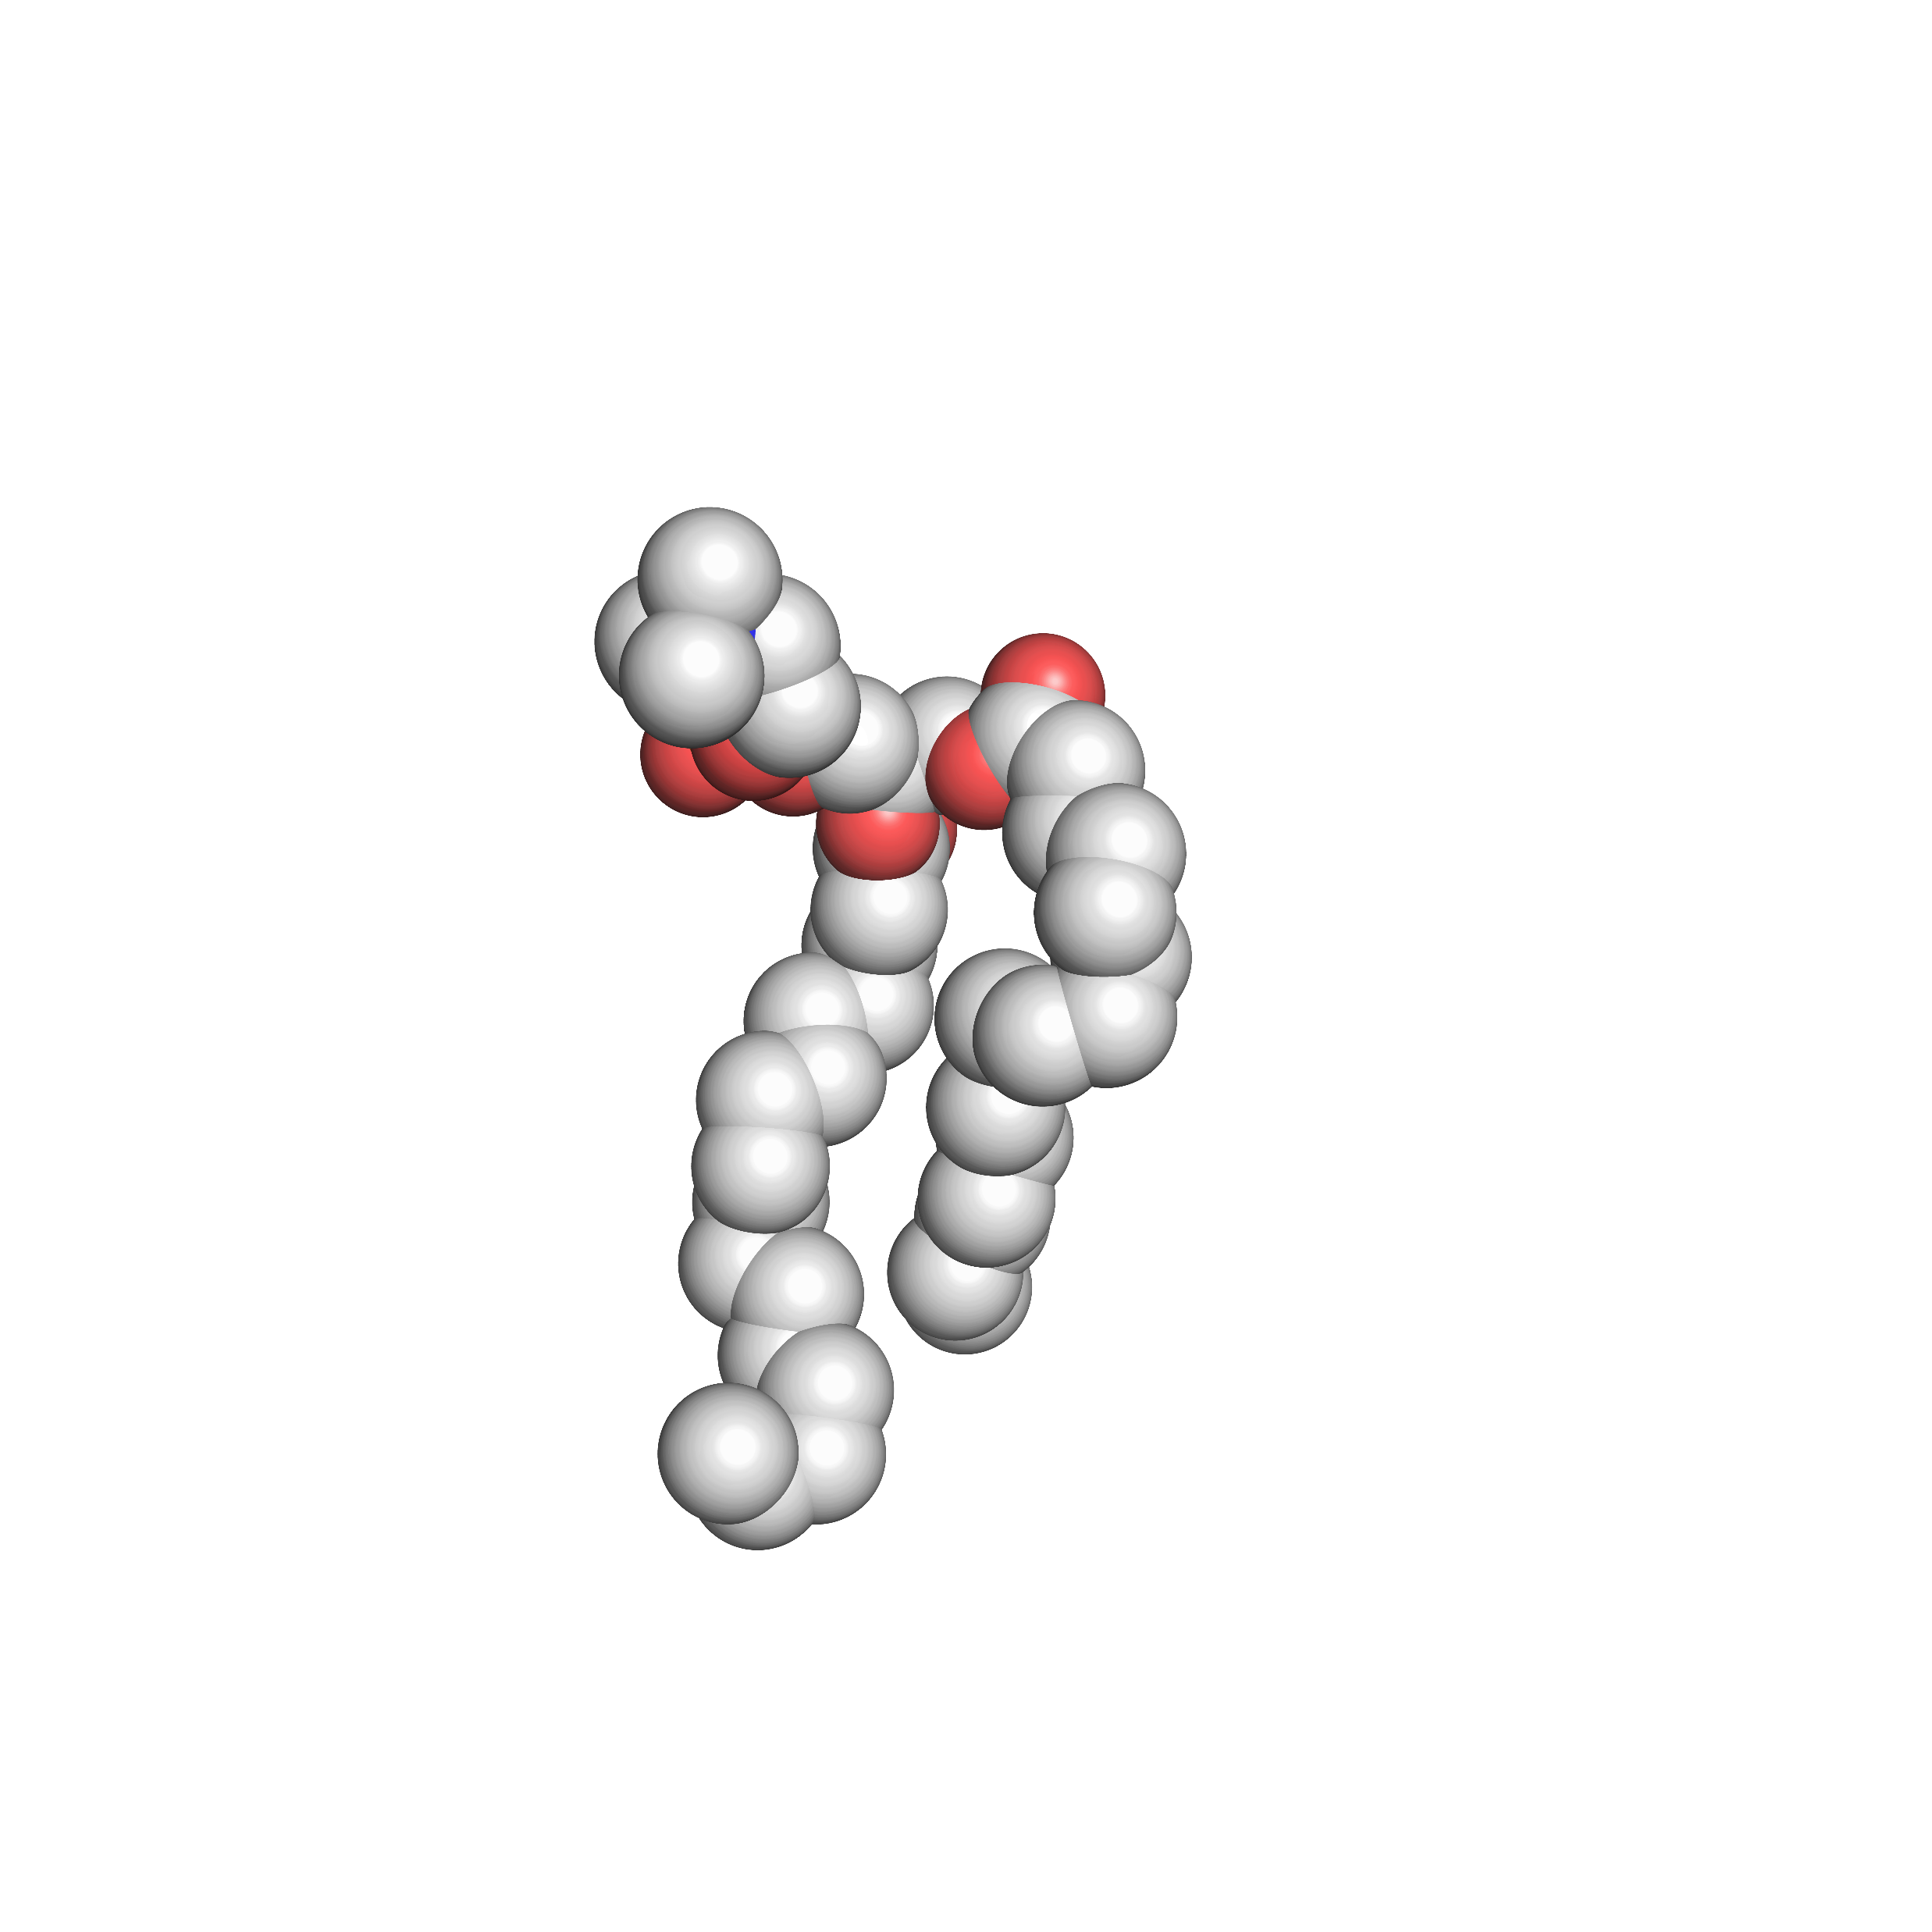
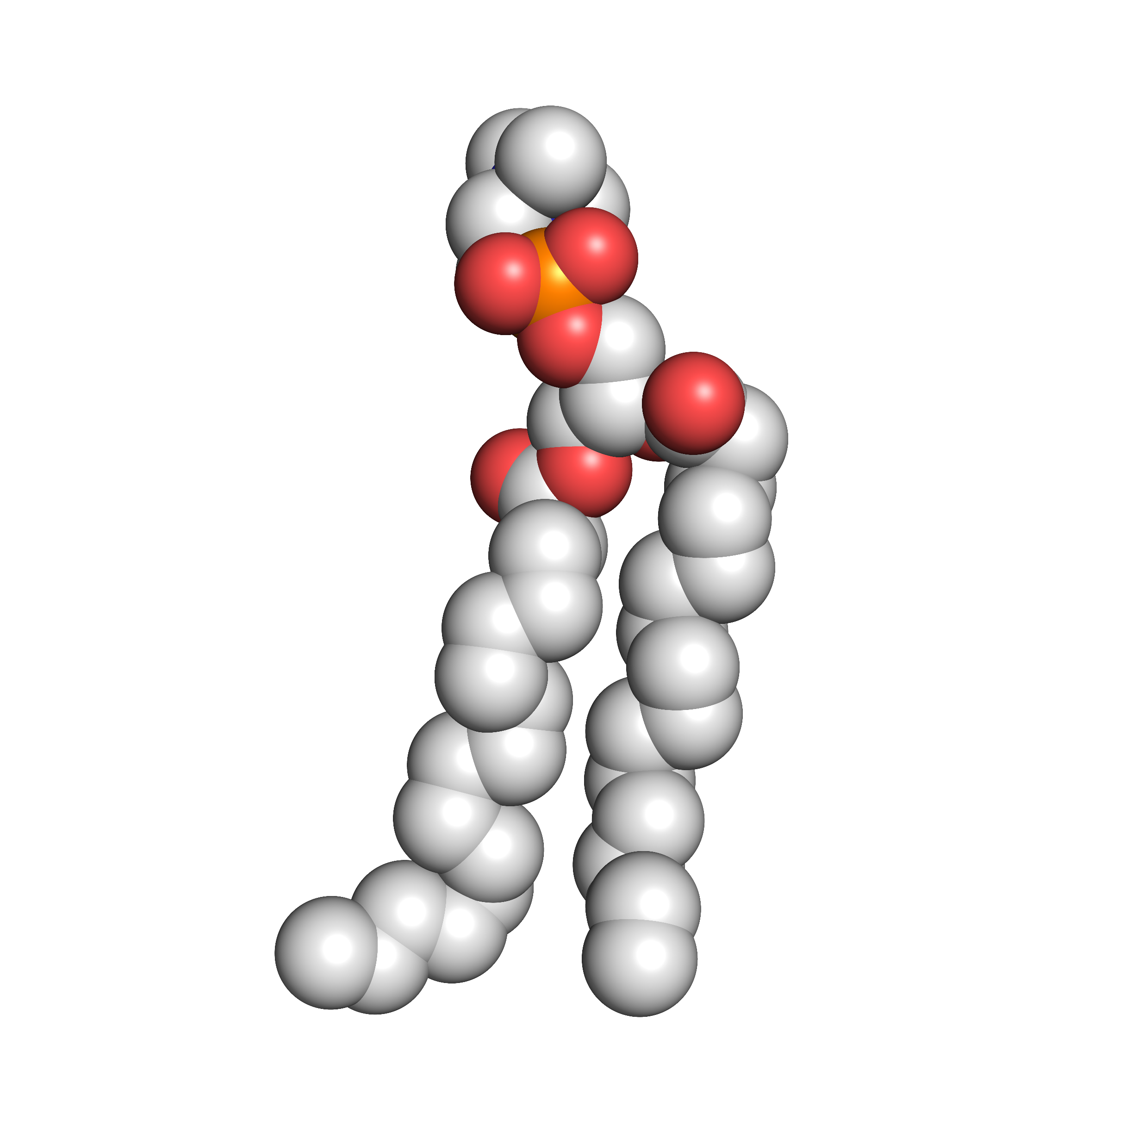
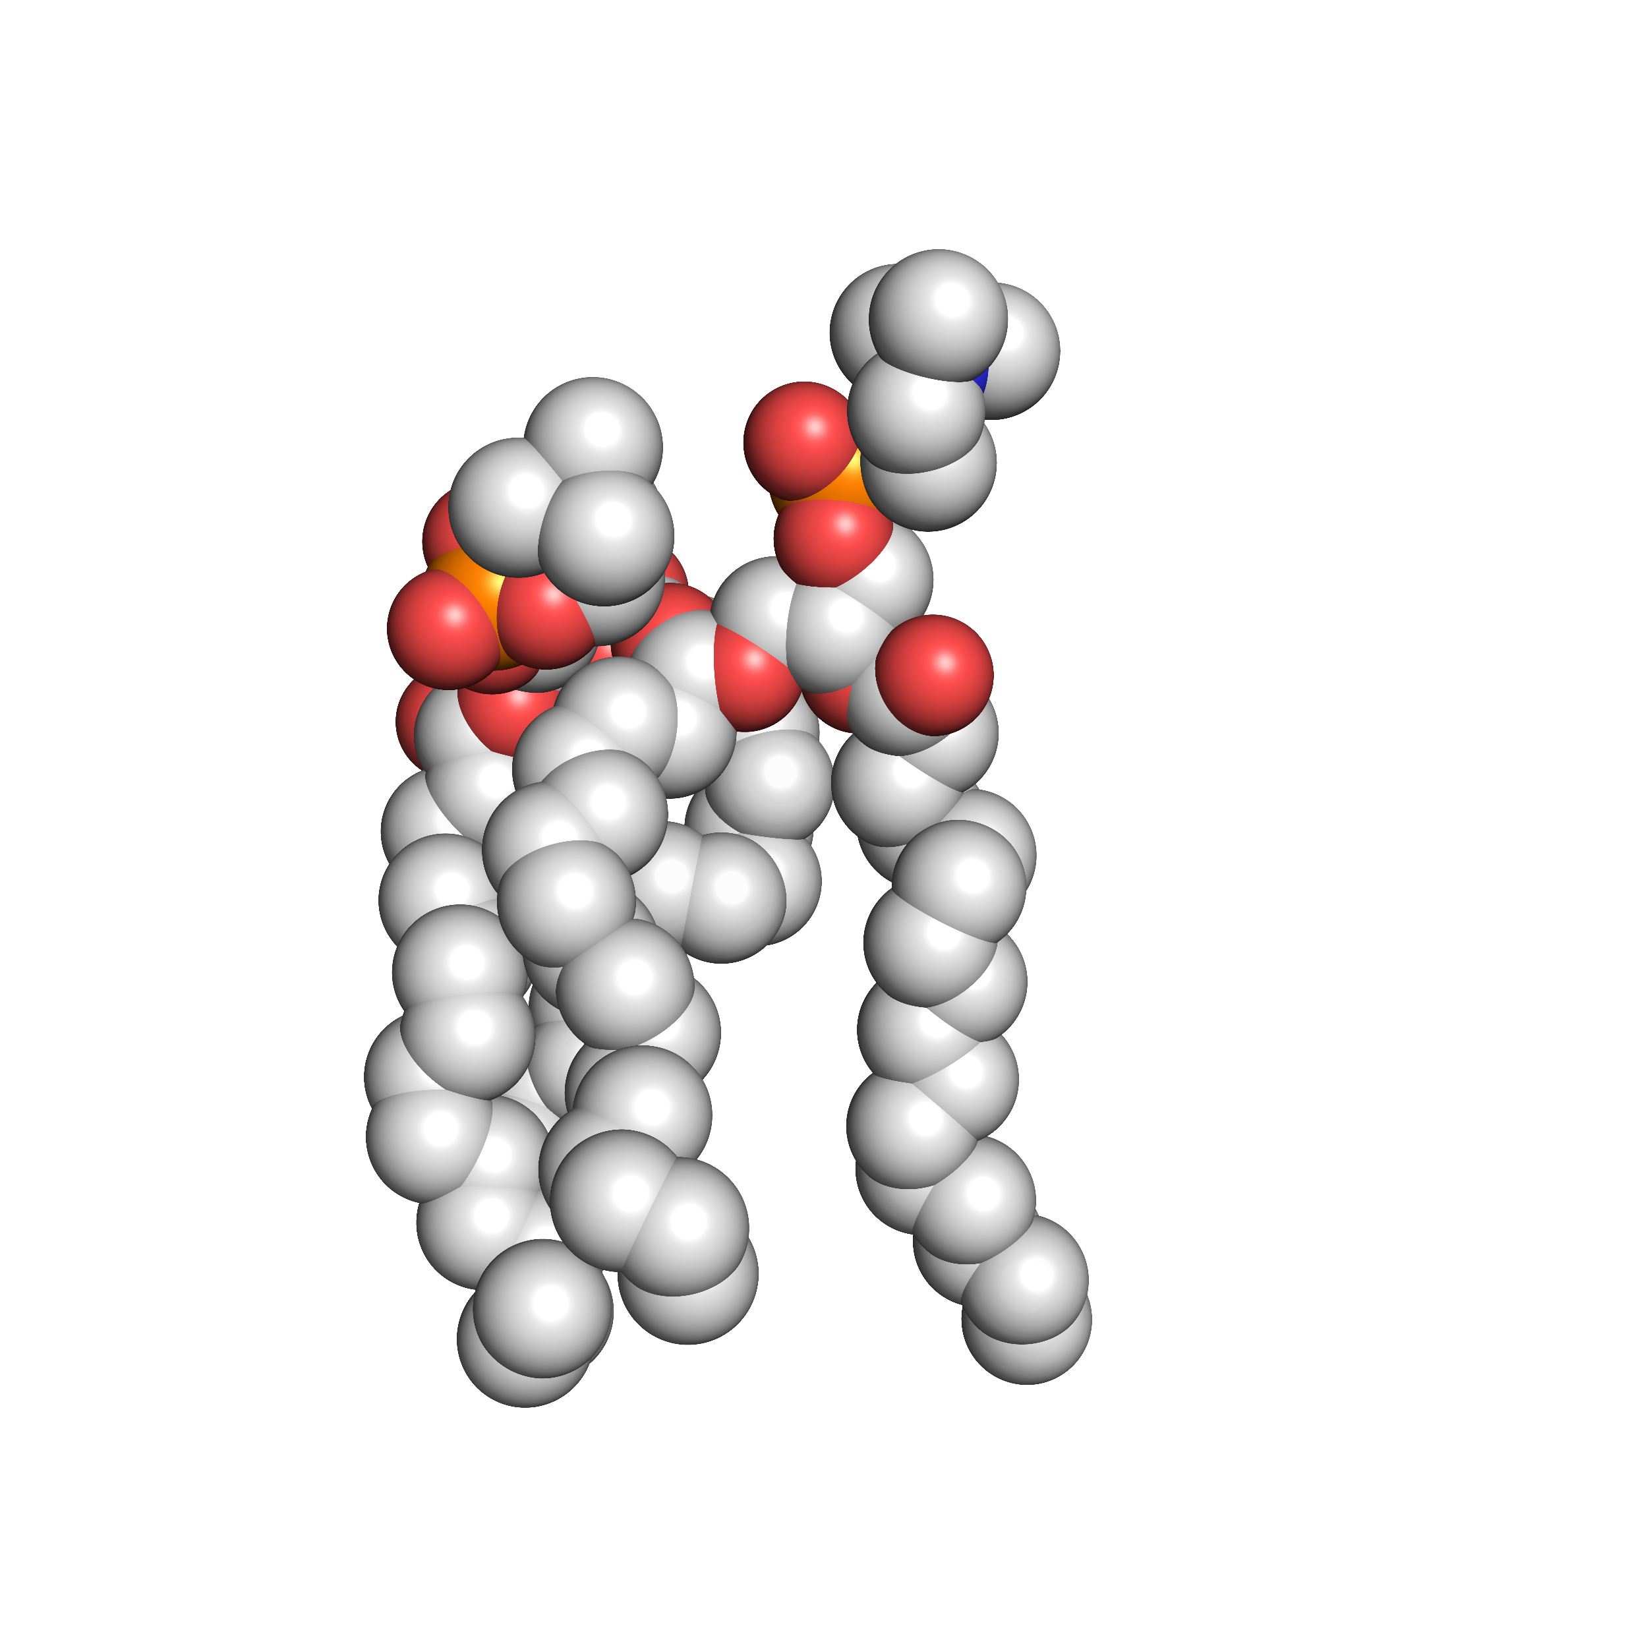
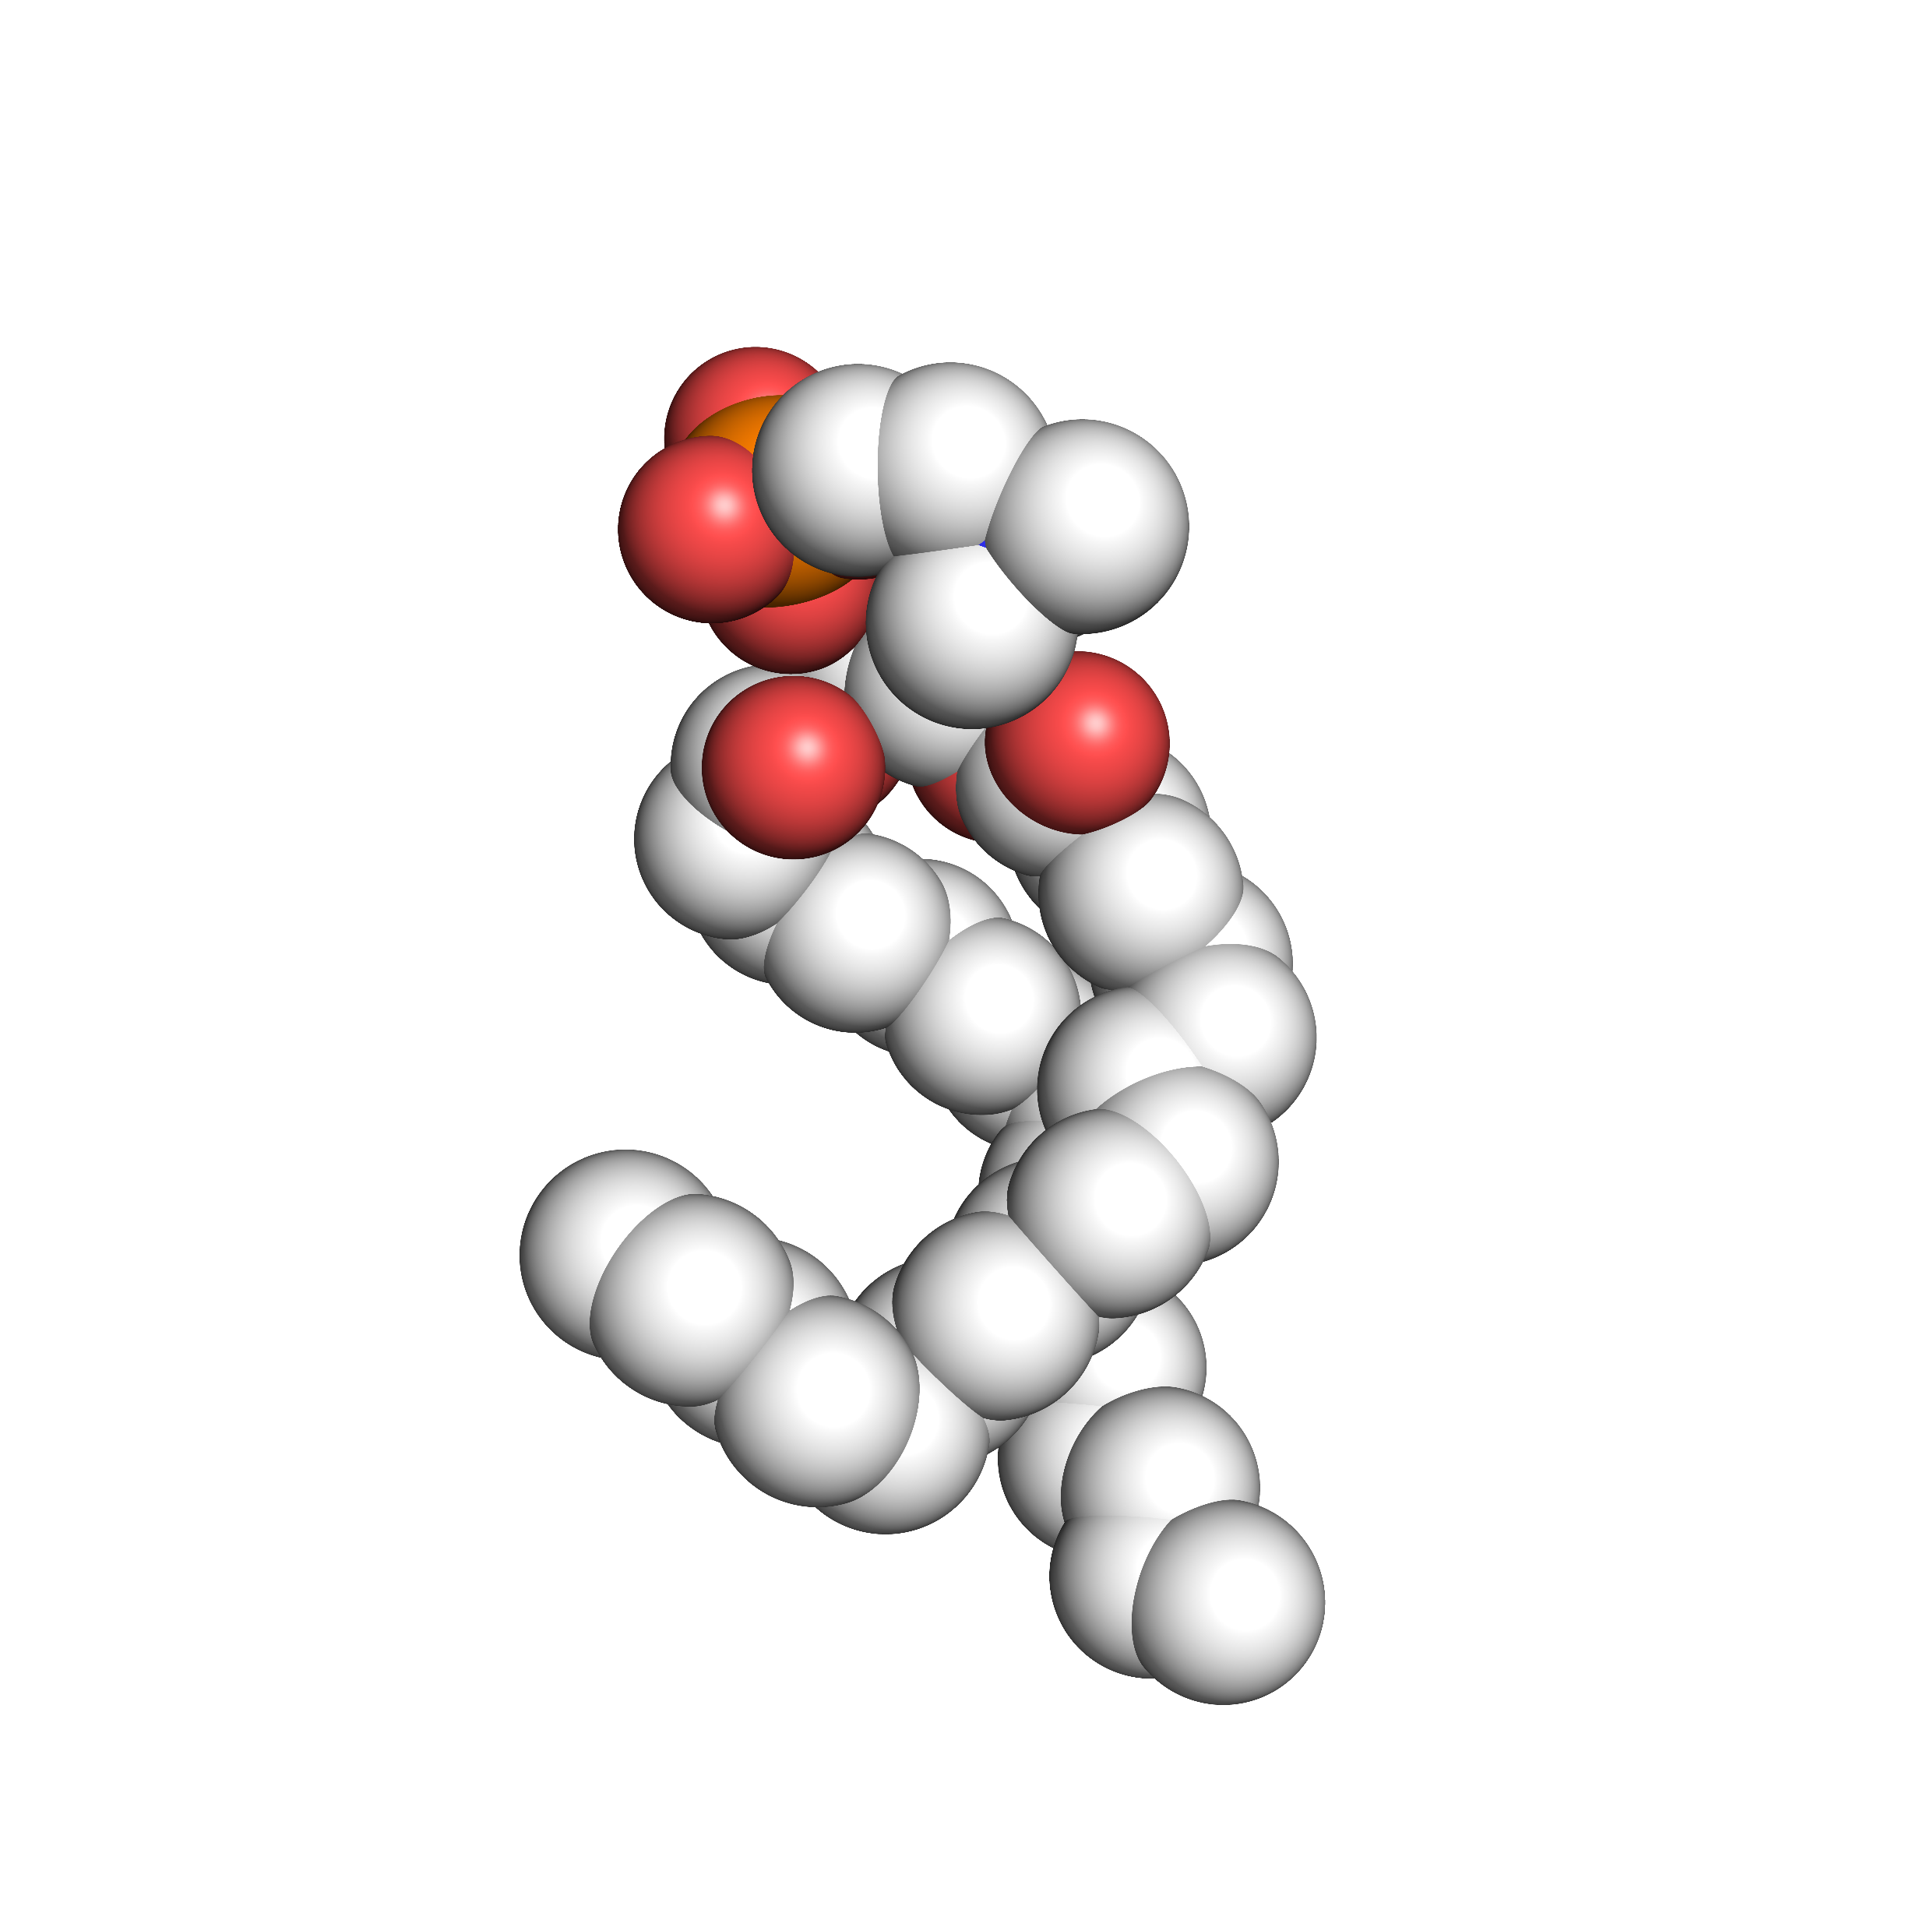
In the membrane, van der Waals packing does not just occur within the protein
1. lipid-lipid packing
Notes:
There are a variety of van der Waals packing interactions present within the lipid bilayer. Lipid hydrophobic tails are in close contact with atoms of other surrounding lipid tails, resulting in van der Waals packing between lipid molecules, or lipid-lipid packing.

Slide 8
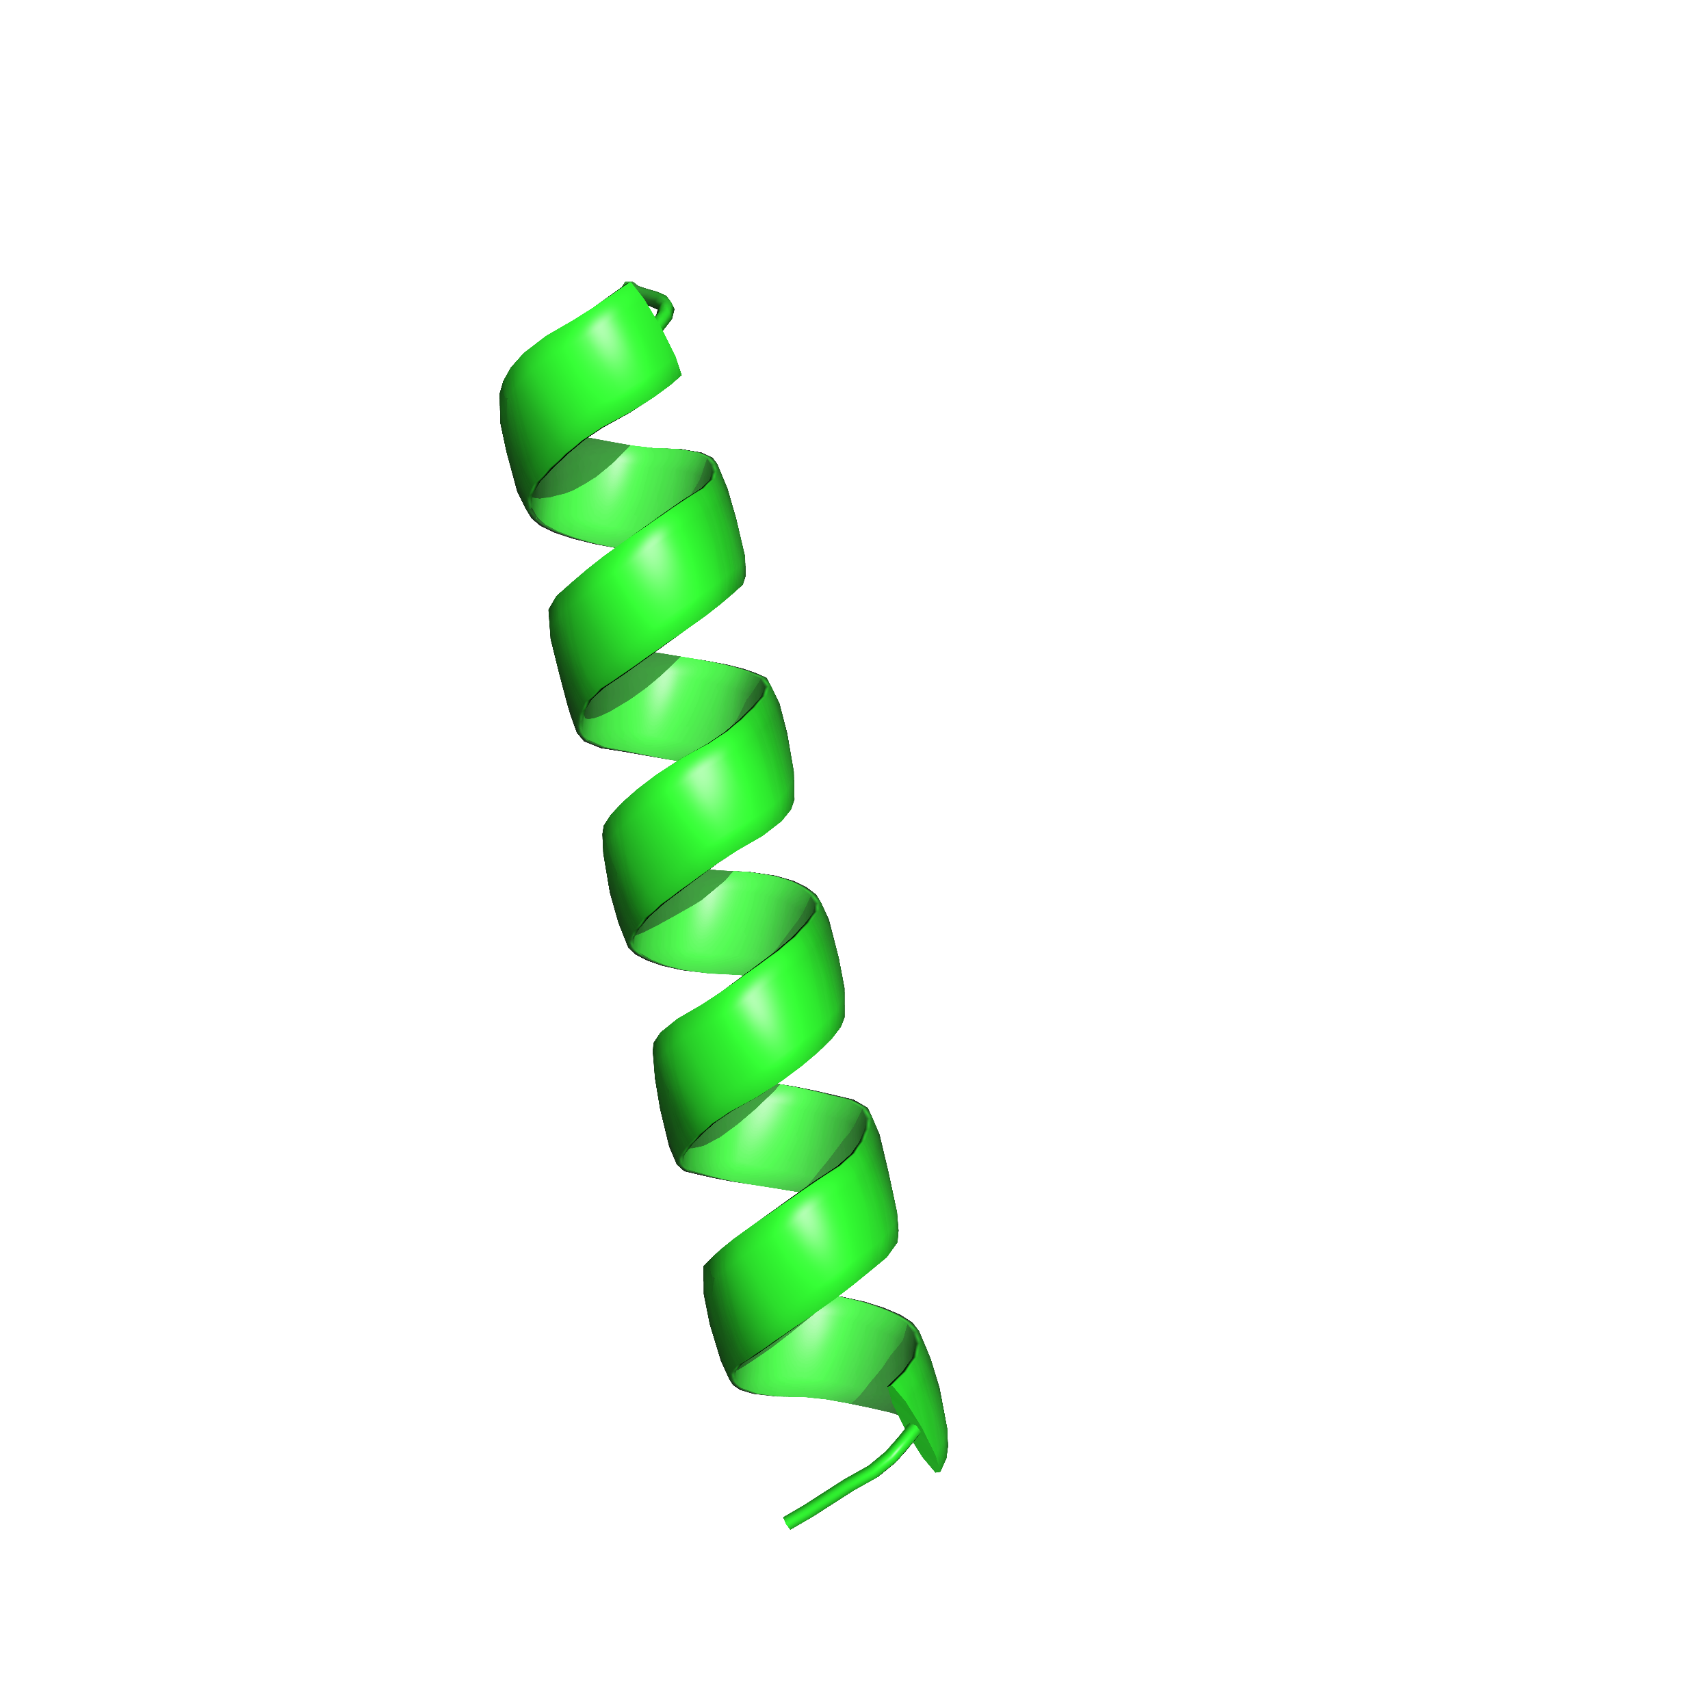
In the membrane, van der Waals packing does not just occur within the protein
1. lipid-lipid packing
2. lipid-protein packing
Notes:
When a membrane protein subunit is inserted into the bilayer, the hydrophobic transmembrane region is completely solubilized by the bilayer, resulting in packing by the close contact between the protein subunit and any surrounding lipids, or lipid-protein packing.

Slide 9
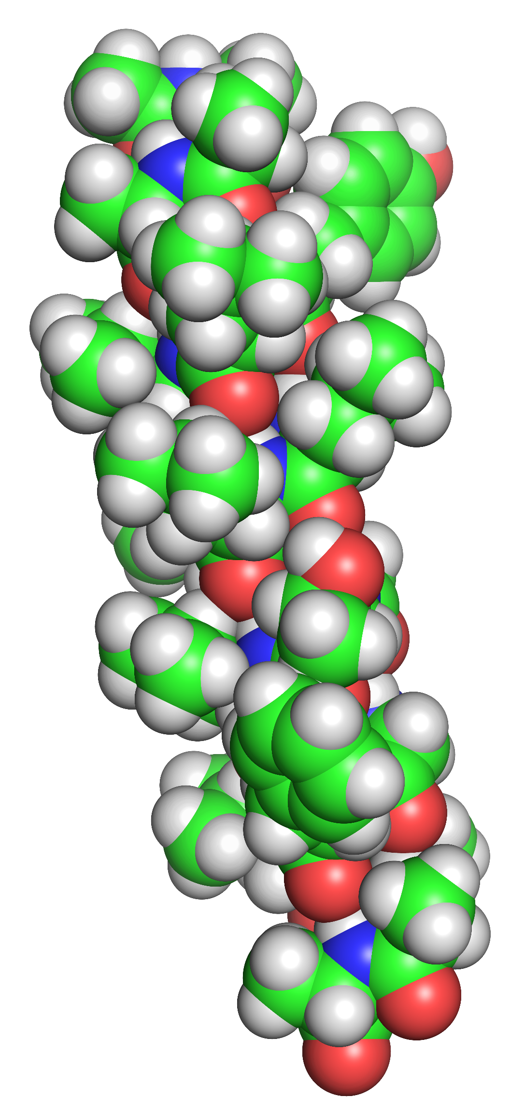
In the membrane, van der Waals packing does not just occur within the protein
1. lipid-lipid packing
2. lipid-protein packing
Notes:
When a membrane protein subunit is inserted into the bilayer, the hydrophobic transmembrane region is completely solubilized by the bilayer, resulting in packing by the close contact between the protein subunit and any surrounding lipids, or lipid-protein packing.

Slide 10
In the membrane, van der Waals packing does not just occur within the protein
1. lipid-lipid packing
2. lipid-protein packing
Notes:
When a membrane protein subunit is inserted into the bilayer, the hydrophobic transmembrane region is completely solubilized by the bilayer, resulting in packing by the close contact between the protein subunit and any surrounding lipids, or lipid-protein packing.

Slide 11
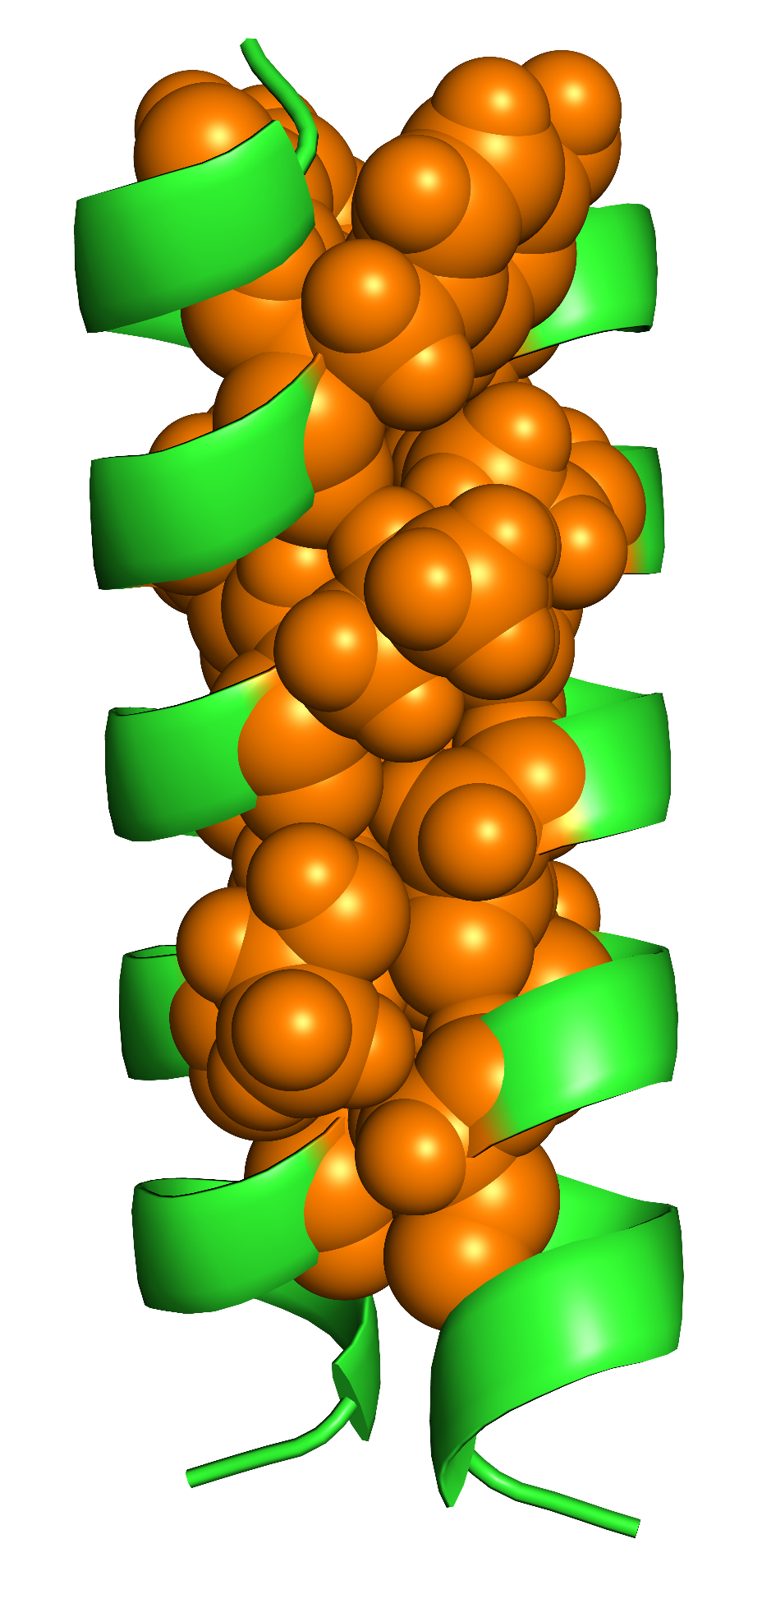
In the membrane, van der Waals packing does not just occur within the protein
1. lipid-lipid packing
2. lipid-protein packing
3. protein-protein packing (sidechain packing)
Notes:
Finally, the individual subunits of a protein associate together, resulting in protein-protein, or sidechain packing.

Slide 12
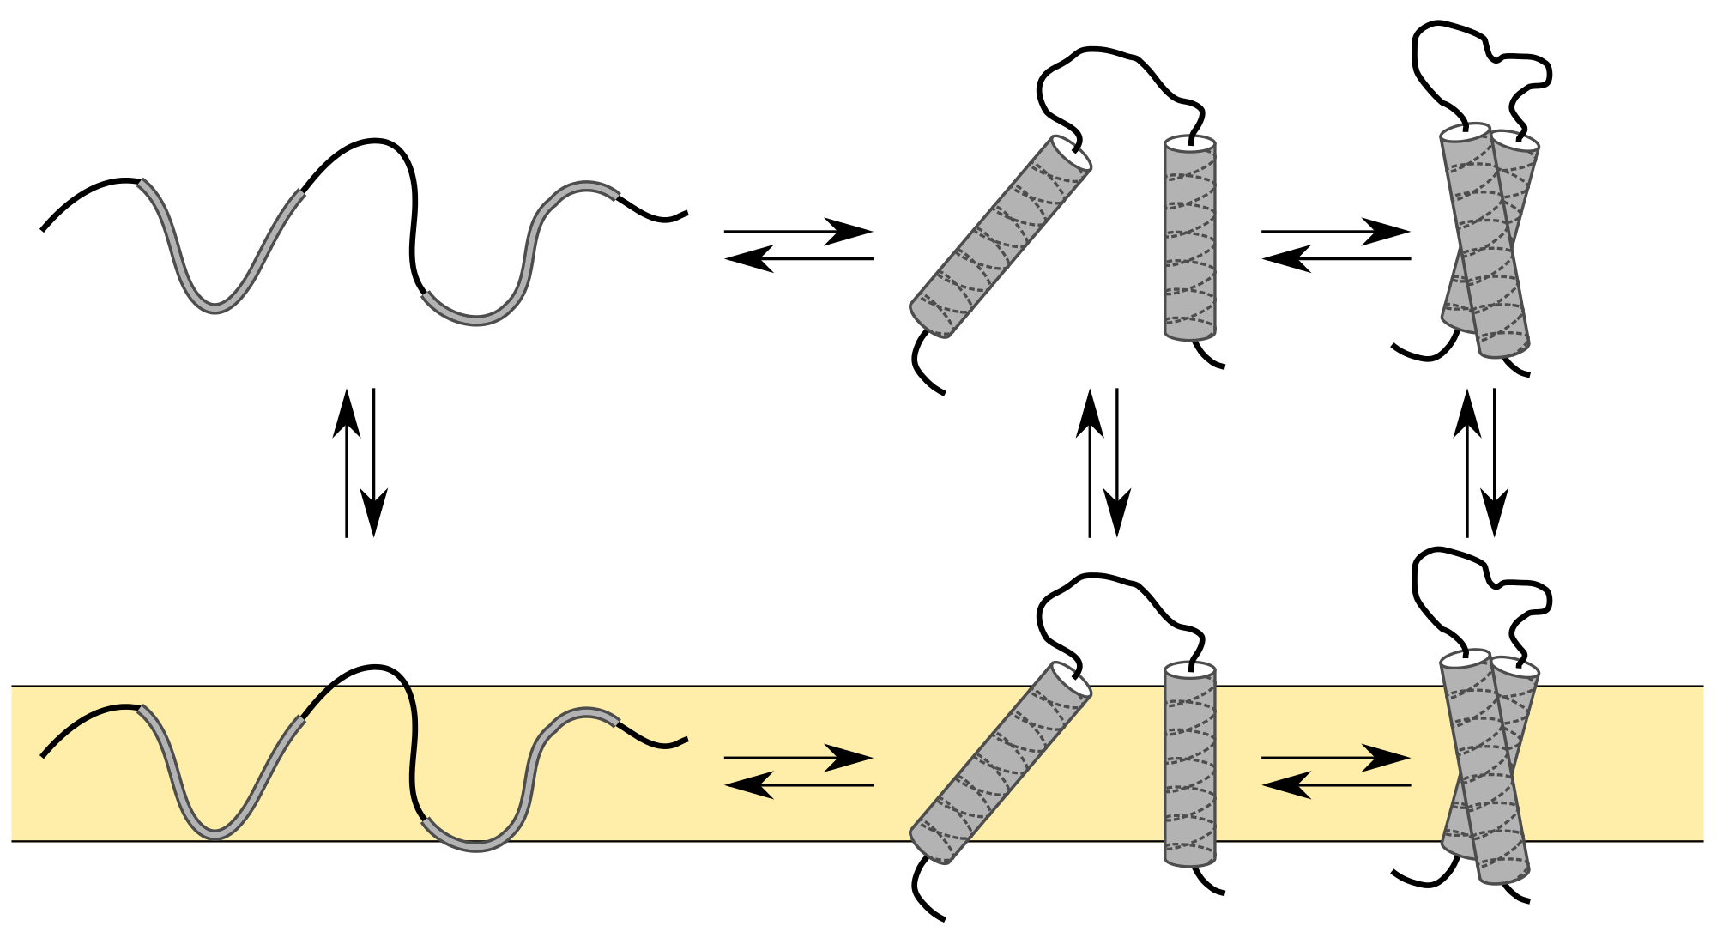
Is sidechain packing simply a stabilizing force, or can it cause association and folding?
Hydrophobic effect
Notes:
For some contrast, first think of soluble proteins.
transition from the unfolded state to the folded state: the hydrophobic effect drives nonpolar amino acids the protein core, resulting in tight sidechain packing.
Known that without the hydrophobic effect, sidechain packing alone cannot cause the protein to fold
In this case, sidechain packing is present to stabilize the folded state (or a necessity), but not causing the protein to fold (or driving folding).

Slide 13
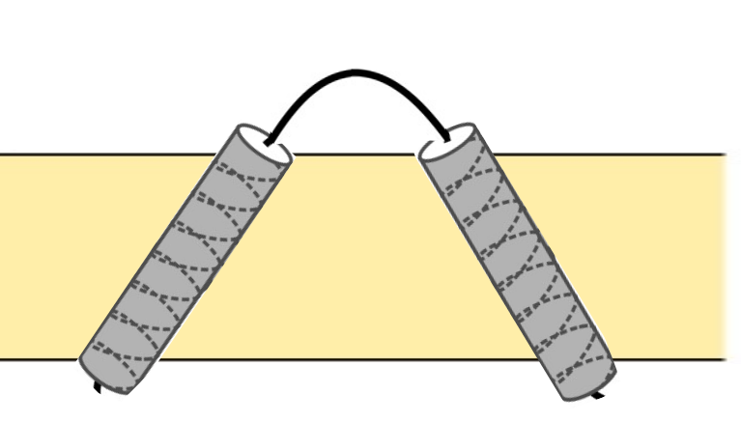
Is sidechain packing simply a stabilizing force, or can it cause association and folding?
Hydrophobic effect
Driving Forces:
H-bonding ✔
Polar interactions ✔
Sidechain packing ?
Notes:
This is still an open question for debate in membrane proteins.
The hydrophobic effect does not affect association and folding within the membrane.
Many helix-helix interactions found within complex membrane proteins without polar residues; left with just hydrophobic amino acids and packing interactions (which happens all of the time in membrane proteins)
The extent at which mainly packing can drive association of individual domains alone or if it is just a necessary force resulting from other forces (hydrogen bond or polar interactions) driving association is not well understood.
Enough evidence to say packing is a driving force (but how strong? Could be a pretty reasonable driving force that stabilizes protein); polar interactions in membrane are less stable, therefore hydrogen bonding is stronger (but often don’t have polar residues, leaving us with hydrophobic sidechains and thus vdW; implies that packing needs to be stronger in the folded state; therefore, how much of a driving force is it? Phrasing: without polars, we are left with hydrophobic sidechains and only sidechain packing, but also lipid packing interactions…how much more stable…say that we are confident that it contributes

Slide 14
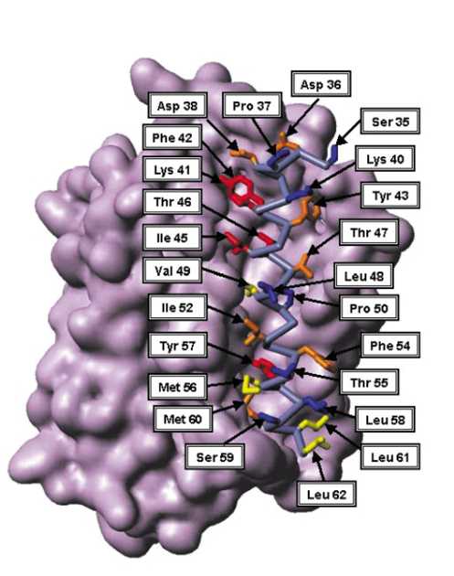
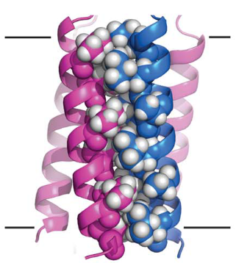
Sidechain packing has been shown to impact folding and association in individual systems
Faham et al., 2003
Mravic et al., 2019
Notes:
Previous research has shown evidence that sidechain packing impacts folding and association.
Research on bacteriorhodopsin by the Bowie lab - making mutations that create voids at the helix-helix interface destabilizes protein structure.
In addition, it has been shown by the DeGrado lab that optimized sidechain packing alone can be used to design a stable membrane protein structure.
This evidence suggests that sidechain packing can impact and drive the folding and association of individual membrane protein systems.
However, the extent at which this is true for the general population of membrane proteins is not well understood. My research will expand upon the current research on the impact of sidechain packing on individual systems to more generally understand the impact of sidechain packing in all membrane proteins.

Slide 15
Study sidechain packing in a variety of membrane protein structures
Notes:
Membrane proteins are proteins that are embedded in a lipid bilayer
GPCRs-relay sensory information to the brain
Enzymes-regulate ion balance and are important for membrane potential of a cell
RTKs-regulate expression of genes
To understand these proteins functions, many groups look to understand how these proteins fold and the biophysical forces involved in this process.

Slide 16
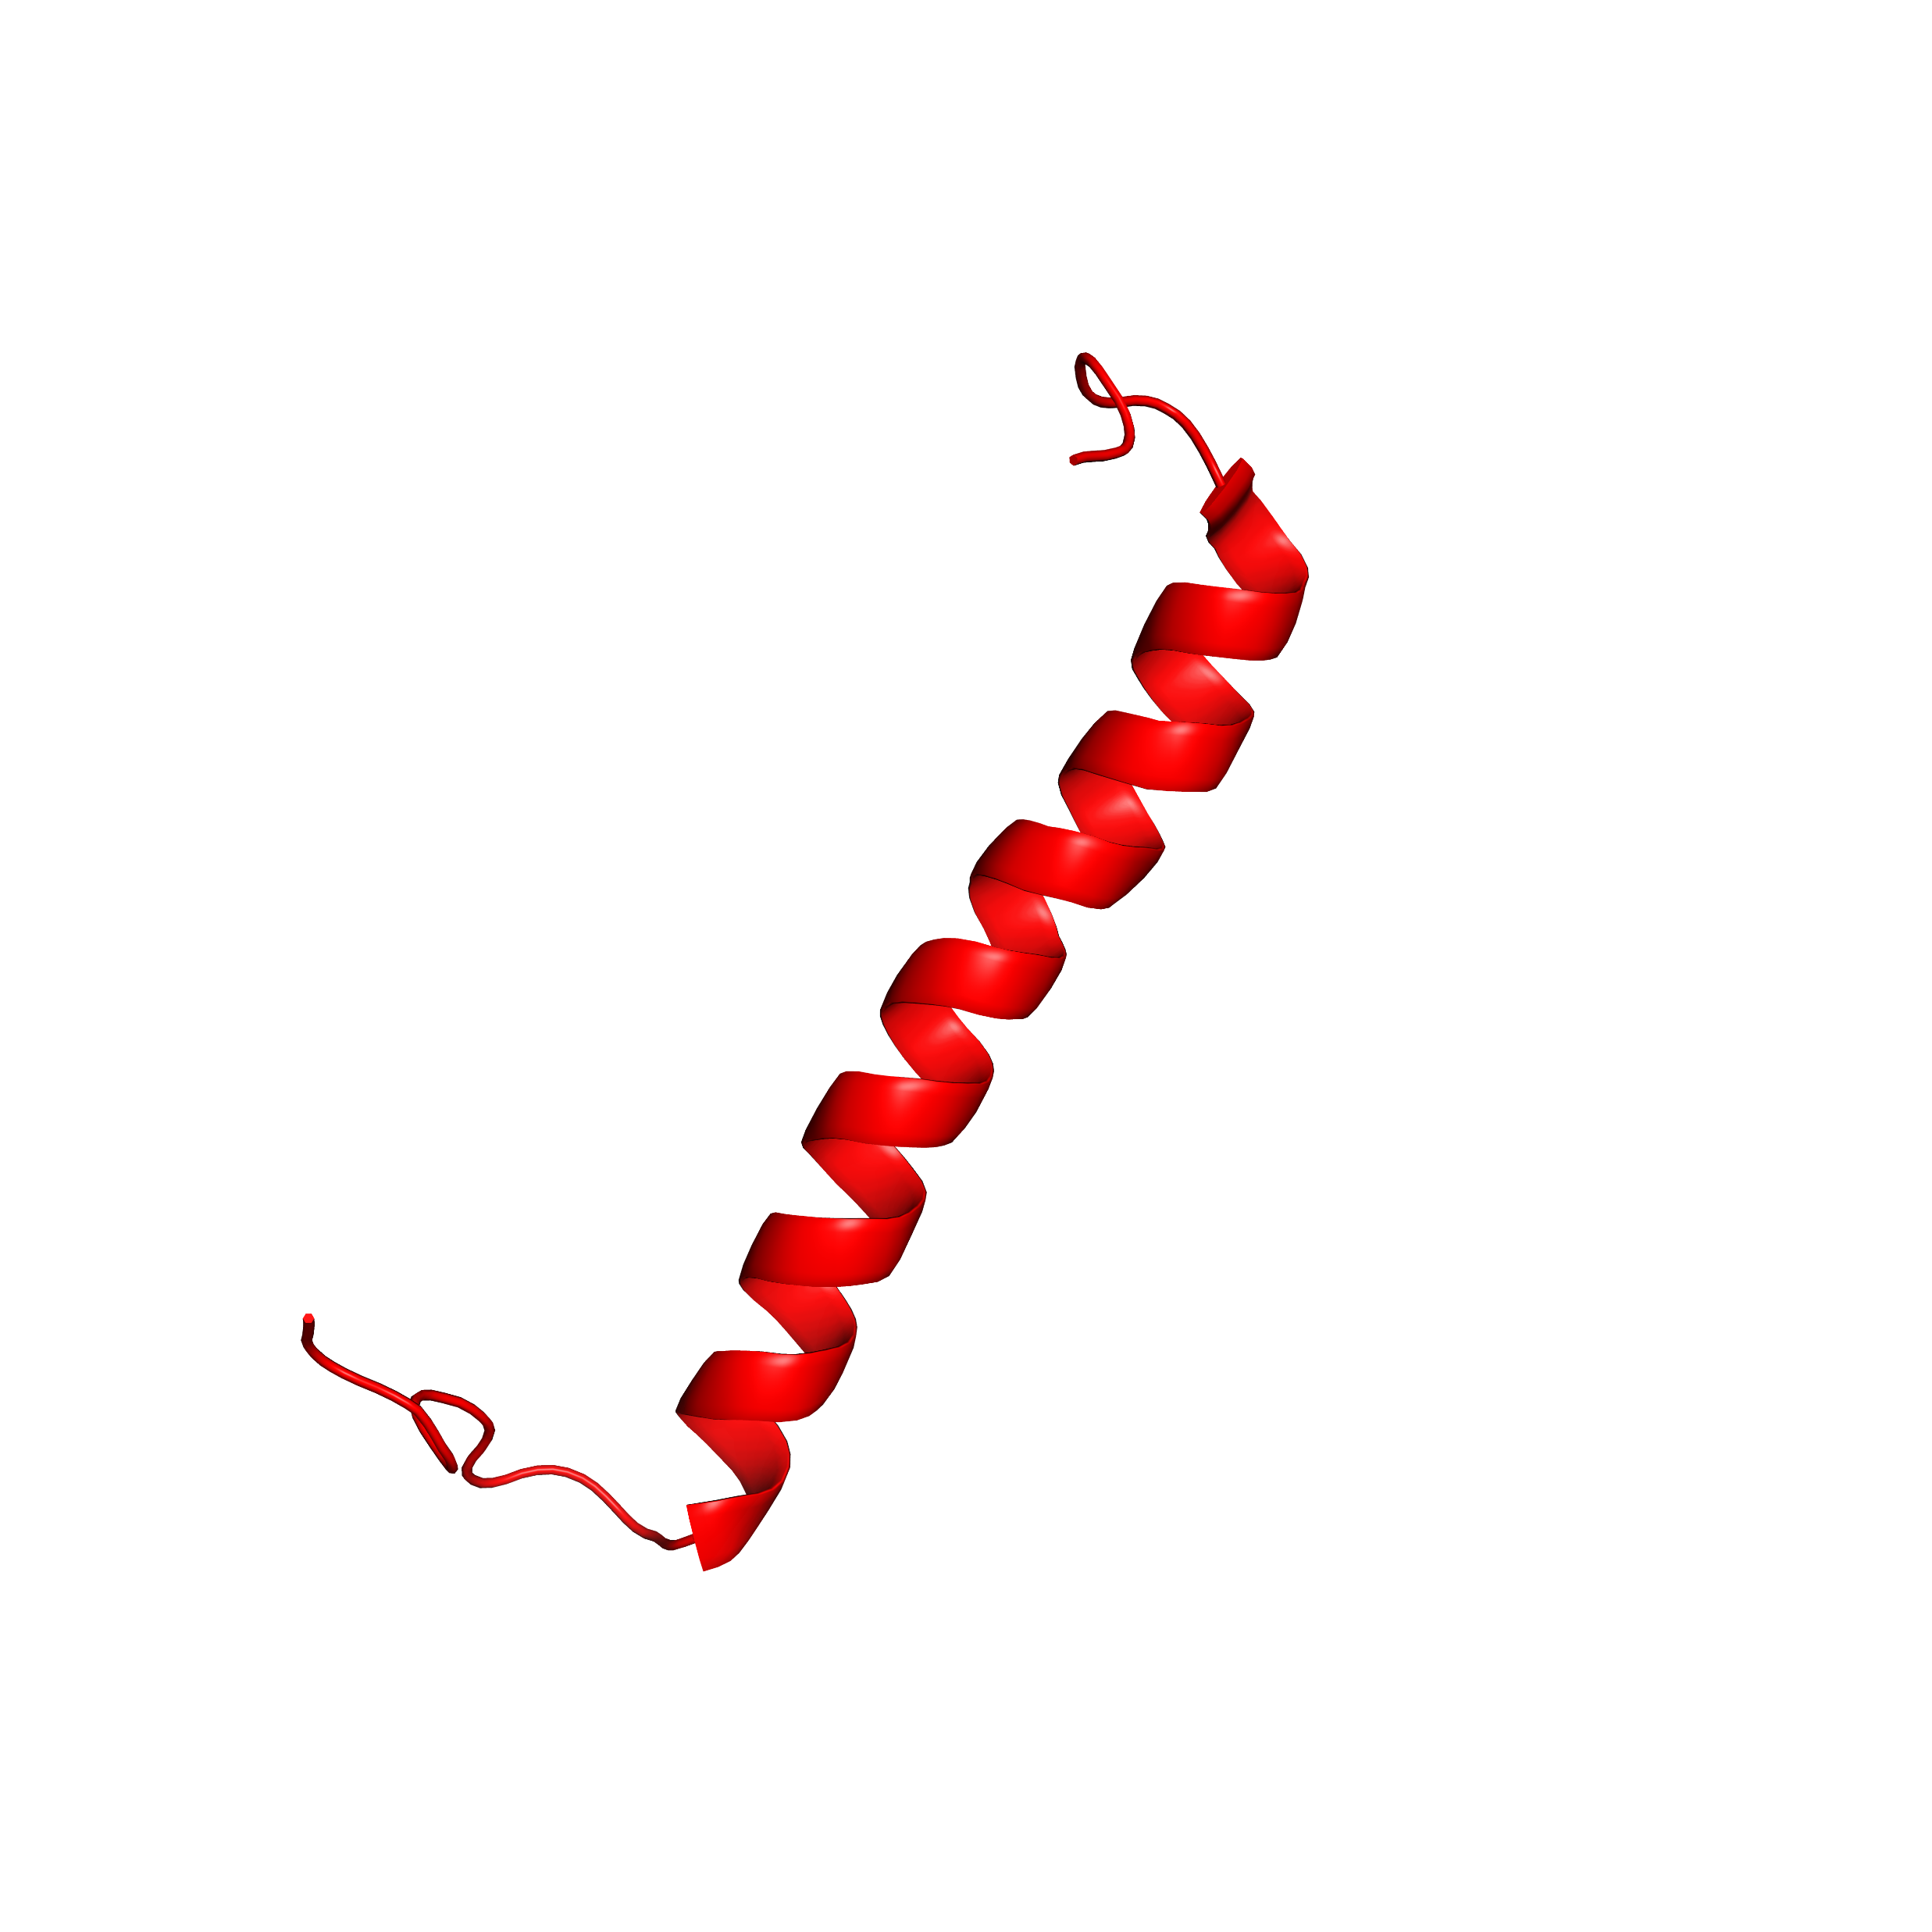
Is packing generally a driving force in membrane protein systems?
hydrogen bonding, polar interactions, van der Waals packing
Notes:
I plan to study the impact of sidechain packing on dimerization
This simple model - used in the past to deduce the strength of hydrogen bonding and polar interactions and their overall impact on association of individual protein subunits.
since many helix-helix interactions in membrane proteins are facilitated by just nonpolar amino acids, and sidechain packing seems to be a stabilizing force,
I can extract backbones and study as dimers to study how sidechain packing impacts association and folding within a large variety of membrane protein systems.
This knowledge can then be applied to gaining a better understanding of van der Waals packing as a whole, advancing our understanding of the fundamental forces involved in membrane protein folding and association.
This contribution can then be scaled up with the number of increasing subunits: the contribution of a hydrogen bond between two helices will be extremely similar to a hydrogen bond between two completely different helices.
Without filling this gap, we are unable to fully appreciate the strength of other forces involved, such as hydrogen bonding and electrostatic interactions. If we can get a better understanding of how much sidechain packing is necessary for folding, we can better understand how each of these forces works in tandem with one another to stabilize a protein in its functional state.
The simplest model of this is dimerization, or two protein subunits associating together to form a dimer. In particular, previous research has used dimerization to investigate both hydrogen bonding and electrostatic interactions, however, research within the field is particularly lacking on our understanding of van der Waals packing, a crucial force that is necessary to understand in order to fully understand the how proteins are stabilized. Each of these is an additional force that must be considered in when studying folding: Even if hydrogen bonding or electrostatic interactions are involved, association itself results in packing because the atoms are brought into close contact. Therefore, to fully understand membrane protein folding, we must understand the impact of each of these packing interactions and how they balance the folded and unfolded states of a protein.

Slide 17
Computational design of homodimers using van der Waals packing as a major driving force

Slide 18
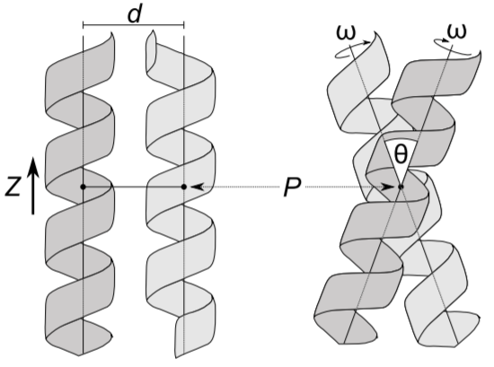
Approaches to specifically study sidechain packing
Notes:
In order to design sequences with differences in sidechain packing, I need to have places to set my helix backbone
Backbones broken down in to geometric parameters, such as d, or the distance between helices, and theta, or the angle between helices.
First goal of my project is to find backbones and orient helices in space

Slide 19
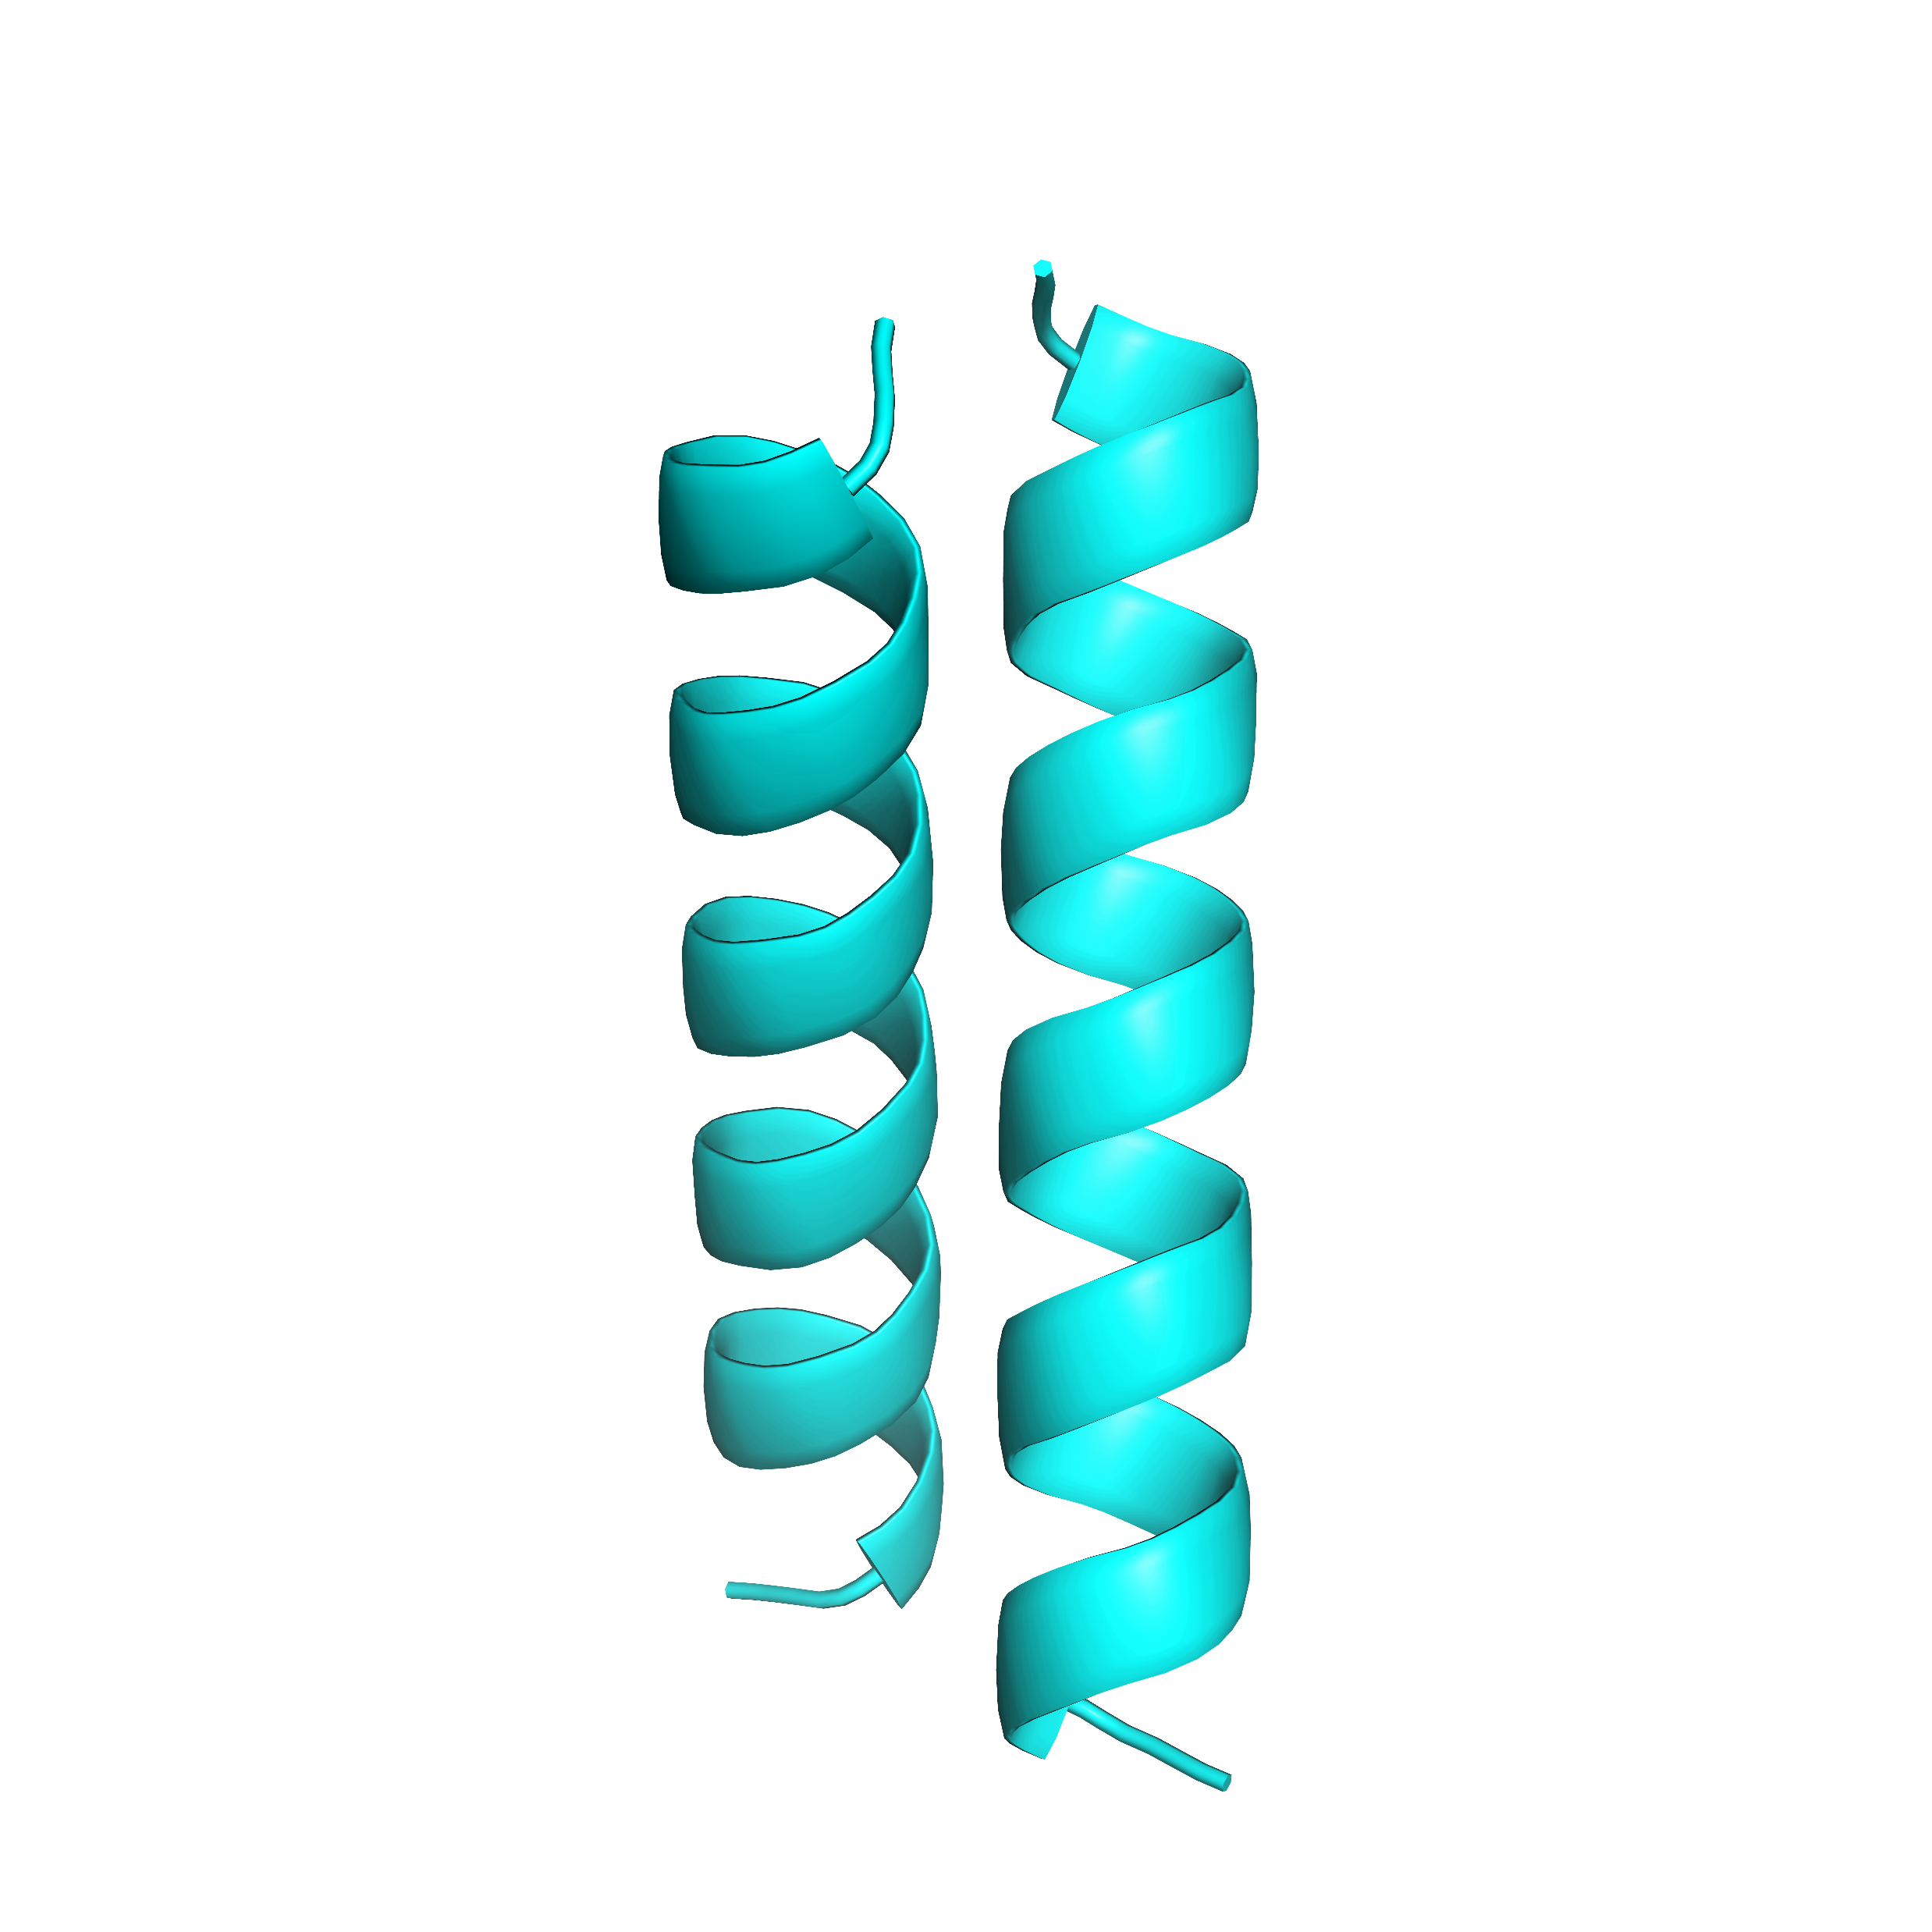
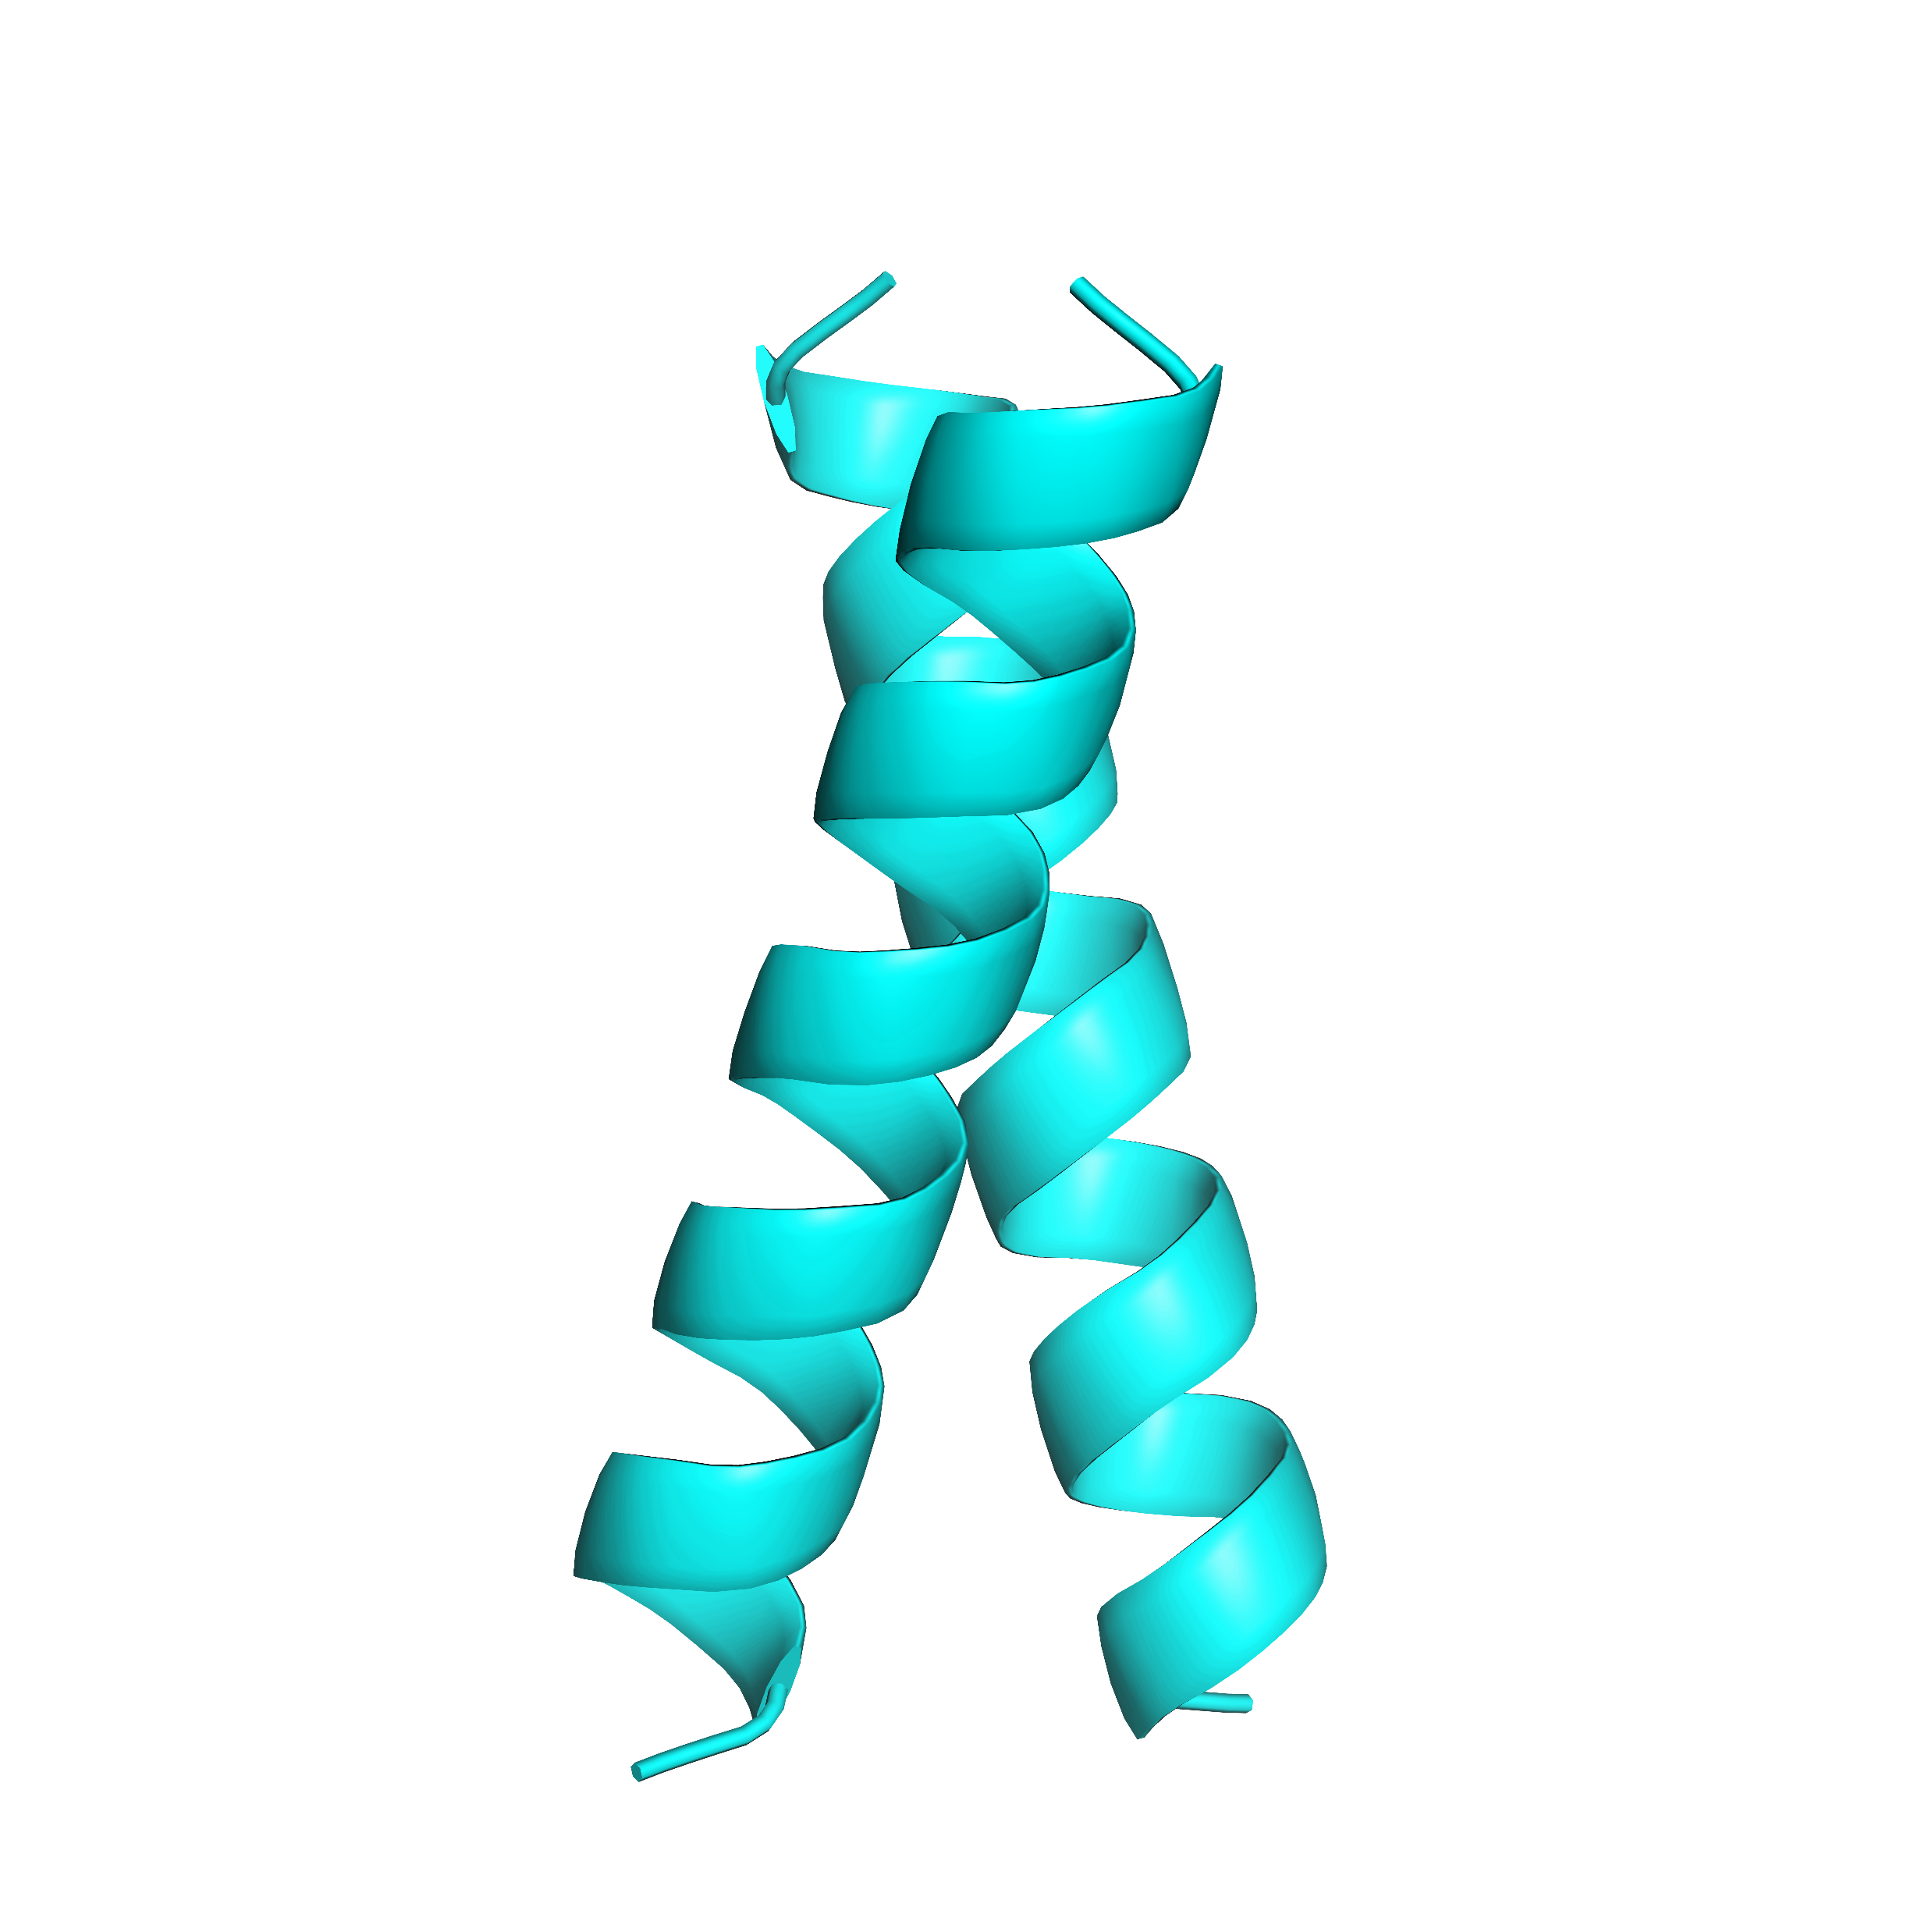
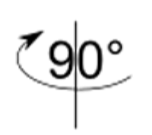
Approaches to specifically study sidechain packing
Notes:
After found backbones, I orient helices in space and explore sequences space for sequences that are stable in this conformation

Slide 20
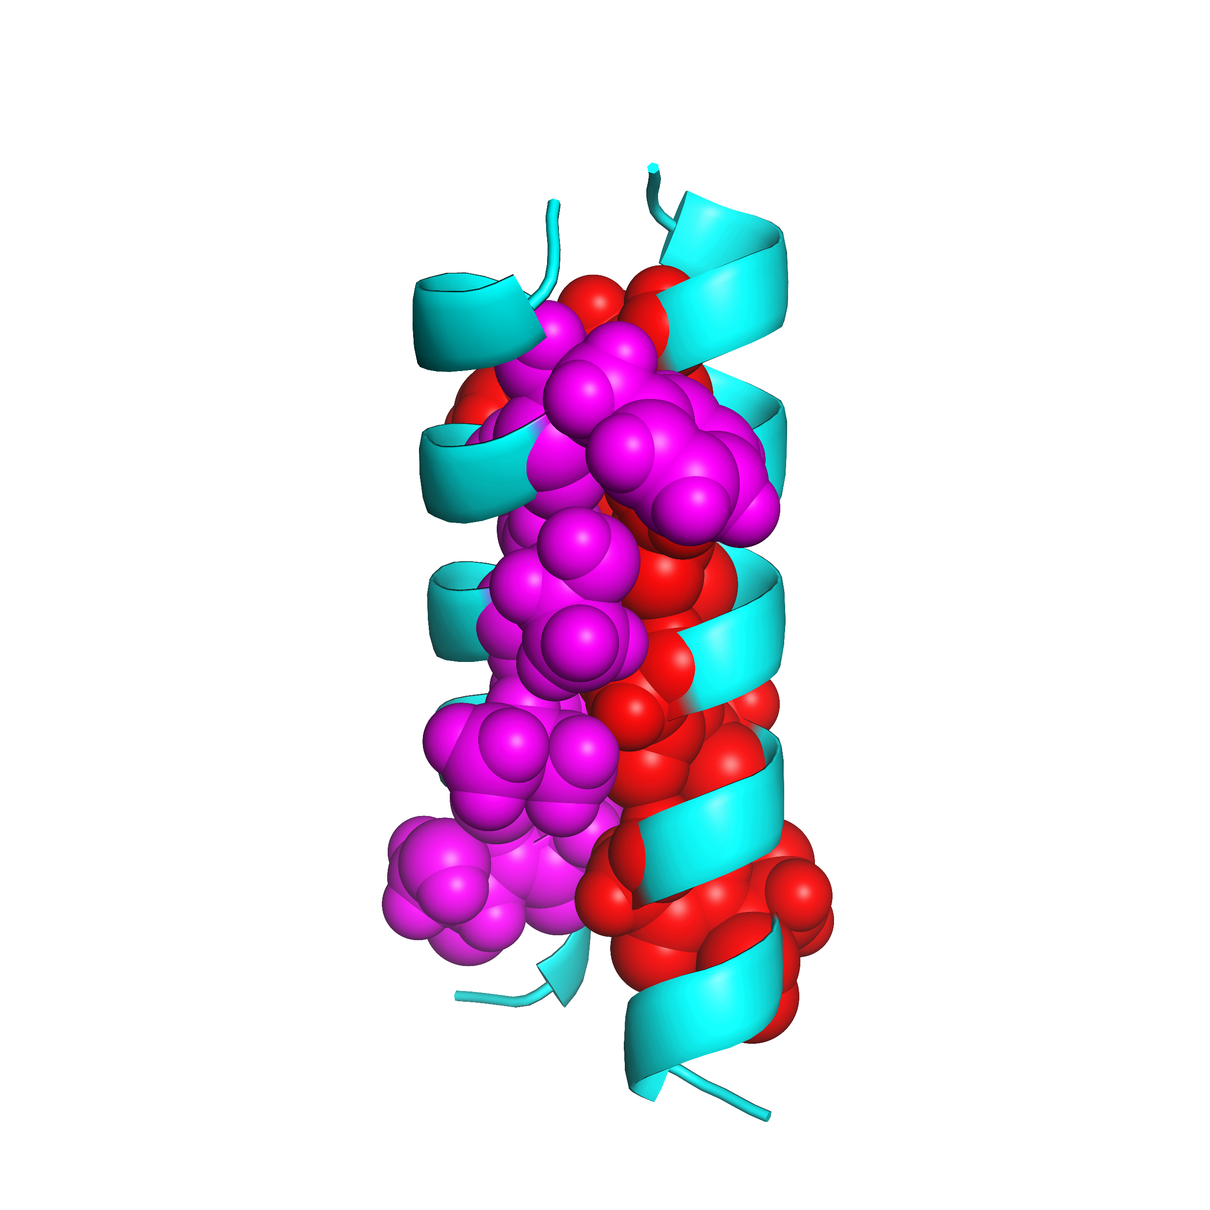
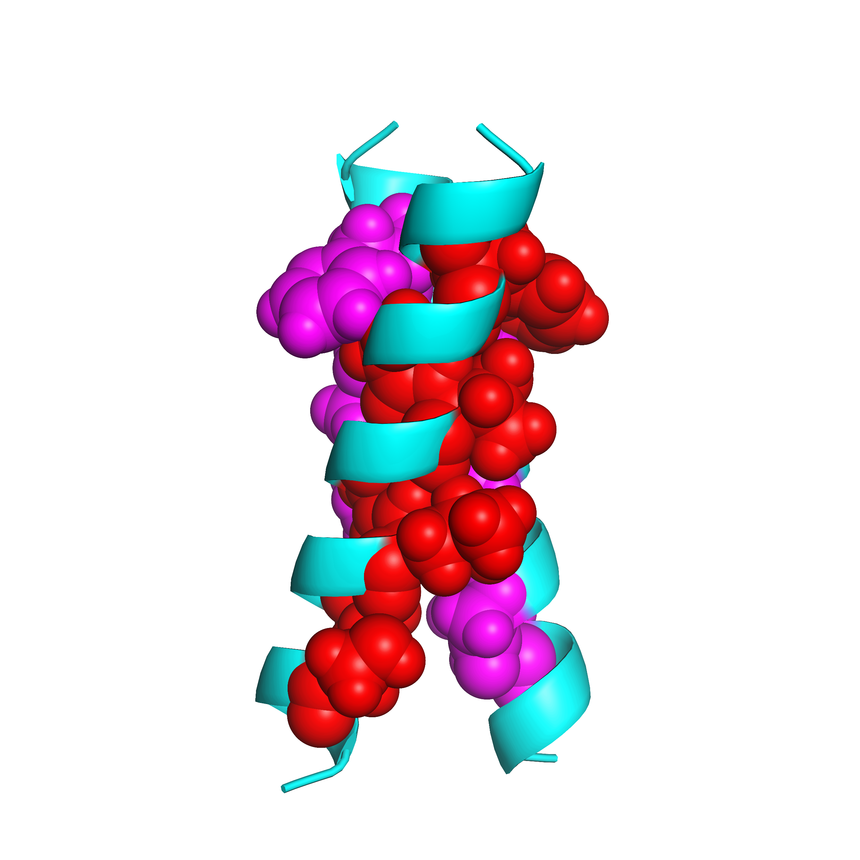
Approaches to specifically study sidechain packing
Notes:
After found backbones, I orient helices in space and explore sequences space for sequences that are stable in this conformation

Slide 21
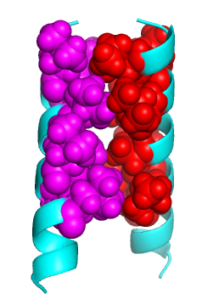
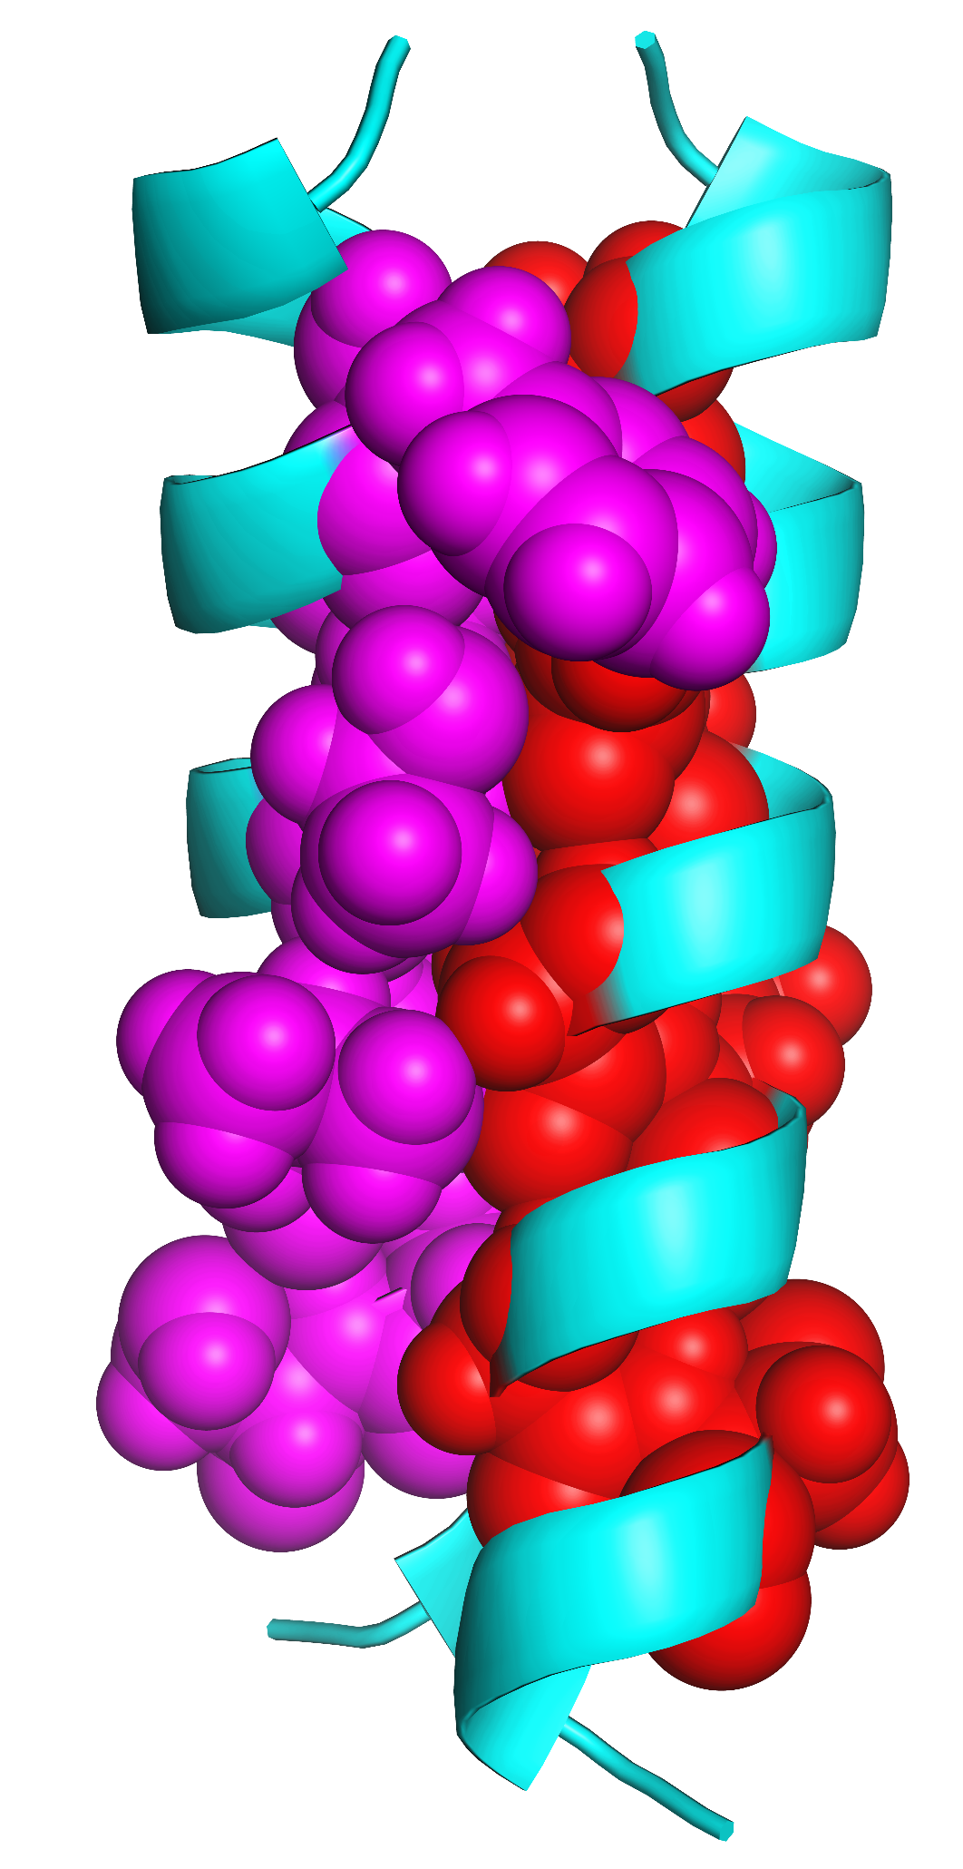
Use design algorithms on these geometries to get a variety of packed structures
Poor packing
Excellent packing
Notes:
Using a design algorithm composed of common computational algorithms, I aim to have an array of structures with a range of packing, from poor (as shown on the left by the obvious void at the interface) to excellent as shown by the well-packed structure on the right.

Slide 22
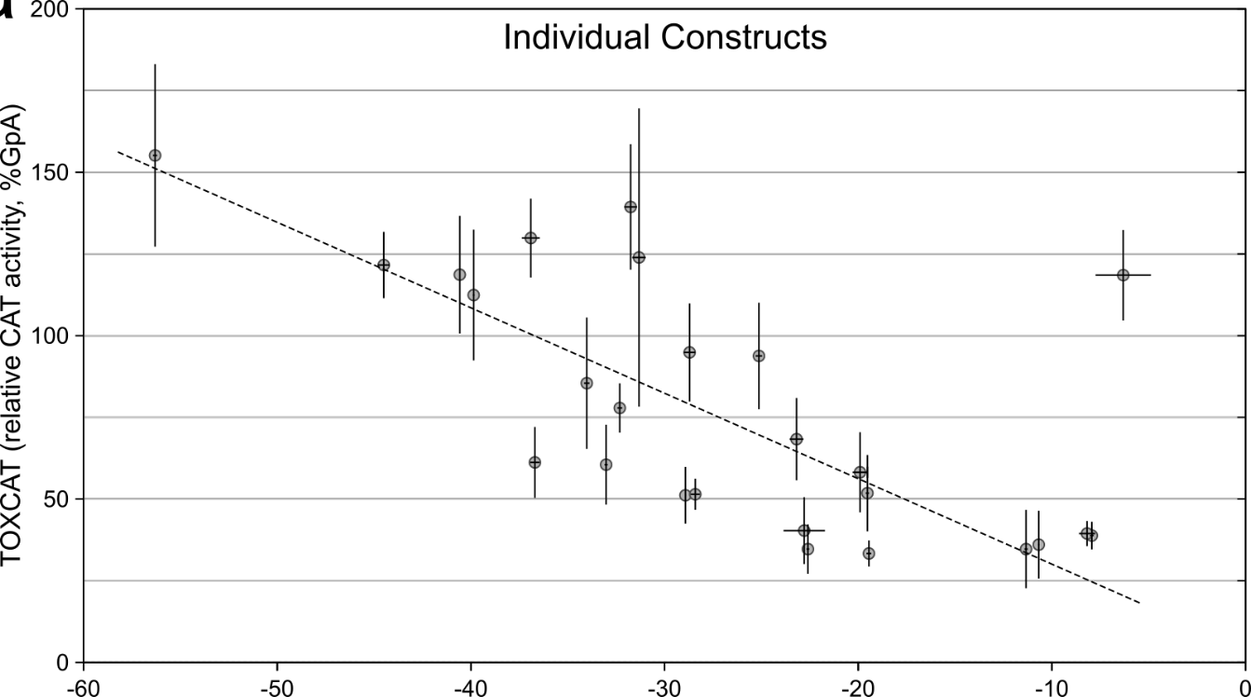
Design hundreds of dimers with differences in packing
Excellent packing
Poor packing
Design Energy Score
VDW+HBOND+Implicit solvent

Slide 23
Defining the design landscape through datamining of membrane protein PDB structures

Slide 24
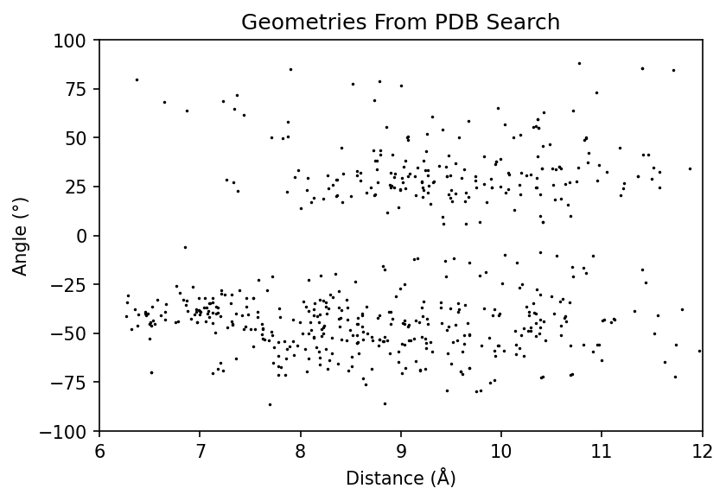
Notes:
Extracted 835 geometric pairs from 531 membrane protein structures (ends up being 594 after filtering for straight helices)

Slide 25
Notes:
Here I have a scatterplot of helix-helix geometries, where the x axis shows distance and the y axis shows angle. Each of these points is a different geometry from extracted from nonredundant proteins found within the PDB. To find common geometries for design, we are particularly interested in looking for clusters of these geometries: where geometry is quite similar in spite of having very different sequences. (more about exploring a whole range of densities within the space; not exploring these exactly, but exploring what the membrane protein space likely looks like without the dynamics known …now how to say that coherently?

Slide 26
26
Notes:
Here I have a scatterplot of helix-helix geometries, where the x axis shows distance and the y axis shows angle. Each of these points is a different geometry from extracted from nonredundant proteins found within the PDB. To find common geometries for design, we are particularly interested in looking for clusters of these geometries: where geometry is quite similar in spite of having very different sequences. (more about exploring a whole range of densities within the space; not exploring these exactly, but exploring what the membrane protein space likely looks like without the dynamics known …now how to say that coherently?

Slide 27
27
Notes:
Here I have a scatterplot of helix-helix geometries, where the x axis shows distance and the y axis shows angle. Each of these points is a different geometry from extracted from nonredundant proteins found within the PDB. To find common geometries for design, we are particularly interested in looking for clusters of these geometries: where geometry is quite similar in spite of having very different sequences. (more about exploring a whole range of densities within the space; not exploring these exactly, but exploring what the membrane protein space likely looks like without the dynamics known …now how to say that coherently?

Slide 28

28
Notes:
Here I have a scatterplot of helix-helix geometries, where the x axis shows distance and the y axis shows angle. Each of these points is a different geometry from extracted from nonredundant proteins found within the PDB. To find common geometries for design, we are particularly interested in looking for clusters of these geometries: where geometry is quite similar in spite of having very different sequences. (more about exploring a whole range of densities within the space; not exploring these exactly, but exploring what the membrane protein space likely looks like without the dynamics known …now how to say that coherently?

Slide 29
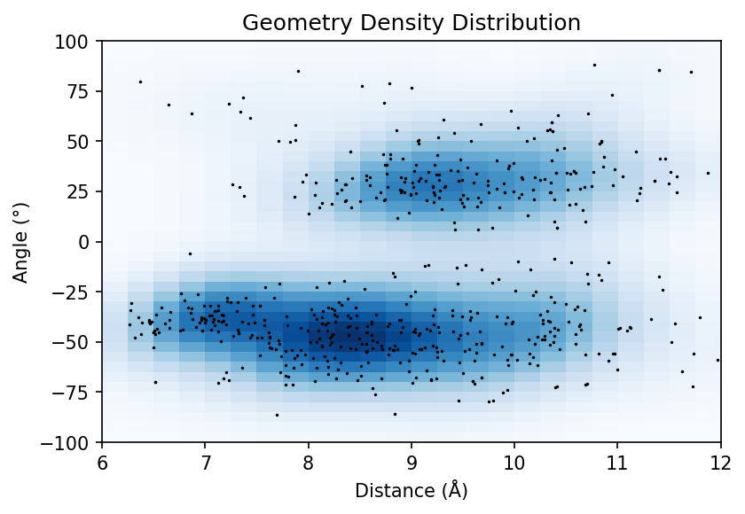
Notes:
Sample this natural conformational landscape in order to capture the association landscape based on vdW packing for a large variety of natural structures….To do that I’ve randomly sampled this landscape based on density where I am more likely to choose high density areas that low…

Slide 30
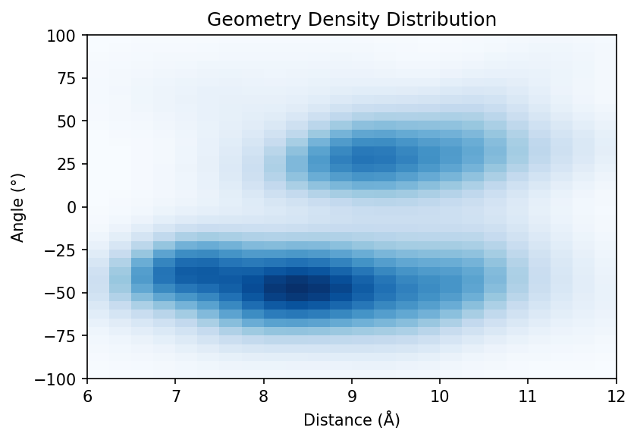
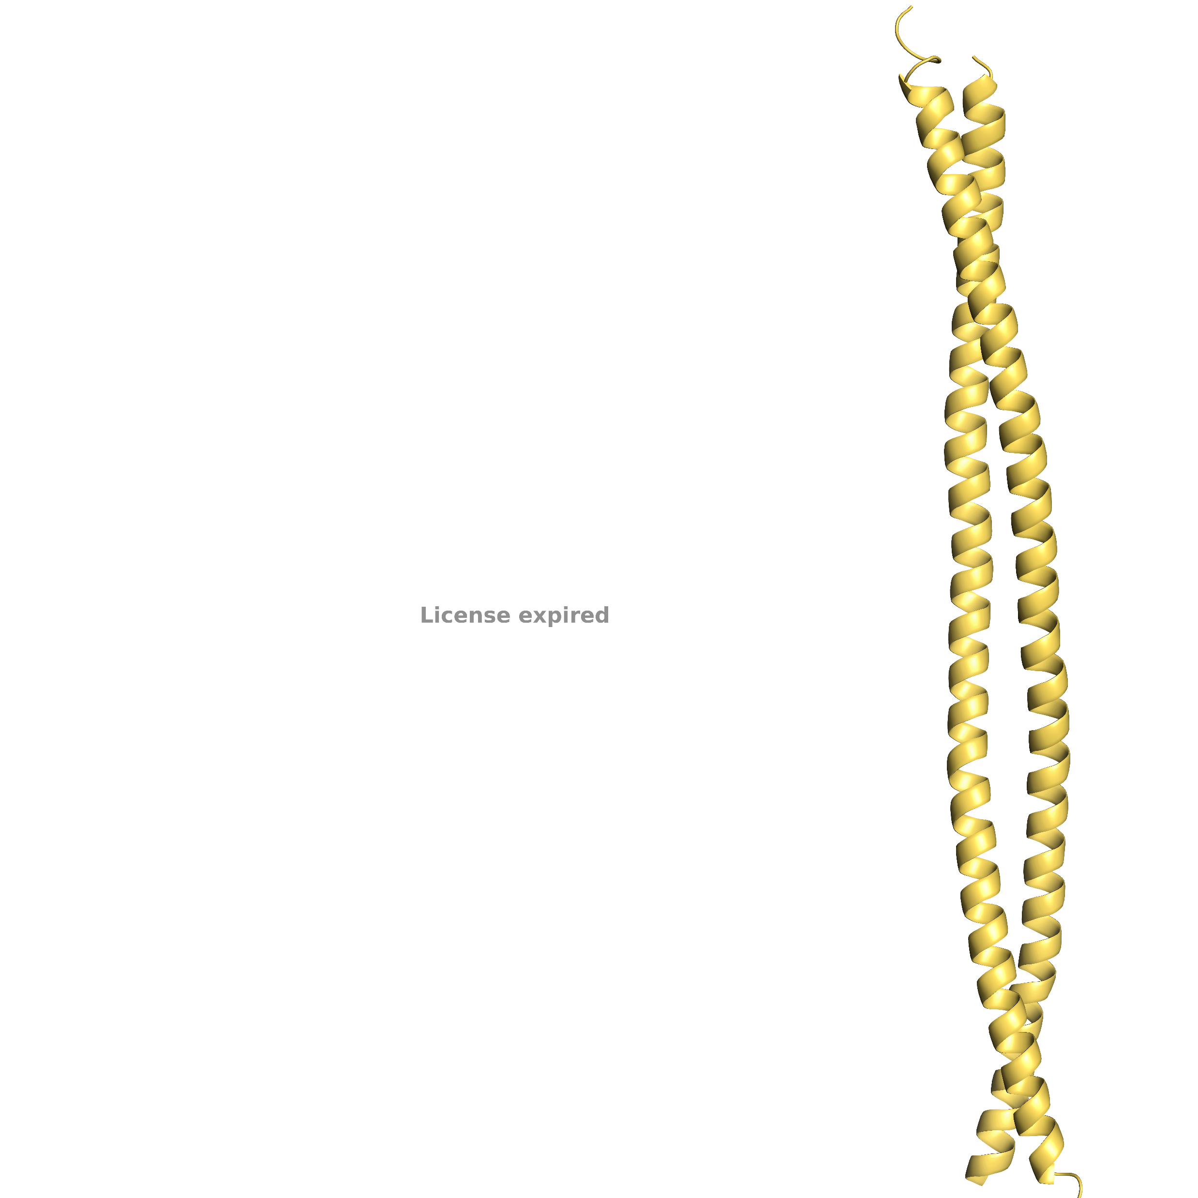
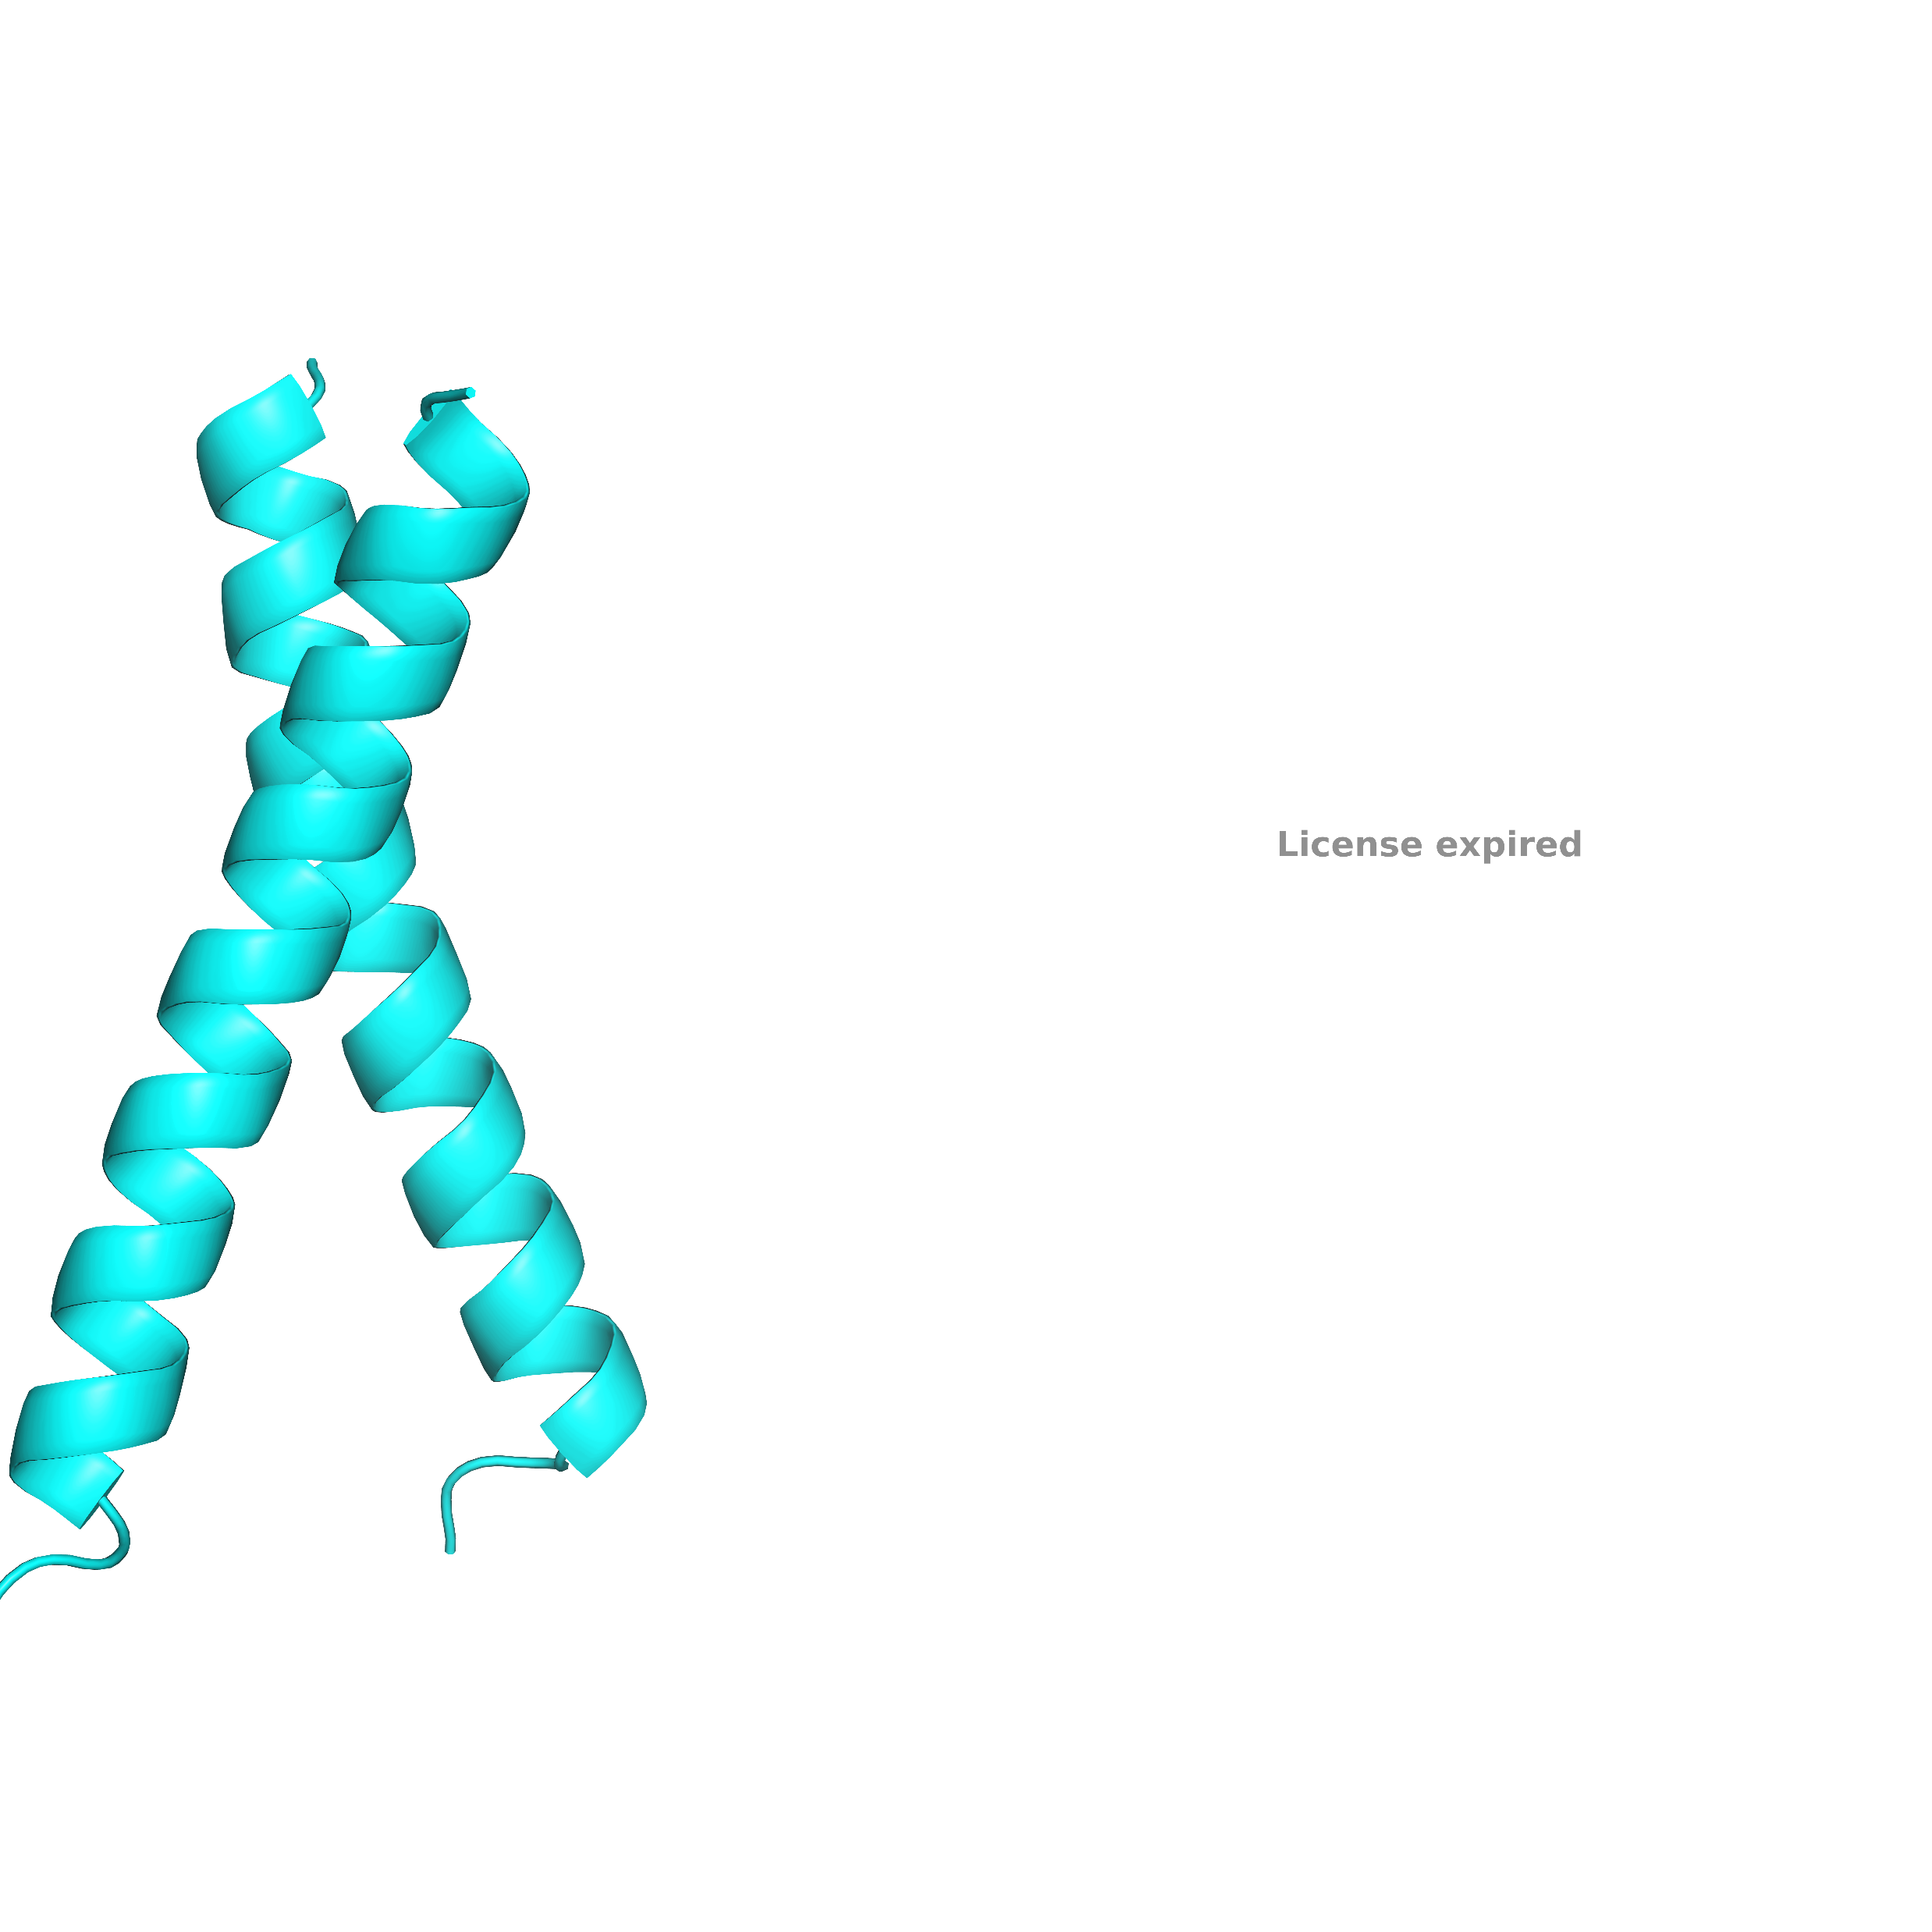
Left (+ Angle)
Right (- Angle)

Slide 31
Sample 100s of these geometries for sequence design
Notes:
Coded a design program that takes backbones from my analysis; finds the best sequence for these backbones
Happy to answer questions about my design algorithm after
Although I have not been able to express and characterize any sequences with our high-throughput in vivo assay, I have coded a design program that will take backbones from my PDB analysis and find the best sequence for each of these backbones. I have been able to show that using a small subset of amino acids, I am able to design sequences with a variety of energy scores, and with a variety of packing at the interface. I won’t talk in explicit detail about my design algorithm during the talk, but would be happy to answer any questions about it afterwards!

Slide 32
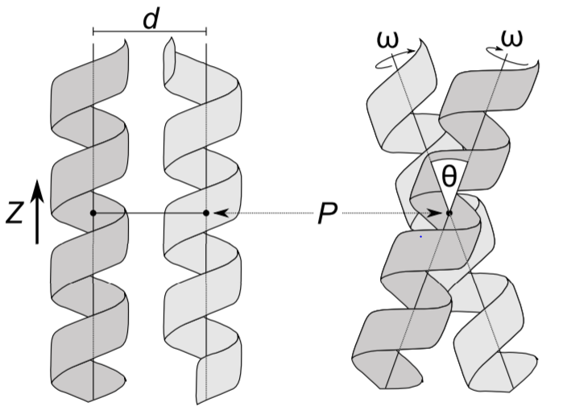
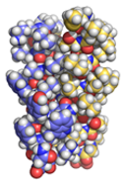
Choose interfacial positions
Search for membrane sequences
Take best evaluated sequence
Local backbone optimization for sequence
Designed Structures
Input geometry

Slide 33
Add in the geometries for designs

Slide 34
GASright info slide

Slide 35
Investigating dimerization as a result of sidechain packing using TOXGREEN and high-throughput Sort-seq
Notes:
After computationally designing hundreds to sequences with differences in sidechain packing energies, I need to characterize these designs with a complementary high-throughput method.
I will use a recently developed high-throughput method developed by my lab known as sort-seq.

Slide 36
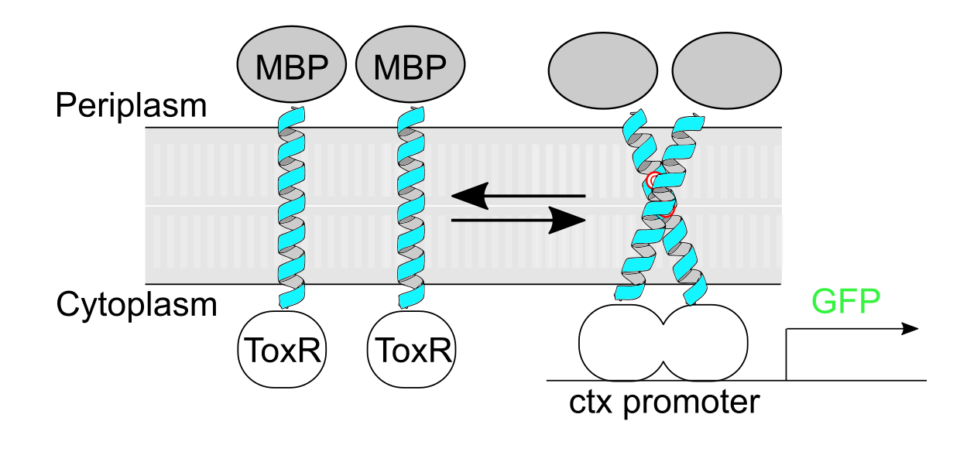
TOXGREEN: in vivo method to screen transmembrane association
Armstrong & Senes BBA 2016
Notes:
This high-throughput in vivo assay uses TOXGREEN, a variant of a commonly used reporter gene assay that measures the dimerization propensity of homodimers.
Our sequences of interest are expressed in E. coli fused to maltose binding protein and ToxR, a dimeric transcription factor.
When the helices dimerize, ToxR also dimerizes, allowing it to bind to a ctx promoter on our plasmids and release GFP.
This GFP can be measured to determine differences in dimerization propensity between my designed constructs and thus sidechain packing

Slide 37
Look for correlation of our designs with dimerization in TOXGREEN
High dimerization
Fluorescence
(Dimerization Propensity)
Low dimerization
Excellent packing
Poor packing
Design Energy Score

Slide 38
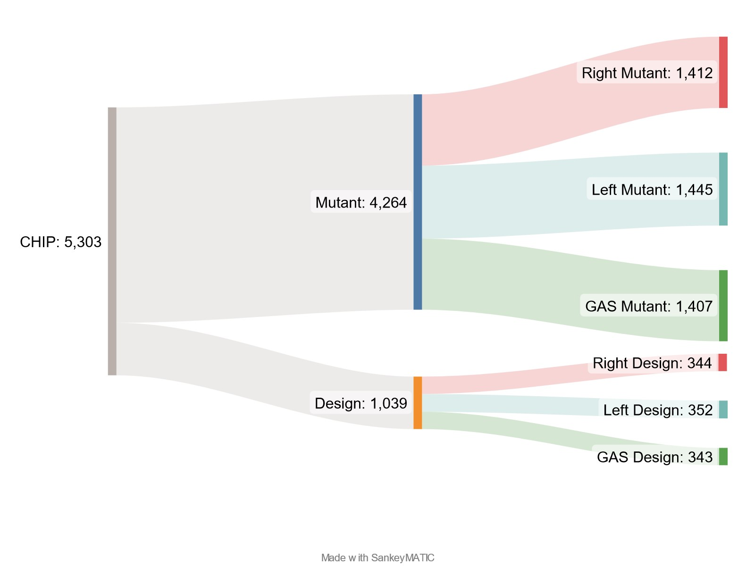
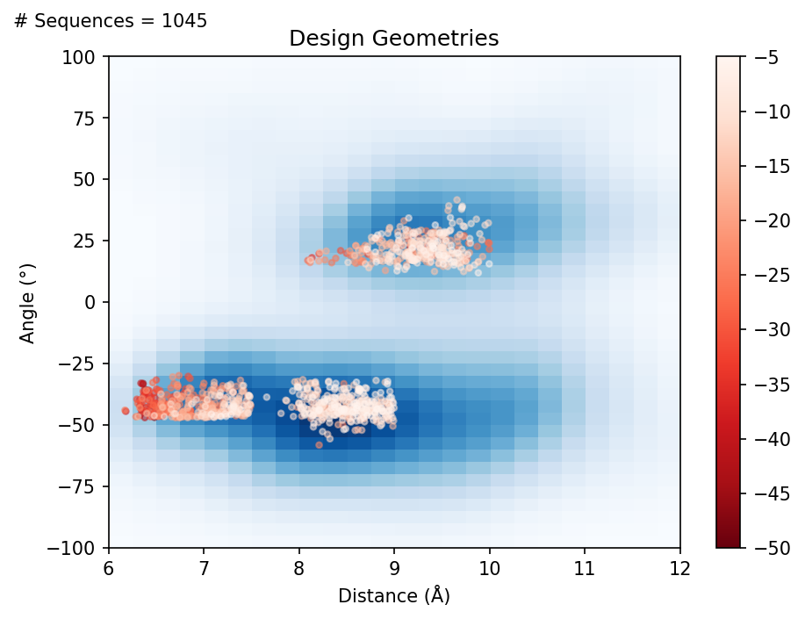
CHIP Design

Slide 39
CHIP Design

Slide 40
CHIP Design
Add in mutant types: clashes and void
Add in images of each as an example

Slide 41
CHIP Design

Slide 42
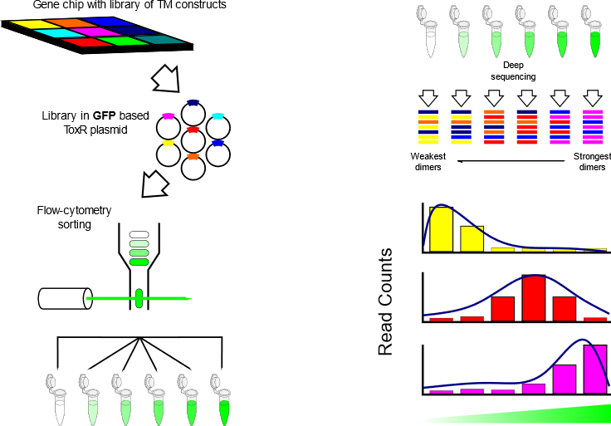
Sort-Seq: high-throughput method to screen transmembrane association
Notes:
Method was designed in collaboration with Vatsan Raman
Combines fluorescence activated cell sorting with next generation sequencing
Allows to screen my TM sequences in high-throughput
Order a gene chip of my designed TMs and transform into ToxR plasmid
This method is known as sort-seq, combining fluorescence activated cells sorting with next generation sequencing to screen our sequences in high-throughput. I will order a gene chip that contains a library of my designed TMs and then transform these into the ToxR plasmid.

Slide 43
Sort-Seq: high-throughput method to screen transmembrane association
Notes:
Clone library into cells and run through a FACs machine
Separates cells into distinct bins based on fluorescence
This library will then be cloned into cells (how to keep relative abundance of each plasmid the same…?) and run through a fluorescent activated cell sorter to separate cells into distinct bins based on the output of fluorescence.

Slide 44
Sort-Seq: high-throughput method to screen transmembrane association
Notes:
Bins are sent for next generation sequencing (bins with low fluor are weak dimers and bins with high fluor are strong)
These bins will then be sent for next generation sequencing, where bins with the lowest amount of fluorescence correlate to weak dimers and bins with high fluorescence correlate to strong dimers.

Slide 45
Sort-Seq: high-throughput method to screen transmembrane association
Notes:
Fluorescence profile is reconstructed for each seq as a function of counts of seq per bin
Allows to distinguish between propensity of dimerization of each of my designed dimers
Then, the fluorescence profile of each sequence can be graphed as a function of counts per bin, allowing me to distinguish between the dimerization propensities of each construct.

Slide 46
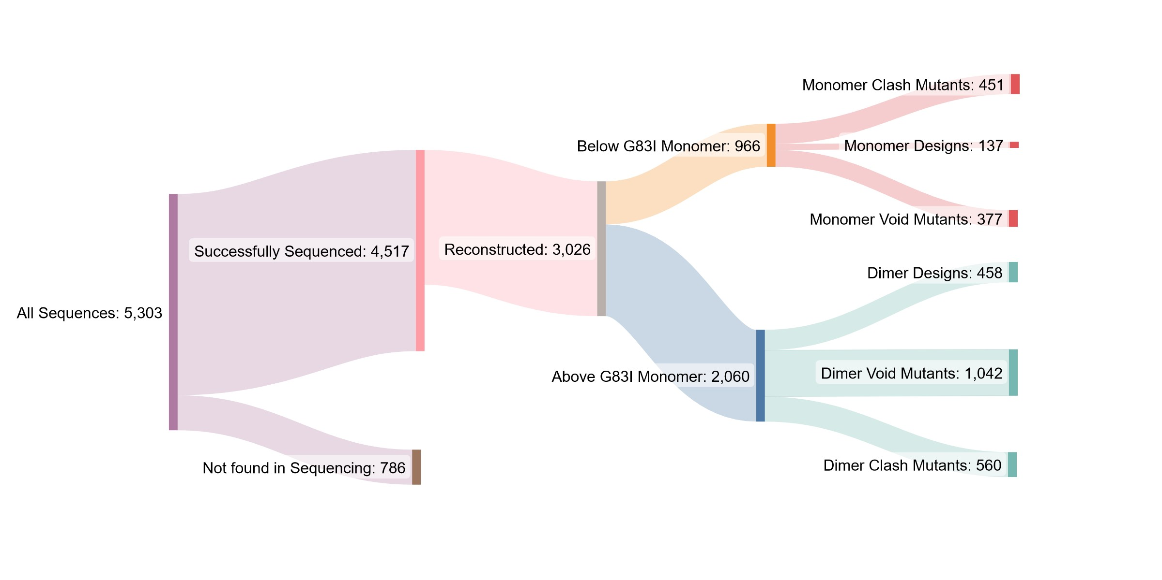
Trimming flow chart

Slide 47
Trimming flow chart

Slide 48
Trimming flow chart

Slide 49
Trimming flow chart

Slide 50
Add in more detail for how we get our final dataset (clashes)

Slide 51
Add in boxplot data here and maybe change the flowchart

Slide 52
Trim to final data
Currently using WT > 35% GpA
Mutant < 25% GpA
Percent WT of the least fluorescent mutant < 50%

Slide 53
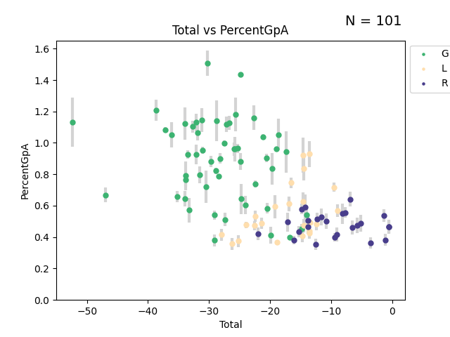
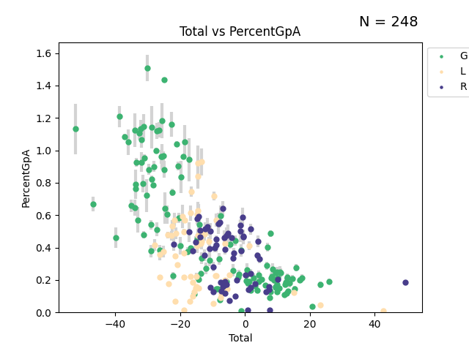
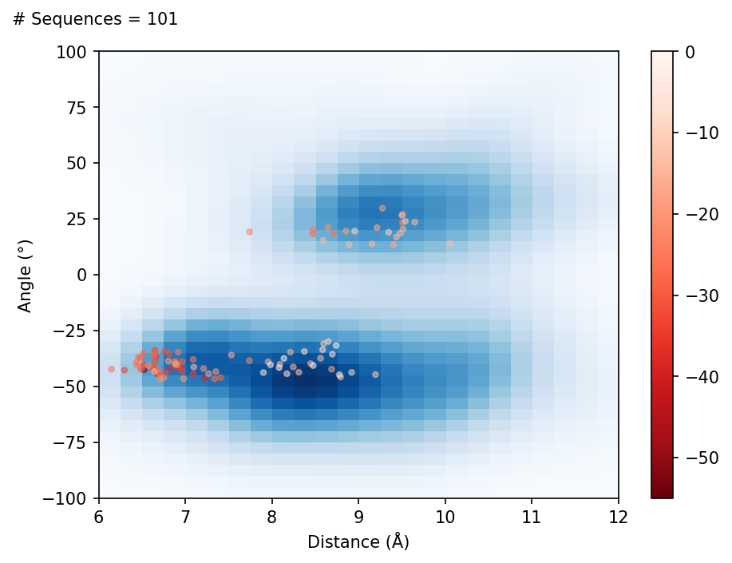
Clashing mutants support our designed interfaces (update this)
GpA
monomer

Slide 54
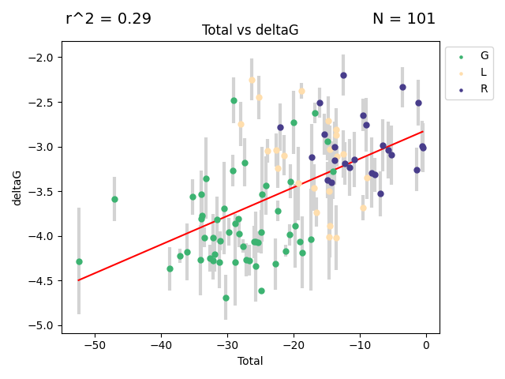
Conversion to deltaG suggests van der Waals packing stabilizes membrane dimers (update this)

Slide 55
TODO
Added in some blank slides where I need to add in data/info
Update some of the figures (these are mostly from the committee meeting a couple months back)
Geometries
Boxplots
Explanation/figures for voids and clash mutants

Slide 56
Future Directions
Continue analyzing mutational data
Specifically void mutants
Rerun maltose test for insertion into the membrane
Test expression levels of a subset of designs using westerns
Publish?

Slide 57
Look for correlation of our designs with dimerization in TOXGREEN
High dimerization
Fluorescence
(Dimerization Propensity)
Low dimerization
Excellent packing
Poor packing
Design Energy Score

Slide 59
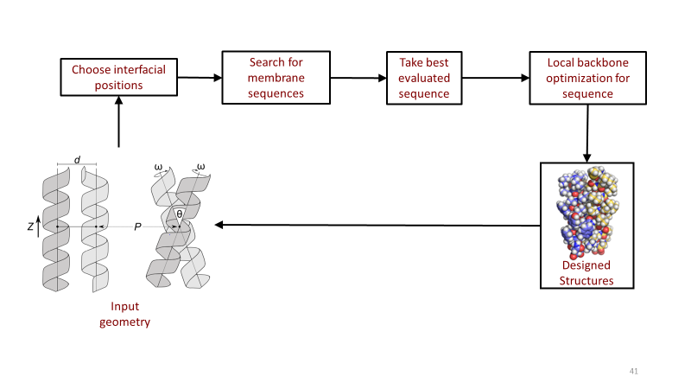
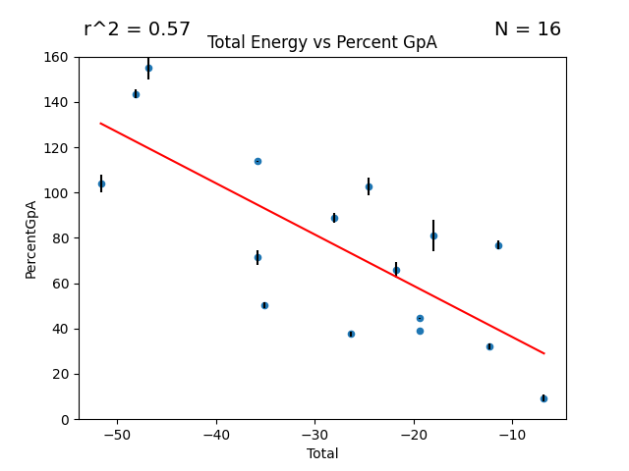
Summary

Slide 60
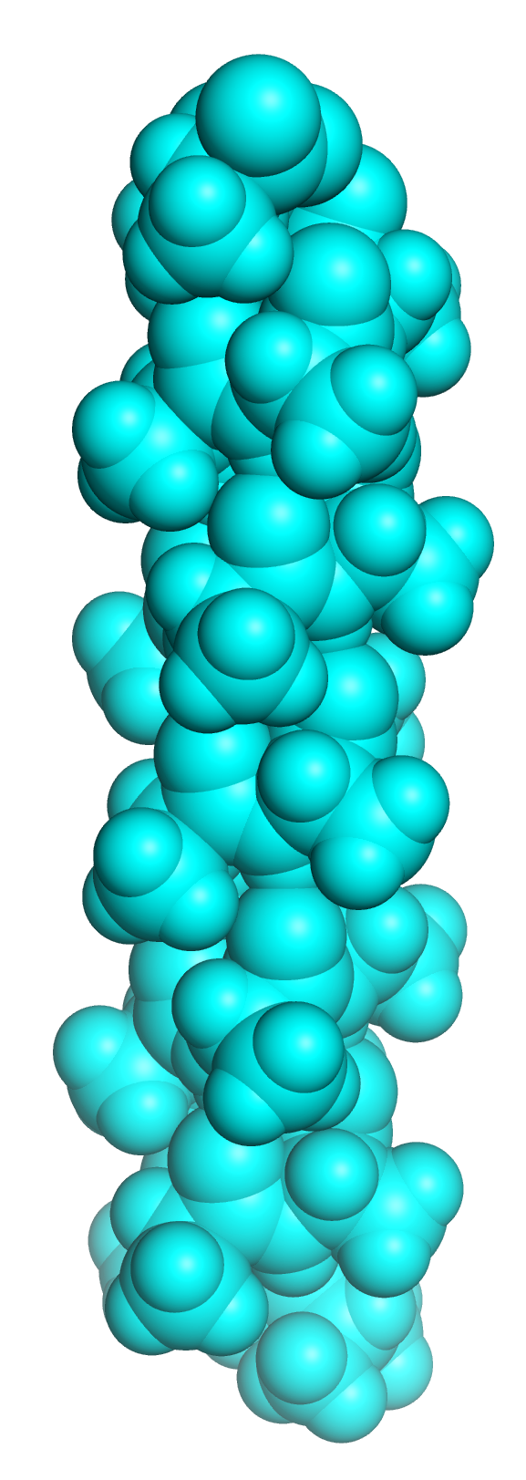
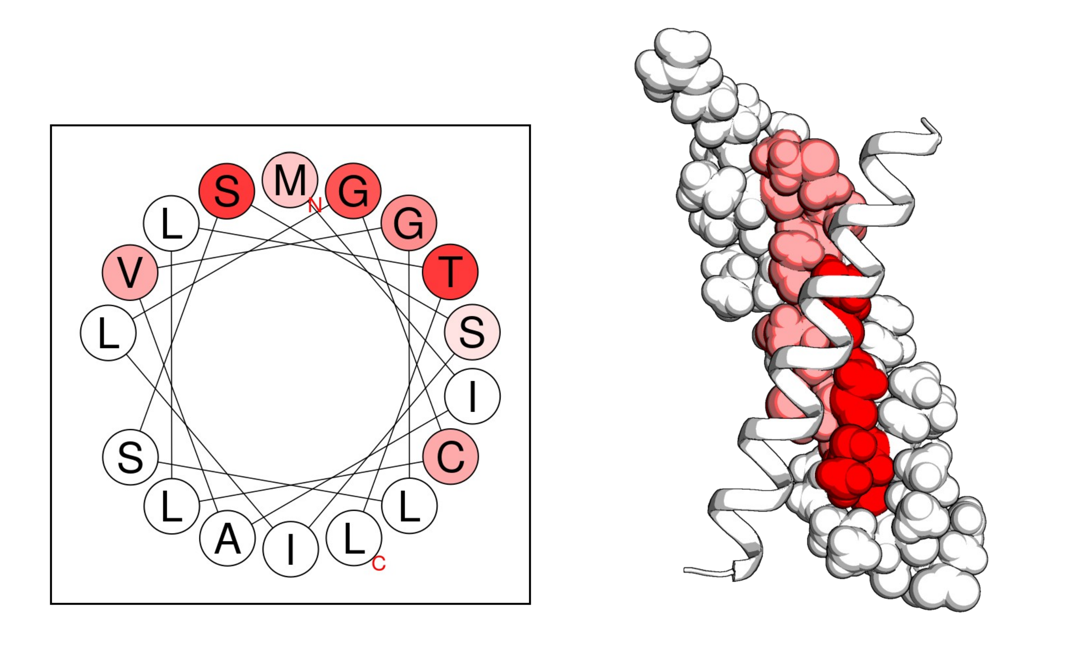
Future directions
Saturating Mutagenesis
Docking
Sort-Seq

Slide 61



Acknowledgements
Former Lab Members
Samson Condon
Samuel Craven
Samantha Anderson
Gladys Diaz-Vazquez
Current Lab Members
Josh Choi
Samridhi Garg
Tamalika Kar
Committee Members
Alessandro Senes
Philip Romero
Helen Blackwell
Samuel Butcher
Baron Chanda
Funding

Slide 62
Questions?

Slide 63
Fluorescence vs design energy score
GpA
G83I
Design Energy Score

Slide 64
Designed sequences associate
GpA
G83I
Design Energy Score

Slide 65

Sequences designed by van der Waals packing
GpA
GpA
G83I
G83I
Design Energy Score

Slide 66

Design Energy Score vs Geometry
Design Energy Score vs Geometry
Energy Score
Energy Score

Slide 67

Design Energy Score vs Geometry
Energy Score

Slide 68
Design Algorithm

Slide 69
Choose interfacial positions
Search for membrane sequences
Take best evaluated sequence
Local backbone optimization for sequence
Designed Structures
Input geometry

Slide 70
Design interfacial amino acids on the given backbone

Slide 71


Design interfacial amino acids on the given backbone

Slide 72


Design interfacial amino acids on the given backbone

Slide 73
Choose interfacial positions
Search for membrane sequences
Take best evaluated sequence
Local backbone optimization for sequence
Designed Structures
Input geometry

Slide 74










A variety of amino acids are allowed at the interface
Phenylalanine
Tryptophan
Tyrosine
Isoleucine
H
Alanine
Glycine
Leucine
Valine
Serine
Threonine

Slide 75
Choose interfacial positions
Search for membrane sequences
Take best evaluated sequence
Local backbone optimization for sequence
Designed Structures
Input geometry

Slide 76

Design Energy Score vs Geometry
Energy Score

Slide 77
Design Energy Score vs Geometry
Design Energy Score vs Geometry
Energy Score
Energy Score

Slide 78

Design Energy Score vs Geometry
Energy Score

Slide 79
Sequence Logos

Slide 80

GASright

Slide 81

Right

Slide 82

Left

Slide 83
Grid space for interfaces

Slide 84
Geometric Grid space
xShift: 1 angstrom; split every 0.2 angstroms
crossingAngle: 10 degrees; split every 2 degrees
axialRotation: 100 degrees; split every 5 degrees
zShift: 6 angstrom; split every 0.5 angstroms
~9828 grid points per each geometric region

Slide 85


GAS: high and low xShift
6.5
7.5
Total = 3755; Percent Accepted = 38%

Slide 86


GAS: high and low crossingAngle
-35
-45
Total = 3755; Percent Accepted = 38%

Slide 87


Right: high and low xShift
8
9
Total = 4355; Percent Accepted = 44%

Slide 88


Right: high and low crossingAngle
-35
-45
Total = 4355; Percent Accepted = 44%

Slide 89


Left: high and low xShift
8.5
9.5
Total = 3507; Percent Accepted = 36%

Slide 90


Left: high and low crossingAngle
18
28
Total = 3507; Percent Accepted = 36%

Slide 91
Scanning Mutagenesis

Slide 92


Example of expected scanning mutagenesis for my constructs
LLLILLLALLLLLLLLLL
L L L I L L L A L L L L L L L L L
Adapted from LaPointe et al. Biochemistry 2013
Notes:
Not a real example, but what we would expect a designed constructs scanning mutagenesis to look like

Slide 93

Scanning mutagenesis profiles can support designed interfaces and structures
LaPointe et al. Biochemistry 2013

Slide 94
Van der Waals geometry/interface

Slide 95
Future (aiming to show at seminar)
Rosetta docking and energy calculation using MSL
Mutants and design sequences
Some data for designs for CHIP2
Energy distribution and geometries

Slide 96
Coiled coil and GpA

Slide 97
DesignRun2

Slide 98
Left (+ Angle)
Right (- Angle)

Slide 99
CHIP1 Data

Slide 100

Majority of designed sequence associate more than monomer G83I
GpA
Fluorescence:
% GpA =
Design Fluor/GpA Fluor*100%
Percent GpA
G83I
Sequence

Slide 101

Results from our experiments are compared to a strong dimer GpA and monomer G83I
GpA
GpA
GpA
Fluorescence:
% GpA =
Design Fluor/GpA Fluor*100%
G83I
G83I
G83I

Slide 102
GpA
G83I

Slide 103

Does this strategy work for sequences with the same interface?
Interfaces:
L--A--YT-TF--SV-TL—I
L--A--YT-TF--AV-TL--I
L--G--FY-IG--AI-TL—I
Geometry:
xShift: 8.51+/-0.33
Angle: 22.45+/-1.23

Slide 104
TOXGREEN DeltaG Data

Slide 105
TOXGREEN Results

Slide 108
Hbond < 0
7 > Hbond > 0
Hbond > 7

Slide 109
Design | Sequence | Total | Percent GpA | Percent Standard Deviation | Region | VDWDiff | HBONDDiff | IMM1Diff
AAAYLLLTTLLAALLSFLAAA | LLLYLLLTTLLAALLSFL | -7.91697 | 76.922618 | 2.131229577 | Right | -29.9165 | 0.0633 | 21.936
LLLYLLLATLLAFLLSFLILI | LLLYLLLATLLAFLLSFL | -18.024 | 38.957209 | 0.086752602 | Right | -36.4431 | 0.0108 | 18.408
LLLYTLLTSLLFTLLTWLILI | LLLYTLLTSLLFTLLTWL | -24.5886 | 37.573075 | 0.996930372 | Right | -46.7283 | 0.493 | 21.647
LLLLWTLLAVLYLLLSFLILI | LLLLWTLLAVLYLLLSFL | -22.7219 | 102.58591 | 3.973864768 | Left | -43.7885 | 0.1282 | 20.939
AAALYVLLWTLALLLSFLAAA | LLLLYVLLWTLALLLSFL | -19.8712 | 66.002636 | 3.3739472 | Left | -34.2152 | 0.1971 | 14.147
LLLLAWLLTILLFLLSVLILI | LLLLAWLLTILLFLLSVL | -14.2117 | 81.1377 | 6.960337731 | Left | -44.609 | 0.3655 | 30.032
AAALYFLTSLLAILTSLLAAA | LLLLYFLTSLLAILTSLL | -17.9537 | 71.355193 | 3.221735919 | Left | -42.4428 | 7.1832 | 17.306
LLLLTWLTALLFTLTSLLILI | LLLLTWLTALLFTLTSLL | -18.4291 | 44.47732 | 0.244757786 | Left | -40.4782 | 0.084 | 21.965
LLLLWVLTWLLTTLTSLLILI | LLLLWVLTWLLTTLTSLL | -23.1847 | 88.949868 | 2.080701706 | Left | -45.3569 | 7.14 | 15.033

Slide 110
DeltaG data

Slide 113
Backbone Optimization

Slide 114
Backbone optimization + mutations strategy
Optimize backbone for 1400 sequences
Randomly make mutations at all highly buried interfacial positions and calculate the energy
Results in > 50000 mutants with both stable (<0) and unstable (>0) energies

Slide 115

Pre Optimization Geometry Map

Slide 116

Post Optimization Geometry Map

Slide 117
CHIP1 run data

Slide 118

Low correlation between energy and fluorescence for non GASright sequences

Slide 119


Slide 120






LLLGLVLGLLFTLLSALLILI
LLLGILTGVLVSLLTLLLILI
LLLAALLGFLWGLLTTLLILI
LLLLLLGTAIGVLVTLLLILI
Sequence | xShift | crossingAngle
LLLLLLGILAGFLLTLLLILI | 6.53676 | -52.6586
LLLLLLGVLIGVLATLLLILI | 6.55858 | -49.3007
LLLLLLGTAIGVLVTLLLILI | 6.35232 | -50.6541
LLLAALLGFLWGLLTTLLILI | 7.26946 | -29.9582
LLLGILTGVLVSLLTLLLILI | 7.72338 | -31.3153
LLLGLVLGLLFTLLSALLILI | 8.39897 | -30.639
LLLLLLGVLIGVLATLLLILI
LLLLLLGILAGFLLTLLLILI

Slide 121


Slide 122


Slide 123


Slide 124


Slide 125
Search for membrane sequences
Local geometric repacks, evaluate energy
Identify interfacial positions
Take 1 sequence
Y
N
N
Are there more stable sequences?
Is it a good solution?
Y
Input geometry
Designed Structures

Slide 126


Probing geometric space for energy and fluorescence correlation
% GpA
Energy Score

Slide 127
Cloning

Slide 128


CHIP Design
Clashing mutants with unstable energy scores
Designs and mutants with stable energy scores
Energy Score
~250 per segment
Segment #
~500 per segment

Slide 129
Colony factor
The number of colony forming units for the sample
The goal is to have a high enough number that it is likely that all of the sequences from a segment are taken up by your cells (aim for 10x number of sequences)
CF = ((Segment plate colonies – control) x dilution factor)/segment number

Slide 130
Example colony factor
Grow a plate with a dilution factor (df) of x100
Control plate has 1 colony
Segment Number = 1000 sequences
Segment 1 plate has 10 colonies
CF = ((10-1) x df)/Segment number = (9 x 100)/1000 = 900/1000 = .9x

Slide 131
Example colony factor
Grow a plate with a dilution factor (df) of x100
Control plate has 1 colony
Segment Number = 1000 sequences
Segment 1 plate has 10 colonies
CF = ((10-1) x df)/Segment number = (9 x 100)/1000 = 900/1000 = .9x
Segment 2 plate has 1000
CF = ((1000-1) x df)/Segment number = (999 x 100)/1000 = 99900/1000 = 99.9x

Slide 132


Cloning has been successful
X100 dilution control
X100 dilution of segment with 657 sequences
Colony factor:
55400/657 = 84.3
66
620 colonies – 66 control colonies = 554
554 times 100 dilution = 55400

Slide 133
Colony factors for all of my segments are higher than the minimum 10x

Slide 134
Sort-seq

Slide 135
FACs troubleshooting
I ran into some issues with using the FACs the first couple of times that led to me having to sort for 9 days instead of the typical 3:
Sorting mode: Some of my sorts were using a mode not focused on purity of sample, but efficiency of the sort. The mode is more likely to sort similar fluorescence into adjacent bins and is less likely to remove dead cells
Sample issues: Some days it was too difficult to sort my sample (decreased fluorescent range), so I had to remake it and start again the next day

Slide 136


FACs troubleshooting
Normal sorting/Sample issue sort
Ultra Purity sorting

Slide 137

Sample flow: good day

Slide 138

Sample flow: bad day

Slide 139





I was able to sort into 5 bins
Bin 1
Bin 2
Bin 3
Bin 4
Bin 5

Slide 140
Next steps
Waiting for NGS data and then analyze
Continue thinking of ways to improve design:
Different crossing points
Changing sequence length
Use electrostatics

Slide 141



Control samples
No TM
G83I
GpA

Slide 142



Example of BNIP3 vs my segments
BNIP3
Mix
My Segments

Slide 143
Kernel density estimator

Slide 144

Density estimators more accurately represent the designable geometric space
Notes:
To do this we have decided to use a density estimator known: Similar to histograms
These don’t take into account how close each data point is to each other and to other bins: doesn’t give accurate spread of the data

Slide 145
Density estimators more accurately represent the designable geometric space
Notes:
By giving each point a gaussian curve, can better estimate the density of a dataset. In our geometric space, we have two bins

Slide 146
vdW

Slide 147

Van der Waals packing is an implicit force in protein folding
Van der Waals force: Weak attractive force between nonbonded atoms in close contact
Notes:
The reason for this is due to the nature of van der Waals forces: The van der Waals force is a weak attractive force that occurs between any atoms in close contact of one another.
On the right is a simplified example, where two residues at the helix-helix interface of my dimer are highlighted. These nonbonded atoms are in close contact with each other at the dimer interface, exhibiting van der Waals attraction.
Maybe put lennard-jones to detail how vdW (requires close contact)

Slide 148

Van der Waals packing is an implicit force in protein folding
Van der Waals force: Weak attractive force between nonbonded atoms in close contact
Van der Waals packing: Combined strength of all atoms in close contact
Notes:
When we add in the rest of the interacting atoms at the helix-helix interface, these van der Waals forces grow in number and thus the total van der Waals contribution grows in strength.
This is defined as van der Waals packing.

Slide 149
Van der Waals packing is an implicit force in protein folding
Van der Waals force: Weak attractive force between nonbonded atoms in close contact
Van der Waals packing: Combined strength of all atoms in close contact
Sidechain packing: Tight packing at the helix-helix interface
Notes:
The packing interactions at the helix-helix interface are distinguished as sidechain packing.

Slide 150
Geometric Space

Slide 152

Favorable Axial Rotations
Cutoff | #
Total designed sequences | 2440
< 5 polar AAs | 2102
Energy Score < 0 | 278
Hbond Energy > -5 | 224

Slide 153

Favorable zShifts
Cutoff | #
Total designed sequences | 2440
< 5 polar AAs | 2102
Energy Score < 0 | 278
Hbond Energy > -5 | 224

Slide 154
Sort-Seq Math

Slide 155

Weighted average is used to reconstruct the fluorescence profile

Slide 156

Weighted average is used to reconstruct the fluorescence profile
Notes:
What we have here are the total counts of a specific sequence i in a specific bin j, divided by the total counts of all sequences in that bin. This gives us a proportion of the sequence of interest i within bin j.

Slide 157

Weighted average is used to reconstruct the fluorescence profile
Notes:
This proportion is then multiplied by the fraction of the total population of sequences contained in bin j, normalizing the bin based on the counts within each other bin.

Slide 158

Weighted average is used to reconstruct the fluorescence profile
Notes:
This normalized fraction of the bin is then divided by the same proportion, but totaled together for each bin. This is the fraction of the population that is solely sequence i as distributed throughout all bins (normalize sequence to each sequence population). This gives us the normalized contribution of the sequence i within each bin, separating it from any other sequences within the population.
By dividing the proportion of a sequence in one bin over all bins, can extract out that sequence from all other sequences within the population.
Divide the proportion of sequences in a bin by proportion of sequences in all bins to normalize the fractional contribution (normalize to the amount of sequences); can calculate fluorescence of each bin by multiplying that by the median

Slide 159

Weighted average is used to reconstruct the fluorescence profile
Notes:
This can then be done for all other sequences within the population as well (bottom left panel).

Slide 160

Weighted average is used to reconstruct the fluorescence profile
Notes:
To calculate the reconstructed fluorescence of each bin, we use the value of the normalized fraction (a) for a sequence in a bin and multiply it by the median fluorescence within that bin. This gives us the contribution of each sequence to the total fluorescence seen in each bin.
Median: could be reconstructed using other things as well such as mean and …, but median was one of the first things tried and the fit was reasonable with it

Slide 161

Weighted average is used to reconstruct the fluorescence profile
Notes:
These can then be added together to reconstruct the fluorescence profile of each sequence, allowing us to compare multiple sequences to each other based on the fluorescence profile from counts of a sequence against the total population.

Slide 162

Notes:
Plate reader = average fluorescence from population
Flow Cytometer = distribution of fluorescence from individual cells
Can measure finer differences in fluorescence than plate reader

Slide 163
How to choose bins?
Peterson and Levine paper? Should likely read and put some notes here
Essentially, it depends on the data and the overall distribution of the data:
The more bins means more resolution, but if the data isn’t distributed well then we may be limited by how fine the instrument can make bins
Notes:
The highest bin is the top ~0.5%. The lowest two bins are decided by trial and error: when you reflow them, do they have different means? Usually the bottom bin is somewhere are around 20-30% of the data.

Slide 164
Sequence Entropy

Slide 165

Developing an energy term to determine likelihood of sequence residing in the membrane
Based on the Boltzmann distribution: determine the probability of being in one state over another
Count the number of each AA in a sequence
The closer it looks to this distribution, the higher the probability, and thus the more favorable the sequence
E_{S1} = -RTln(P_{S1})
E_{S2} = -RTln(P_{S2})
If P_{S1} > P_{S2} , E_{S1} < E_{S2}
Liu et al. Genome Biology 2002
Notes:
Sequence entropy: based on the Boltzmann distribution: compares the probabilities of two states in order to determine an energy for each (how likely one sequence would be more favorable than another)

Slide 166
Calculating sequence proportions
P(C) = 0.2; P(A) = 0.8
CAA
Probability = P(C)*P(A)*P(A) = 0.2*0.8*0.8 = .128
Permutations= #LettersInSequence!/#ofEachLetter! = 3!/2(A)!1(C)! = 3
3! would be 6 combinations: CA1A2, CA2A1, A1CA2, A2CA1, A1A2C, A2A1C. Half of them are duplicates, so need to divide by 2, which is also the #As!. So 3!/2! = 3 combinations
Probability*Permutations = Adjusted Sequence Probability = 0.384
CCA
Probability = P(C)*P(C)*P(A) = 0.2*0.2*0.8 = 0.032
Permutations= 3!/2(C)!1(A)! = 3
Probability*Permutations = Adjusted Sequence Probability = 0.096
Normalize comparing just one sequence to another:
P1 = 0.384/(0.384+0.096) = 0.8
P2 = 0.096/(0.384+0.096) = 0.2
Notes:
If you know how many possibilities there are based on the

Slide 167
Calculating sequence proportions
P(C) = 0.2; P(A) = 0.8
CAA
Probability = P(C)*P(A)*P(A) = 0.2*0.8*0.8 = .128
Permutations= #LettersInSequence!/#ofEachLetter! = 3!/2(A)!1(C)! = 3
3! would be 6 combinations: CA1A2, CA2A1, A1CA2, A2CA1, A1A2C, A2A1C. Half of them are duplicates, so need to divide by 2, which is also the #As!. So 3!/2! = 3 combinations
Probability*Permutations = Adjusted Sequence Probability = 0.384
CCA
Probability = P(C)*P(C)*P(A) = 0.2*0.2*0.8 = 0.032
Permutations= 3!/2(C)!1(A)! = 3
Probability*Permutations = Adjusted Sequence Probability = 0.096
Normalize comparing just one sequence to another:
P1 = 0.384/(0.384+0.096) = 0.8
P2 = 0.096/(0.384+0.096) = 0.2
Notes:
If you know how many possibilities there are based on the

Slide 168
Calculating sequence proportions
P(C) = 0.2; P(A) = 0.8
CAA
Probability = P(C)*P(A)*P(A) = 0.2*0.8*0.8 = .128
Permutations= #LettersInSequence!/#ofEachLetter! = 3!/2(A)!1(C)! = 3
3! would be 6 combinations: CA1A2, CA2A1, A1CA2, A2CA1, A1A2C, A2A1C. Half of them are duplicates, so need to divide by 2, which is also the #As!. So 3!/2! = 3 combinations
Probability*Permutations = Adjusted Sequence Probability = 0.384
CCA
Probability = P(C)*P(C)*P(A) = 0.2*0.2*0.8 = 0.032
Permutations= 3!/2(C)!1(A)! = 3
Probability*Permutations = Adjusted Sequence Probability = 0.096
Normalize comparing just one sequence to another:
P1 = 0.384/(0.384+0.096) = 0.8
P2 = 0.096/(0.384+0.096) = 0.2
Notes:
If you know how many possibilities there are based on the

Slide 169
Calculating sequence proportions
P(C) = 0.2; P(A) = 0.8
CAA
Probability = P(C)*P(A)*P(A) = 0.2*0.8*0.8 = .128
Permutations= #LettersInSequence!/#ofEachLetter! = 3!/2(A)!1(C)! = 3
3! would be 6 combinations: CA1A2, CA2A1, A1CA2, A2CA1, A1A2C, A2A1C. Half of them are duplicates, so need to divide by 2, which is also the #As!. So 3!/2! = 3 combinations
Probability*Permutations = Adjusted Sequence Probability = 0.384
CCA
Probability = P(C)*P(C)*P(A) = 0.2*0.2*0.8 = 0.032
Permutations= 3!/2(C)!1(A)! = 3
Probability*Permutations = Adjusted Sequence Probability = 0.096
Normalize comparing just one sequence to another:
P1 = 0.384/(0.384+0.096) = 0.8
P2 = 0.096/(0.384+0.096) = 0.2
Notes:
Use the final values to get

Slide 170
Calculating sequence proportions
P(C) = 0.2; P(A) = 0.8
CAA
Probability = P(C)*P(A)*P(A) = 0.2*0.8*0.8 = .128
Permutations= #LettersInSequence!/#ofEachLetter! = 3!/2(A)!1(C)! = 3
3! would be 6 combinations: CA1A2, CA2A1, A1CA2, A2CA1, A1A2C, A2A1C. Half of them are duplicates, so need to divide by 2, which is also the #As!. So 3!/2! = 3 combinations
Probability*Permutations = Adjusted Sequence Probability = 0.384
CCA
Probability = P(C)*P(C)*P(A) = 0.2*0.2*0.8 = 0.032
Permutations= 3!/2(C)!1(A)! = 3
Probability*Permutations = Adjusted Sequence Probability = 0.096
Normalize comparing just one sequence to another:
P1 = 0.384/(0.384+0.096) = 0.8
P2 = 0.096/(0.384+0.096) = 0.2
E1 = -RTln(P1)
E2 = -RTln(P2)
If P1 > P2 , E1 < E2
Notes:
Use the final values to get

Slide 171
Developing an energy term to determine likelihood of sequence residing in the membrane
Example:
S1: LLLLMLLCCLCMLMCLLLLLL
Energy S1+ new term > Energy S2 +new term
S2: LLLLALLCCLCMLMCLLLLLL
Liu et al. Genome Biology 2002
Liu et al. Genome Biology 2002
Notes:
Analyzed AA distribution of 168 membrane protein families with more than 20 members
Use this as a reference for our sequences (if distributions look similar, should demonstrate that they are membrane protein sequences)
M+C+S+T=20%; for our sequences should be up to 4 polars per sequence. current distribution is 7, or 33%

Slide 172

Sequence entropy working well slide
 | Previous Sequence | New Sequence
1 | LLLLSLLLSLWSLLTLLLLLL | LLLLSLLLYLWSLLTLLLLLL
2 | LLLLSLLLYLWSLLTLLLLLL | LLLLFLLLYLWSLLTLLLLLL
3 | LLLLFLLLYLWSLLTLLLLLL | LLLLFLLLYLISLLTLLLLLL
4 | LLLLFLLLYLISLLTLLLLLL | LLLLFLLVYLISLLTLLLLLL
5 | LLLLFLLVYLISLLTLLLLLL | LLLLFLLVALISLLTLLLLLL
Notes:
Is it possible to say this without calling back to lack of membrane baseline term? Or do I have to

Slide 173


Slide 174
Example of expected scanning mutagenesis for my constructs
LLLILLLALLLLLLLLLL
L L L I L L L A L L L L L L L L L
Adapted from LaPointe et al. Biochemistry 2013
Notes:
Not a real example, but what we would expect a designed constructs scanning mutagenesis to look like

Slide 175
Previous Research has measured differences in dimerization using minimalistic set of energy functions

Slide 176
Energy Function
Energy Score = vdW + Hydrogen bonding + solvation energy
CHARMM22 = vdW based on Lennard-Jones potential
SCRWL4 = H-bonding
IMM1 = solvation energy

Slide 177

In vivo Dimerization Propensity (%GpA)
strong
weak
Predicted Energy Score

Slide 178
Estimated dynamic range of measuring sidechain packing comparing to GpA
100
75
50
25
0
Dimerization Propensity (%GpA Flourescence)
-30 -25 -20 -15 -10 -5 0
strong
weak
Predicted Energy Score
Notes:
GpA predicted energy score:
~-42 = 100%
Best score
-26 = ~75% GpA
-8 = ~40% GpA usually a cutoff for dimer
Dynamic range increased slightly with sort-seq
Increase more by using the

Slide 179

Previous research: Predicted energies of structures correlate to dimerization propensity
Adapted from Anderson et al. JACS 2017
Notes:
Previous study in our lab characterized multiple sequences in terms of sequence, structure, and energy. We have an understanding of how sequence affects structure and energetics that can be probed for sequences of specific energies; with those two pieces of information, leads me to design

Slide 180
Previous research: Predicted energies of structures correlate to dimerization propensity
Adapted from Anderson et al. JACS 2017
Notes:
Previous study in our lab characterized multiple sequences in terms of sequence, structure, and energy. We have an understanding of how sequence affects structure and energetics that can be probed for sequences of specific energies; with those two pieces of information, leads me to design

Slide 181
FRET

Slide 182


Cy3 and Cy5 have limited spectral overlap
Notes:
Due to lack of spectral overlap, exciting Cy3 will not result in much excitation of Cy5. This will decrease experimental background fluorescence from the acceptor (bleedthrough), allowing for more confidence in any fluorescence we see from the acceptor as a result of FRET.
Forster radius is 50 angstroms; also remember that overlapping spectra and orientation of the fluors are important

Slide 183

FRET will be used to quantify free energy of association of a subset of sequences
D
A
Aim 2: Thermodynamic quantification of the influence of sidechain packing on dimerization
Notes:
Although my previous aim will deduce the extent at which sidechain packing influences dimerization, it will not measure the biophysical strength of sidechain packing. I will use FRET to calculate the differences in free energy of association between my designed constructs, thus determining how sidechain packing impacts membrane protein association for a variety of dimers with differences in sidechain packing energy.

Slide 184

FRET will be used to quantify free energy of association of a subset of sequences
E. coli
Aim 2: Thermodynamic quantification of the influence of sidechain packing on dimerization
Notes:
My designed proteins will be expressed as a chimeric construct in E. coli, with my TM helices attached to staphylococcal nuclease, or SN.

Slide 185
FRET will be used to quantify free energy of association of a subset of sequences
Extract from membrane into detergent
Protein in detergent micelle
E. coli
Aim 2: Thermodynamic quantification of the influence of sidechain packing on dimerization
Notes:
After expression, these chimeras will be extracted from the membrane and then purified in detergent micelles.

Slide 186


FRET will be used to quantify free energy of association of a subset of sequences
Extract from membrane into detergent
Protein in detergent micelle
E. coli
Aim 2: Thermodynamic quantification of the influence of sidechain packing on dimerization
Notes:
Half of this protein is labeled by donor and other half by acceptor

Slide 187
FRET will be used to quantify free energy of association of a subset of sequences
}
Aim 2: Thermodynamic quantification of the influence of sidechain packing on dimerization
Notes:
Populations then mixed 50 50. These can then be reconstituted in different concentrations of lipids (different protein/lipid ratios). High protein/lipid = dimer

Slide 188
FRET will be used to quantify free energy of association of a subset of sequences
}
Aim 2: Thermodynamic quantification of the influence of sidechain packing on dimerization
Notes:
Low protein/lipid = monomer. By doing a gradient of these mole fractions, I will be able to see the transition from dimer to monomer, enabling me to get the Kd. Then using Kd can calculate the free energy of association of a subset of my designed sequences.

Slide 189
We expect flipping to occur randomly
}
Aim 2: Thermodynamic quantification of the influence of sidechain packing on dimerization
Notes:
Robertson lab: chloride channel dimerization; calculated potential fluorescence values for FRET if randomly distributed (50% signal) and then did FRET and saw that their calculations were correct
If strength of association is known, can calculate a curve, which means you can back calculate to change in fluorescence

Slide 190

FRET will be used to quantify free energy of association of a subset of sequences
Aim 2: Thermodynamic quantification of the influence of sidechain packing on dimerization
Notes:
I will use FRET to calculate the differences in free energy of association between my designed constructs, thus determining how sidechain packing impacts membrane protein association for a variety of dimers with differences in sidechain packing energy. To do so, I can measure changes in fluorescence of a subset of TMs labeled with fluorophores, where I will see only donor fluorescence (green) if they are not associating, but if the helices are in close contact, I will see a decrease in donor fluorescence and an increase in acceptor fluorescence (red).

Slide 191
FRET will be used to quantify free energy of association of a subset of sequences
Aim 2: Thermodynamic quantification of the influence of sidechain packing on dimerization
Notes:
This is possible due to the differences in excitation and emission wavelengths from my fluorophores. The donor fluoresces when excited by a specific wavelength that has little affect on the acceptor. If the donor fluorophore is near an acceptor fluorophore, it will undergo an energy transfer event, leading to the excitation of the acceptor fluorophore, due to the donor emission and acceptor excitation spectral overlap.

Slide 192


FRET will be used to quantify free energy of association of a subset of sequences
Calculating Free Energy from Acceptor
F670
Mole fraction (Protein/Detergent)
Aim 2: Thermodynamic quantification of the influence of sidechain packing on dimerization
Notes:
Using the change in acceptor fluorescence, we can calculate the free energy of association of each sequence. On the Y-axis is fluorescence at 670, the wavelength that we measure our acceptor fluorescence at, and on the x-axis is mole fraction, or the protein over detergent/lipid ratio. On the graph, each of these points is a fluorescent value from different mole fractions and the equation below the curve has been derived to fit a dimer by changes in fluorescence. By fitting our points to this equation, I can solve for the Kd where the equilibrium is 50% monomer and 50% dimer, which I can then use to determine the free energy of association for each construct.
Break the derivation of the equation down

Slide 193



Derivation of fit for FRET
$$T=\frac{[Protein]}{[Detergent]}=mole fraction$$
$$\left[M\right]=\frac{−K_{D}+\sqrt{K_{D}^{2}+8TK_{D}}}{4}$$
$$F_{670}=\frac{[M]}{T}\left(F_{M}−F_{D}\right)+F_{D}$$

Slide 194
Add some slides here to explain the stuff Josh mentioned?
Or just kind of big picture? Maybe know how to talk about some stuff (gating specifically? I feel like that’s the likely question to be asked)
Know how libraries are made: approximately 20000 sequences can be ordered, but the more sequences, the more difficult it is to clone
300 sequences in past segments that have been successfully cloned
With 10 controls in each
5 bins: x <-30, -30<x<-25, -25<x<-20, -20<x<-15, -15< x
50 sequences each, then 50 non-well designed sequences
How many cells need to be counted…?
Typically do around 5 million
8-10 hours
I think at the very least explain some of what I can do with my sequences
Shuffle mutants

Slide 195

Extract helix-helix interactions within the PDB
Notes:
Exploring straight helices in the PDB to design straight helices
White = backbone of interest
Yellow = straight helices to compare to backbone to determine if it is straight
Previous research has done similar analyses on geometries from the PDB, but my research has expanded on this by specifically exploring the geometric space for straight helices. In doing so, I have been able to determine geometries that would be likely more appropriate for designing homodimers using straight helices. (explanation is a little complex; write notes here)

